Slide 1
Service Excellence
Tufts Medicine Care at Home

Slide 2
Tufts Medicine Care at Home
Compassionate Attentive Responsive Exceptional Service

Slide 3
Pathways to Excellence
Friendliness and Professionalism
Establishing Expectations
Communication
Privacy and Safety
Continuity of Care and Scheduling
Ending your visit

Slide 4
Privacy
Use key words and phrases during the course of the home visit to reassure the patient that you are
concerned with his/her privacy.
“I want you to know that we are concerned about your privacy...”
When there is a 3rd party present during the visit, acknowledge them and ask the patient if it is okay to discuss their care in front of the 3rd party.
Always ask permission before touching the patient for a procedure.
Ask others to leave the room when you need to perform a potentially embarrassing procedure.
Ask patients if they would like curtains drawn, blinds shut, or any other gesture that indicates to them that privacy is a concern.

Slide 5
Safety
Recommend specific changes to their home environment to enhance patient safety (i.e., furniture or rugs that could be a safety hazard.)
“I want to make your home as safe as possible for you. Here are my recommendations.”
Don’t assume your recommendations will be welcomed, you may need to alter your approach or have a plan B to ensure safety

Slide 6
Continuity of Care and Scheduling
Let the patient know what other caregivers have informed you about his/her condition. This reassures the patient that we are working together for the best outcome.
Keep the patient well-informed of visit dates and times without over-promising.
While with the patient, plan your next visit. Then confirm the visit either the day before or the morning of the next visit.
Call the patient when you are en route to their home. If there is a significant change, inform the patient and apologize for the inconvenience.

Slide 7
Ending the Visit
Review the visit with the patient. Explain what you did and why--always relating back to the patient’s goals and the Plan of Care.
Ask if there are any final questions, concerns, or worries before you leave.
Make sure they are clear about how often and when you will visit. (Use a calendar from the office or their personal calendar.)
Let the patient know who to contact after hours/on weekends to answer questions and triage calls.
Provide an overview of what the patient can expect to happen or how he/she might feel—both physically and emotionally--after the visit.

Slide 8
Finally, wrap a nice bow around the visit by leaving with a fond farewell:
• “Do you have any other questions or concerns?”
• “Is there anything else I can do for you right
now?”
• “You are doing great. Keep up the good
work.”
• “I look forward to seeing you next week.”

Slide 9
https://youtu.be/E1H60b--fiw

Slide 10
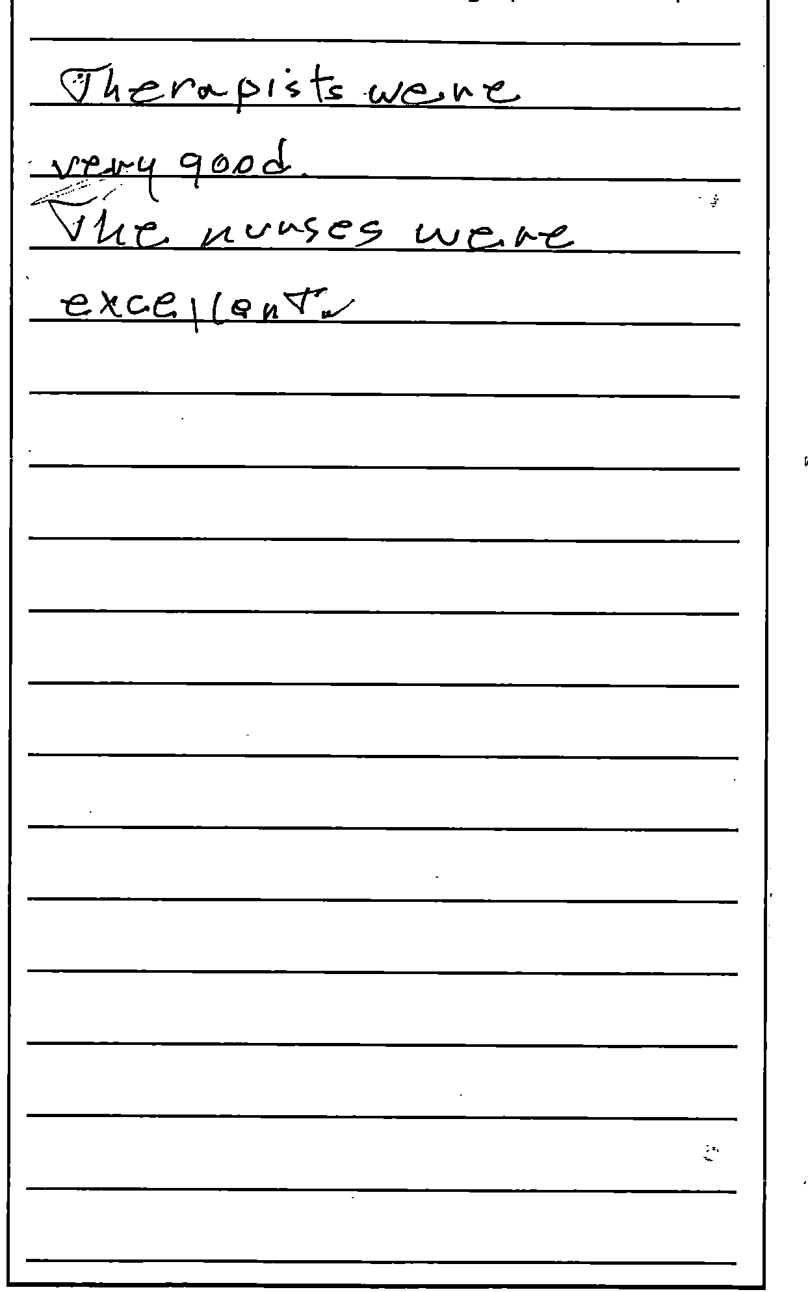
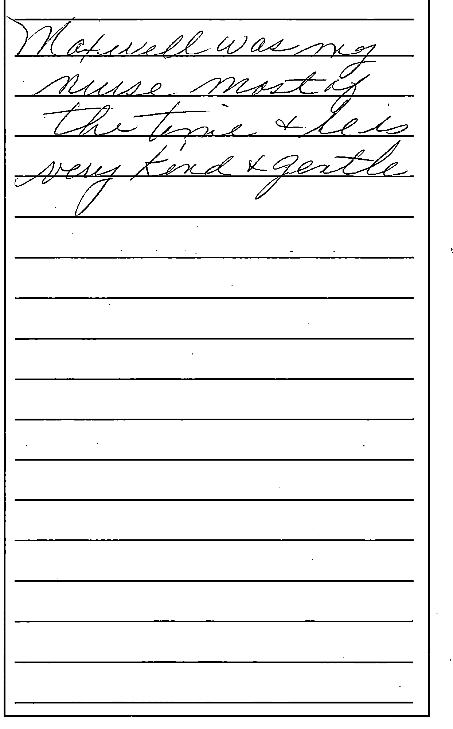
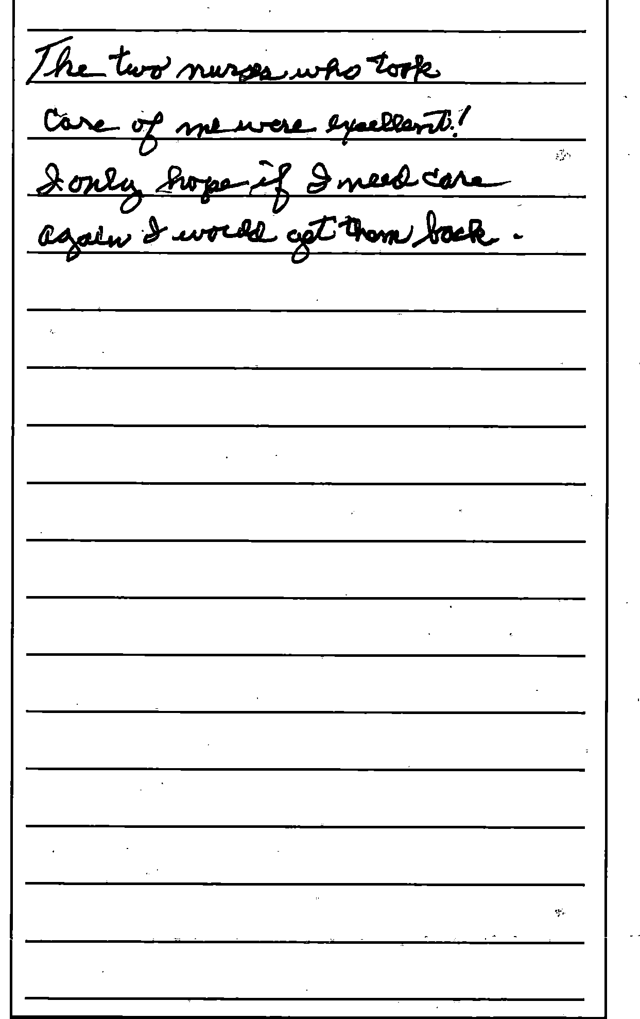

Slide 11
Coming Next Month
Service Recovery

