Slide 1
Basic Wound Care
Clinical Staff Education; 08/2025

Slide 2

Learner Objectives
By the end of this session, the learner will be able to:
Describe the principles of infection control in home care and hospice, including correct use of clean vs. sterile technique and appropriate disposal of supplies and sharps.
Identify characteristics, risk factors, and evidence-based management strategies for common wound types (arterial, venous, diabetic/neuropathic, pressure injuries, skin tears, burns).
Interpret Ankle-Brachial Index (ABI) results and determine safe compression therapy parameters according to current clinical guidelines.
Demonstrate accurate wound assessment measurement techniques, including photography standards and hospice-specific reassessment intervals.
Apply CMS OASIS-E1 documentation requirements for wounds and integrate findings into the patient’s care plan.
Evaluate when to initiate, continue, or modify wound care interventions in alignment with patient goals of care and agency policy.

Slide 3
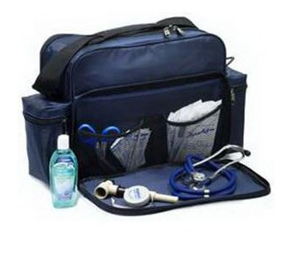
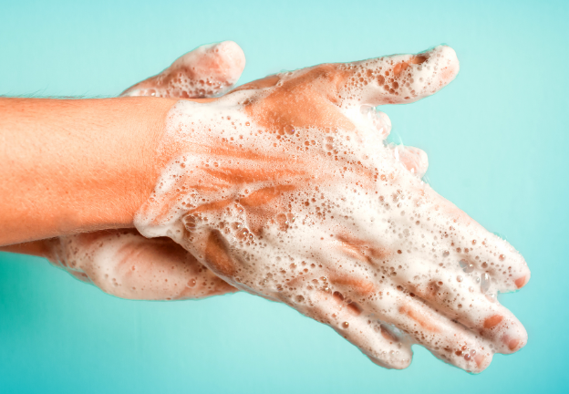
Infection Control
Hand hygiene: Perform hand hygiene with Alcohol-Based Hand Rub (ABHR) when not visibly soiled, wash with soap and water when visibly soiled OR for C. difficile/ norovirus!
  Prior to wound care
  After dressing removal
  Between wound care for different wounds
Bag technique: Follow agency police to meet Joint Commission and CMS survey requirements
Wound Care in the Home:
  Clean technique for chronic wounds
  Sterile technique for fresh surgical wounds, invasive procedures, or in severely immunocompromised patients.
Dispose of used supplies in a sealed/tied bag in household trash; “double-bag” if required by local waste regulations or when visibly saturated with blood/bodily fluids.
Use single-use sterile saline vials when possible (e.g., saline syringes for irrigation); If using a multi-dose bottle in the home, discard within 24 hours of first opening (or sooner per manufacturer) AND if filling syringes – they are ONE TIME USE!

Slide 4
You Own the Visit!
You are responsible for the whole visit
Update primary nurse
Order supplies- 2 weeks Medicare and BCBS,
1 month for Managed Medicare, Medicaid and all other private insurances
Call MD for new orders or changes to POC
Complete documentation using agency-approved, validated wound assessment tool
  Location, stage/type, measurements, exudate, periwound condition, pain, and treatment at each visit
Schedule the next visit
Right dressing – right wound – right time
Can you teach the patient or caregiver to participate in wound care?
Is it time to change the treatment or frequency?

Slide 5
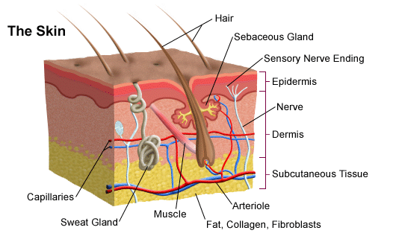
The Integumentary System
Epidermis:
< 1mm thick, avascular, layered, regenerates every 28-30 days (longer with aging)-AVASCULAR
Dermis:
1-4mm thick, matrix of loose connective tissue, majority of sensory organs, vascular network

Slide 6
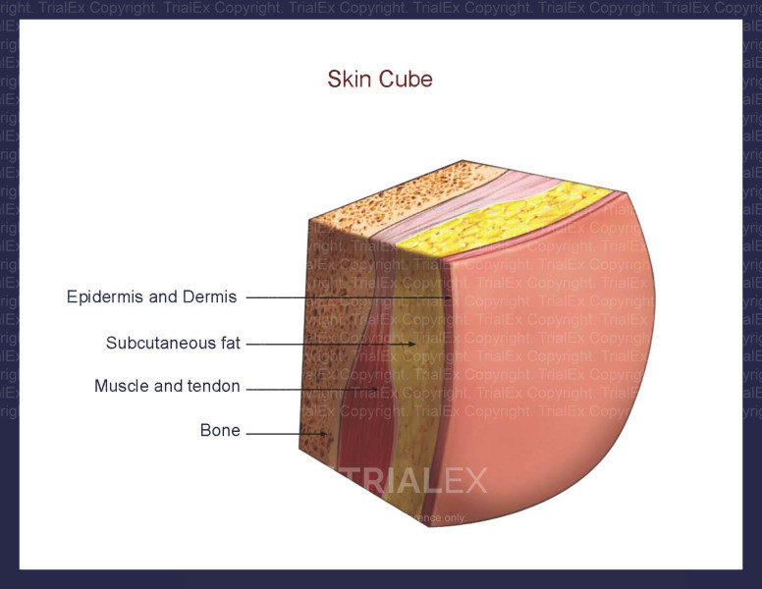
The Integumentary System
Support Structures
  Adipose Tissue (FAT)
  Fascia
  Muscle
  Ligament
  Cartlidge
  Bone
googleimages.com, 2024

Slide 7
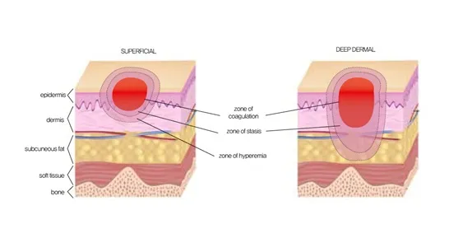
Determining Tissue Damage
Pressure Injury
Superficial Thickness:
  Tissue damage limited to the epidermis.
Partial Thickness
  Tissue damage through Epidermis extends to, but not through, the dermis.
Full Thickness
  Tissue damage through dermis and into adipose tissue
  Extends through adipose, exposing muscle, bone, fascia or tendon.

Slide 8
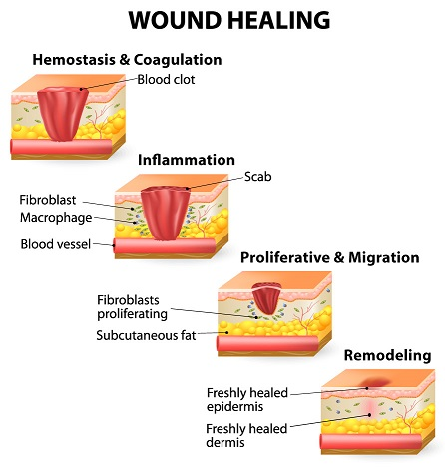
Inflammation Characteristics:
Localized redness
Heat
Swelling
Pain
Decreased Function
4-6 days
4-21 days
Up to 2 years
Notes:
4 phases of wound healing
Hemostasis: Bleeding activates series of events designed to control blood loss, establish bacterial control and form a plug to close the damages site.
Inflammation: Coordinated effort by variety of cells to heal the wound- lymphocytes (immunity and Ab production), macrophages destroy bacteria and secrete growth factors. Fibroblasts recruit immune cells to injury site.
Proliferation: New tissues built, wound closes (lasts 4-21 days). Granulation tissue- temporary latticework of vascularized connective tissue that fills wound. Epithelization- wound resurfaced with keratinocytes- cannot migrate over nonviable tissue.
Remodeling: strengthening and reorganization of granulation tissue matrix . Continues for up to 2 years after wound closure

Slide 9
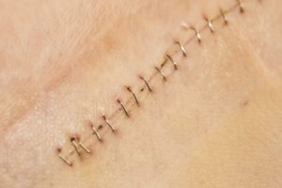
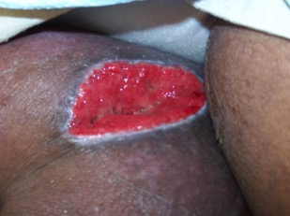
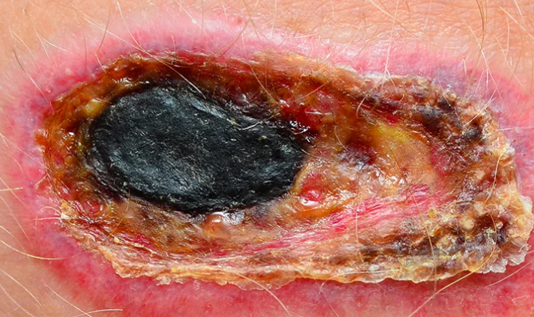
Factors Affecting Wound Healing
Mechanism of onset
Wound dimensions
Temperature
Wound hydration
Necrotic tissue or foreign body
Infection
Nutrition
Pressure
Hyperglycemia
Medications
Premature wound closure

Slide 10
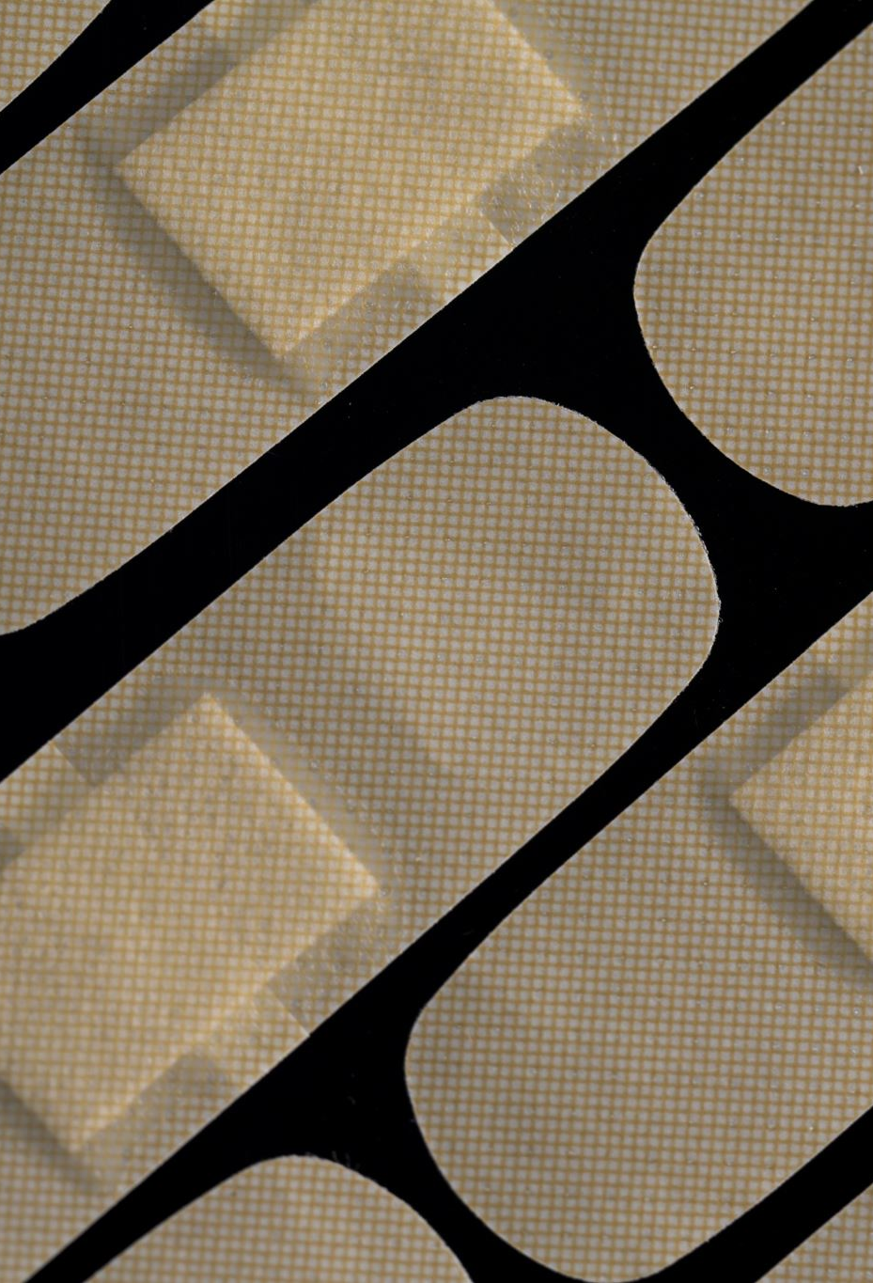
Types of Wounds
Surgical
Arterial
Venous
Diabetic/ Neuropathic
Pressure Injuries
Skin Tear
Burns

Slide 11
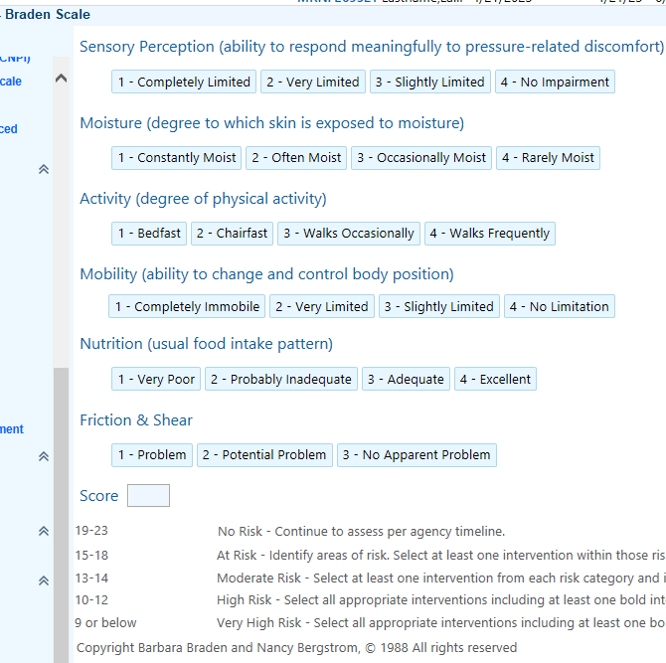
Prevention
Repositioning
Sunscreen
Hygiene/ incontinence
Nutrition / no smoking
Maintain healthy weight
Educate patients and caregivers
Risk factors chronic illness (e.g., PVD, DM, long term steroid use)
Braden Scale at Start of Care (SOC) and with any change in patient’s condition.
Notes:
Add to care plan- risk for skin breakdown, impaired nutrition

Slide 12
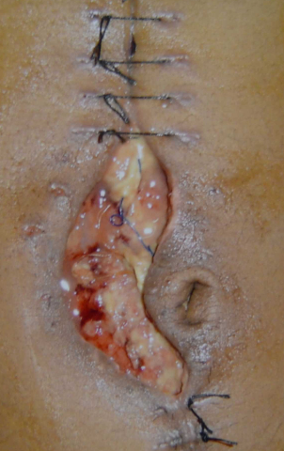
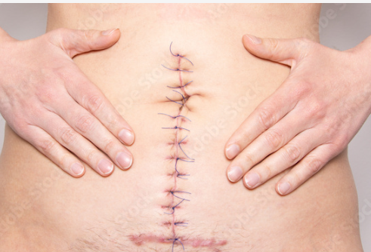
Surgical Wounds
The result of an incision made with a cutting instrument during a sterile procedure
Intact: edges approximated with sutures, staples or adhesive
Dehisced- edges open; notify surgeon and obtain wound care orders
Notes:
Dehiscence- due to poor surgical technique, strenuous activity, infection, smoking, comorbidities (DM, obesity, renal insufficiency)

Slide 13
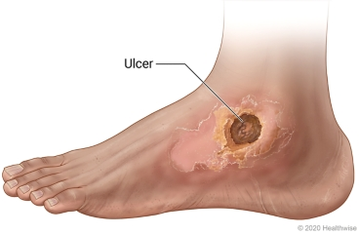
Arterial Wounds
Decreased arterial blood supply results in ischemia; ulcer from trauma to ischemic limb
Signs of arterial insufficiency- arterial stenosis, intermittent claudication, ischemic rest pain, ulcer formation
Punched-out appearance, usually round with well defined margins, pale base
Dry & painful, often on toes, heels, outer ankle
Risk factors: HLD, smoking, DM, HTN, trauma, advancing age
Notes:
arterial stenosis –increased resistance to blood flow and decreased blood flow distal to obstruction
Intermittent claudication- activity specific discomfort due to local ischemia. Pain stops 1-5min after stopping activity
Ischemic rest pain- burning pain exacerbated at night or with elevation, relieved by dependency- by the time rest pain occurs, tissues in the foot are severely ischemic and may require amputation
Ulceration and gangrene occur when oxygen requirements of local tissue exceeds perfusion

Slide 14
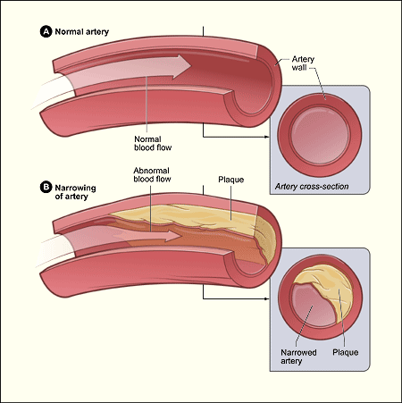
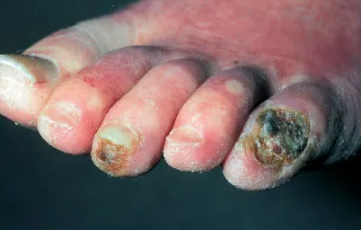
Arterial Wounds
Etiology:
  Disease of poor circulation through diseased blood vessels.
  Thorough vascular work up. (ABI/US)
  Manage risk factors- Cholesterol, BP, DM, Smoking cessation.
Care:
  Avoid compression
  Pain management
  Surgical revascularization
Local wound care
  Stable, dry eschar on ischemic limbs of heels: DO NOT DEBRIDE; keep dry, urgent vascular referral
  Consider povidone-iodine only to maintain dryness in dry gangrene (short-term)
  Avoid antiseptics on open visible tissue
Advanced wound healing after revascularization
  If wound becomes moist/infected initiate moist wound care and debride per provider order (if within scope of education, knowledge, and training) Limb Salvage-Amputation last resort!!

Slide 15
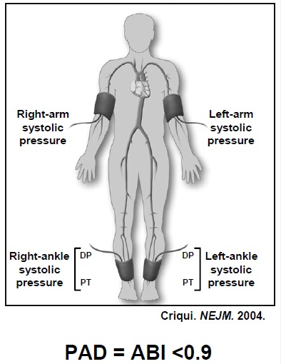
Testing for Arterial Insufficiency
Rubor of Dependency:
  Patient supine- note color of plantar foot
  Elevate leg to 60 degrees for 1 minute and note color
  Return leg to surface and note how long it takes for color to return to normal
    Normal arterial supply- there should be little change in color and color should return to normal in 15-20 seconds
Ankle-Brachial Index (ABI):
  Ratio of systolic BP of lower extremities to that of upper extremities
  0.9-1.1 is normal ABI. Lower number indicates poor arterial circulation
Compression should be used with caution in patients with arterial disease-can have mixed disease!
Notes:
Also pedal pulses

Slide 16
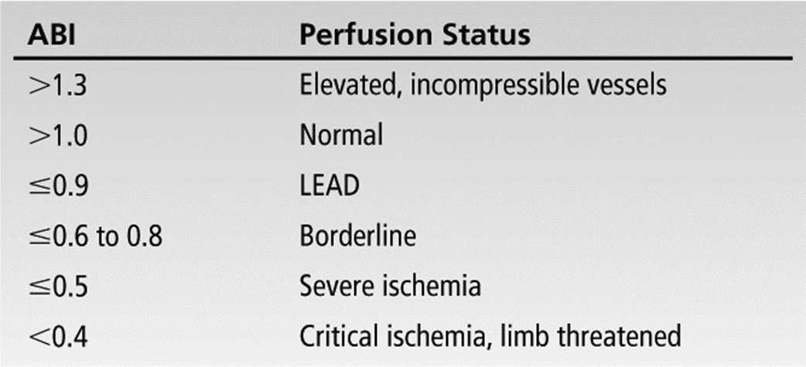
ABI INTERPRETATION
googleimages.com, 2024
Notes:
Also pedal pulses

Slide 17
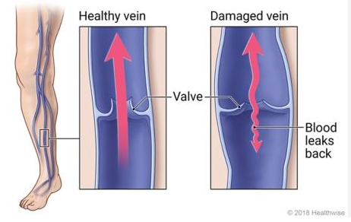
Venous Wounds
Venous insufficiency ulcers are the most common type of leg ulcer
Venous insufficiency commonly caused by vein dysfunction or calf muscle pump failure
Vessel hypertension leads to fluid and protein accumulation- peripheral edema
Ulcers thought to form due to impaired oxygen and nutrient exchange
Risk factors: peripheral edema, damage to
veins due to trauma, calf muscle weakness,
decreased mobility, prolonged standing,
history venous ulcer, age, DM
Notes:
As calf muscle contracts, muscle compress the deep veins. Valves prevent backflow.
DM- increased risk of microvascular disease and impaired immune response. Impaired wound healing all 3 phases.

Slide 18
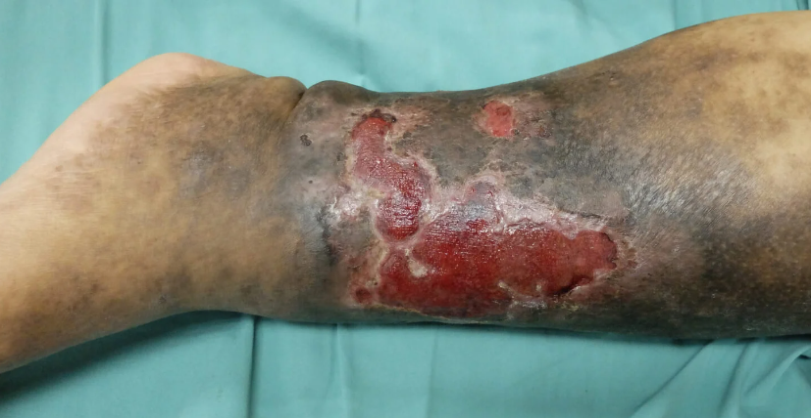
Venous Ulcers
Etiology and Characteristics
  Disease of congestion!
  Characterized by edema and exudate.
  Mild leg pain, heaviness, increases with
  Dependency and relieved by elevation or compression.
  Superficial, irregular shape, moderate to high drainage.
  Beefy red granulation tissue or ruddy appearance to wound bed.
  Edema, cellulitis common.
  Hemosiderin staining.
Notes:
Hemosiderin – protein that helps the body store iron. With venous insufficiency, blood pools in the legs causing overabundance of blood cell breakdown and iron accumulation

Slide 19
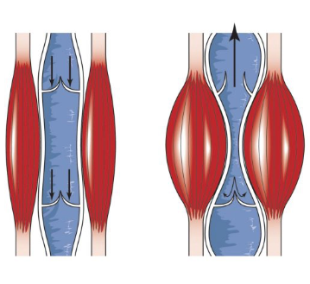
Treatment of Venous Wounds
Absorb drainage
Debride necrotic tissue
Protect surrounding skin- moisturizer to dry skin, skin barrier to protect from wound drainage
Enhance venous return- elevation, compression, ROM exercises, ambulating
Compression therapy enhances calf muscle pump effectiveness, venous return, tissue oxygenation, and reduces pain.
  Initiate full therapeutic compression when ABI >/= 0.8
  Modified/light compression (<30 mmHg) for ABI 0.5-0.8 AND only with a provider order and close monitoring
Do not compress if ABI <0.5 or ABI >1.3 (Obtain toe-brachial index (TBI) and/or Vascular Consult – due to likely arterial calcifications)
Notes:
Unna boots- nonelastic, should only be used on ambulatory pts. relies on action of calf muscle to be effective

Slide 20
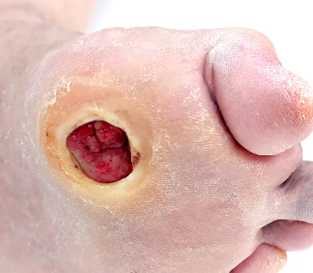
Diabetic/Neuropathic Wounds
Hyperglycemia causes tissue trauma and destruction and impairs wound healing
Neuropathy results in:
  Sensory- inability to sense trauma
  Motor- atrophy of plantar muscles, deformities cause increased pressure points
  Autonomic- decreased sweat- dry, cracked skin- increased infection risk
Impaired healing and immune response
Wound characteristics: plantar metatarsal head, round, punched out with rim of callus. Skin dry and cracked, toenails thickened due to fungus.
Notes:
Hyperglycemia changes RBCs, PLT, capillaries, alters blood flow increases microvascular pressure. Glycosylation of proteins causes tissue trauma. Accumulation of sorbitol results in tissue destruction
Impaired healing- increased osteomyelitis, soft tissue infections, candida infections

Slide 21
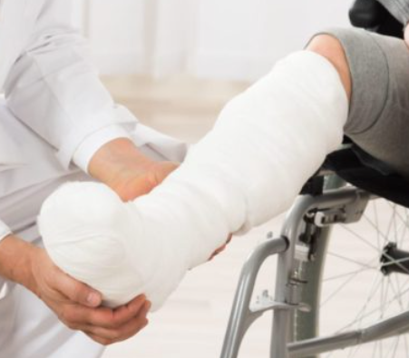
Diabetic Wound Treatment
Interdisciplinary team
Educate – patient and caregiver
Bone scan or x-ray if osteomyelitis suspected
Local wound care: debride callus, moisturize,
offloading, therapeutic footwear
Total contact cast- gold standard for offloading
Other treatment: optimize blood sugar, treat infection,
surgical correction of deformity, amputation
Notes:
Interdisciplinary- MD, nurse, wound care, surgeon, podiatrist, diabetic educator/nutritionist, endocrinologist, social worker
Education- pt and CG- disease, management, reducing risk factors, proper footwear, daily foot checks
Total contact cast- fiberglass or plaster shell, bar on bottom. Shell fits leg and foot closely, distributes weight along sole
Soft foam under ulcer so no pressure on sore
Usually changed weekly
Cannot apply if poor circulation

Slide 22
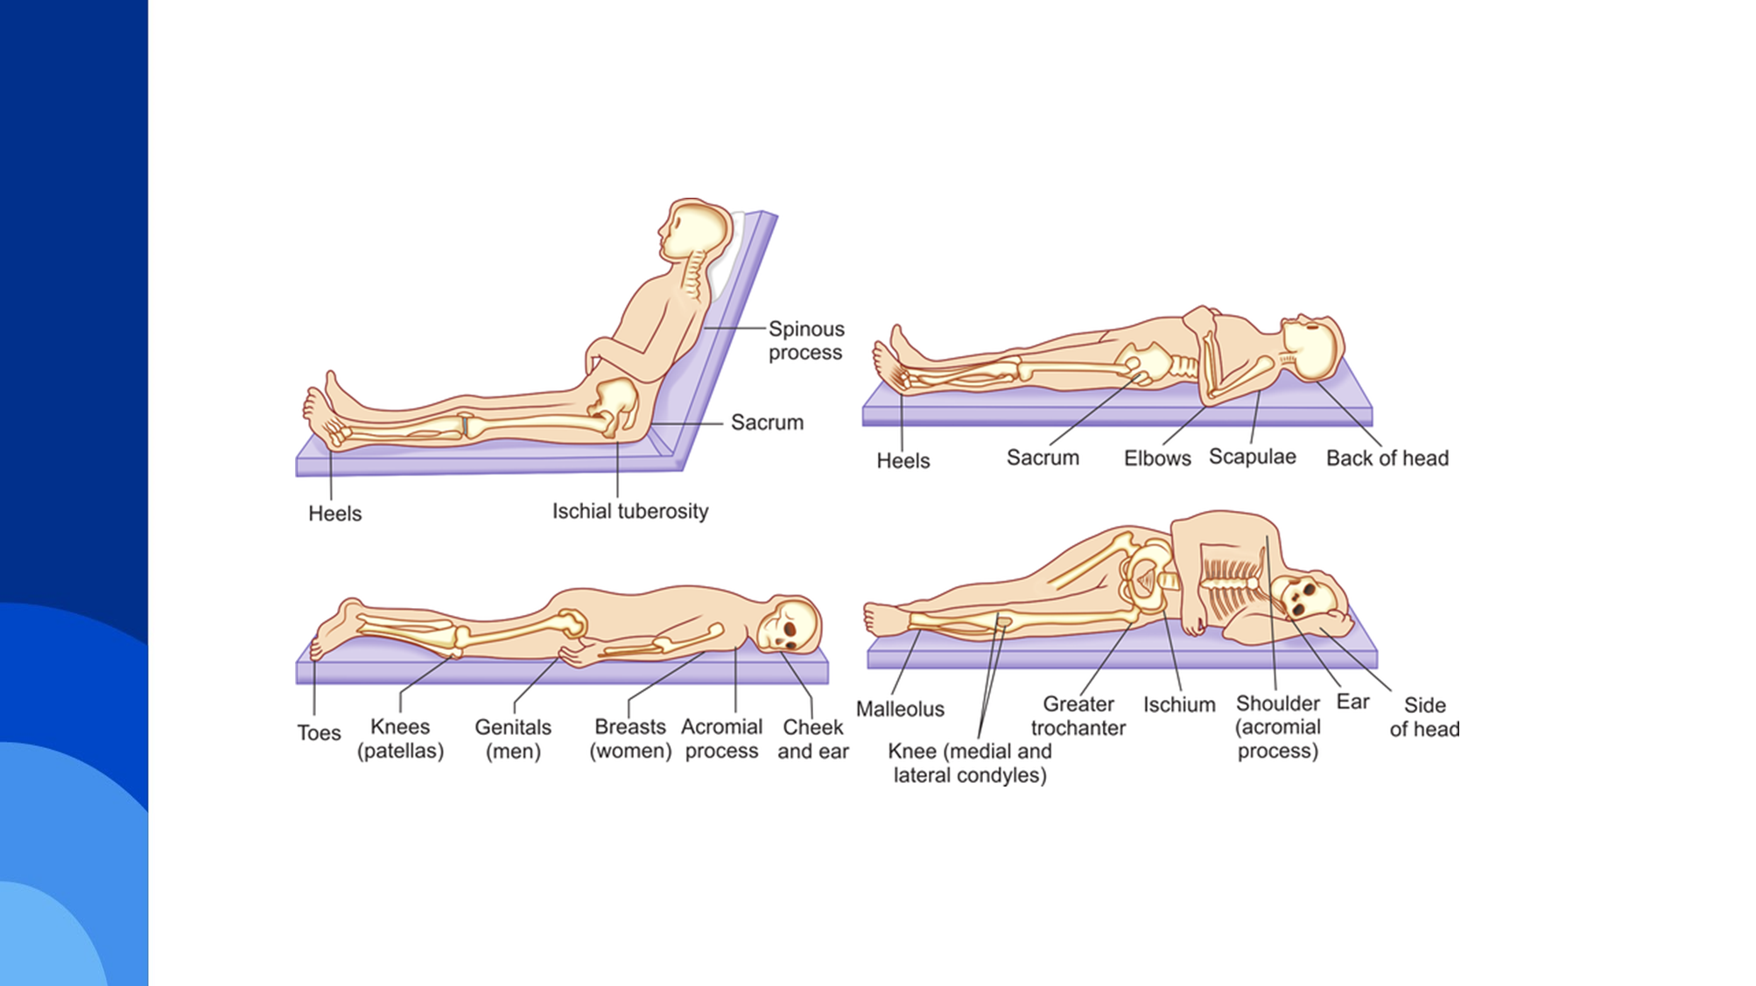
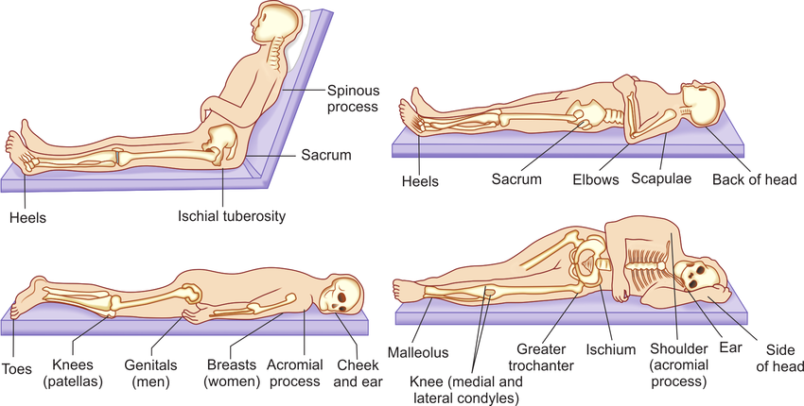
Pressure Injuries (PI)
Localized damage to the skin and underlying soft tissue usually over a body prominence or related to a medical or other device.
The injury can present as intact skin or an open ulcer and may be painful.
May also be affected by microclimate (nutrition, perfusion, co-morbid conditions).
May occur in as little as two hours.
Tissue damage may be extensive before any s/s are seen.
Prevention is key-Braden Risk Assessment Scale.
Stages 1, 2, 3, 4, Unstageable, Deep Tissue Pressure Injury, Medical Device and Mucus Membrane; Once closed, a PI is documented as healed Stage X, not downgraded
Notes:
Pressure on bony prominence compresses intervening structures between skin and bone. When this pressure is greater than the intracapillary blood pressure, blood flow is obstructed, and local tissue ischemia occurs
Education- pt, CG, health care worker- daily skin checks, proper transfers and position changes, management of incontinence
Early detection- blanchable erythema- redness that turns white when pressed then immediately turns red again when pressure is removed. Can be early sign of imminent tissue damage
Reverse staging- scar tissue does not have same composition as skin prior to wound, more fragile and more likely to open back up

Slide 23
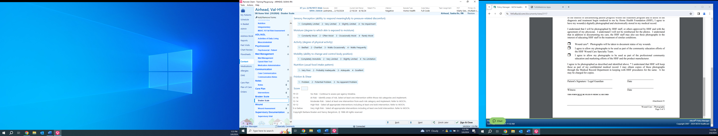
Risk For Pressure Injury
Be very careful when you complete the Braden Scale Risk Assessment-If you identify risk make sure you promptly, place meaningful interventions around risk prevention!
Notes:
Wound assessment form part 1

Slide 24
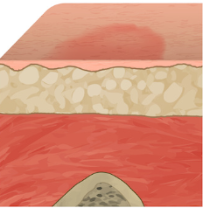
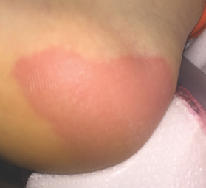
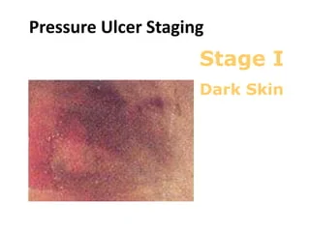
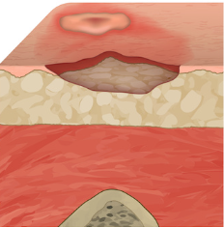
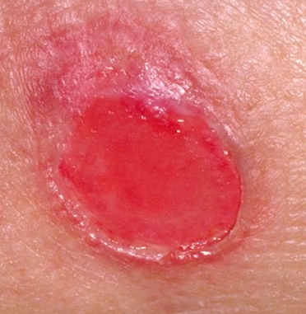
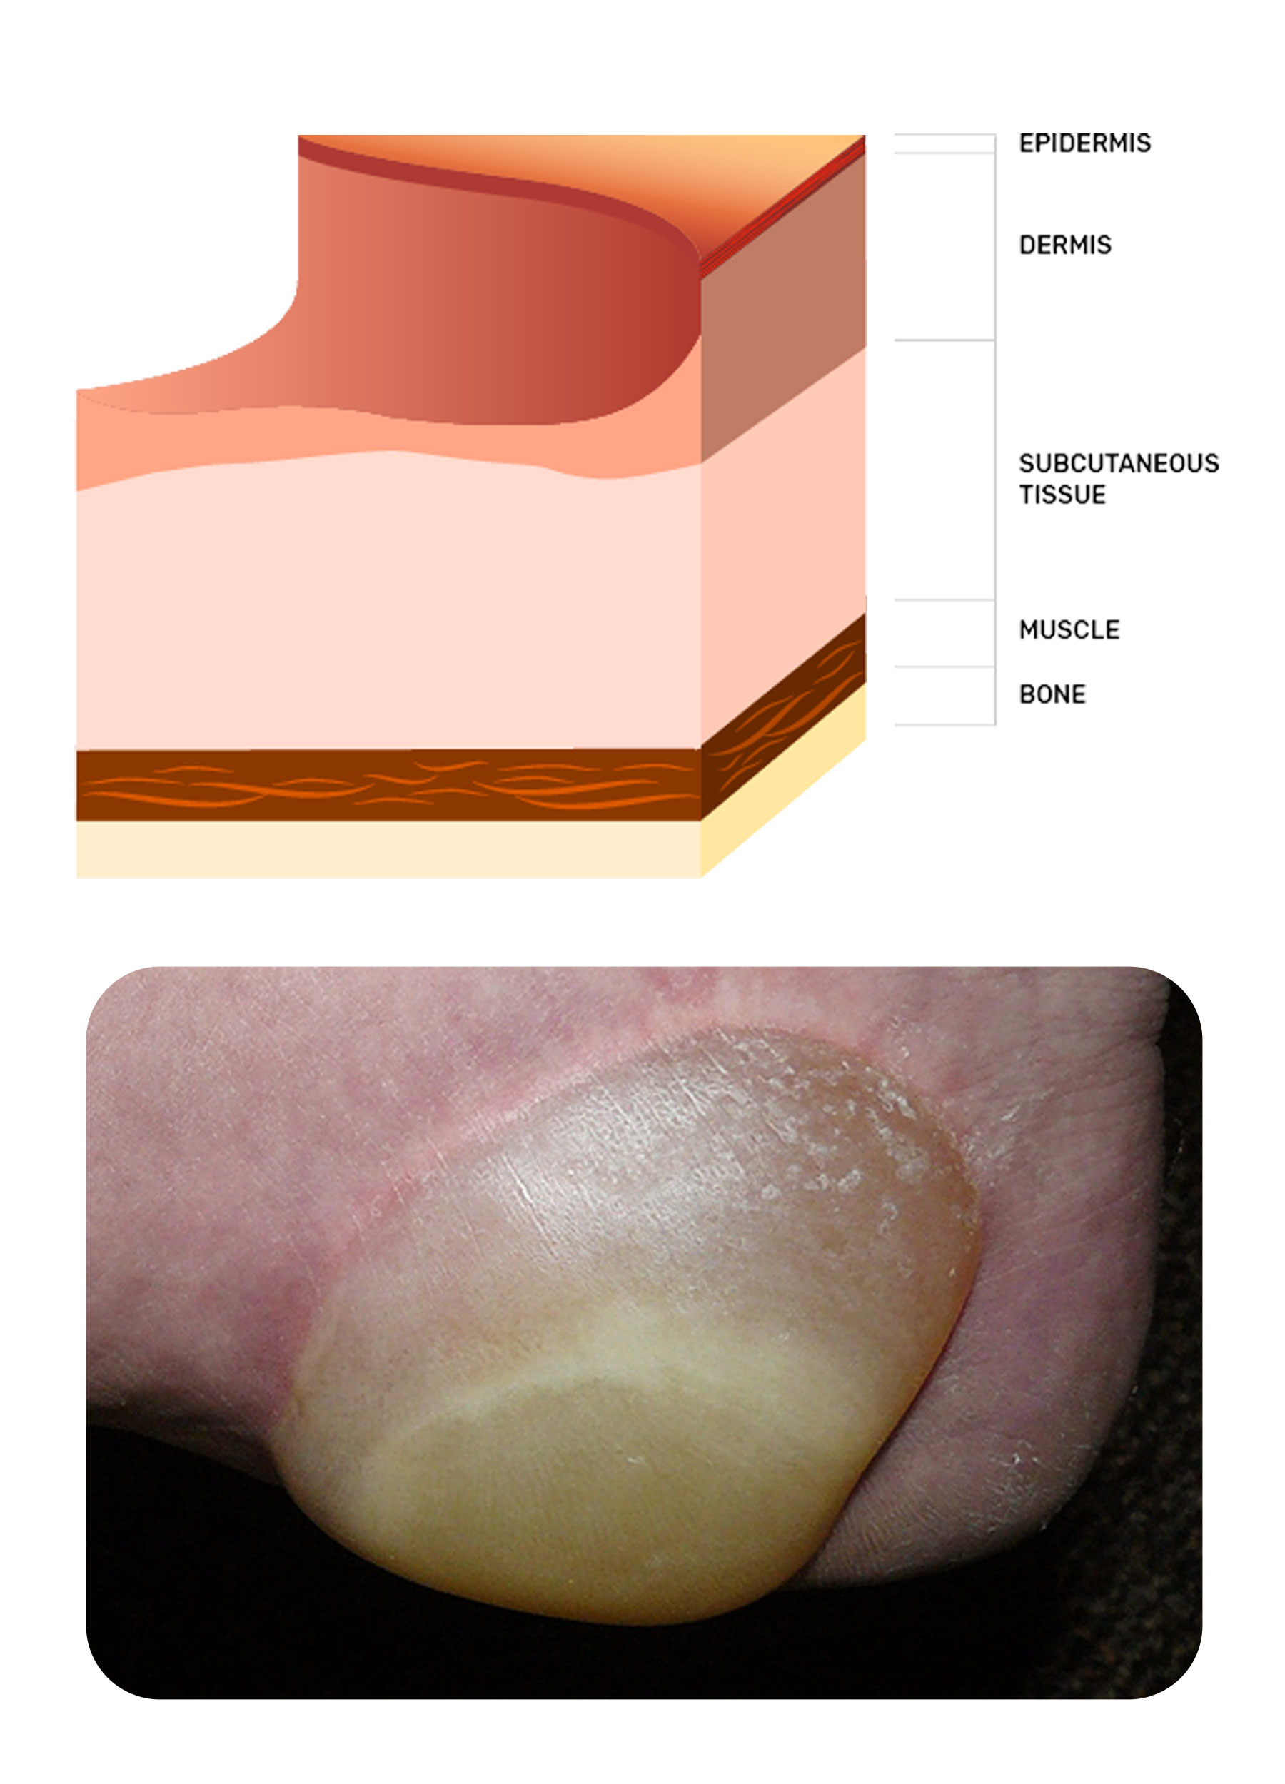
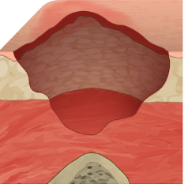
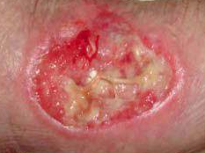
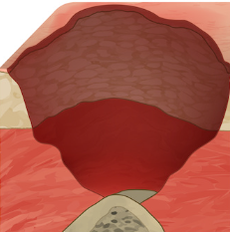
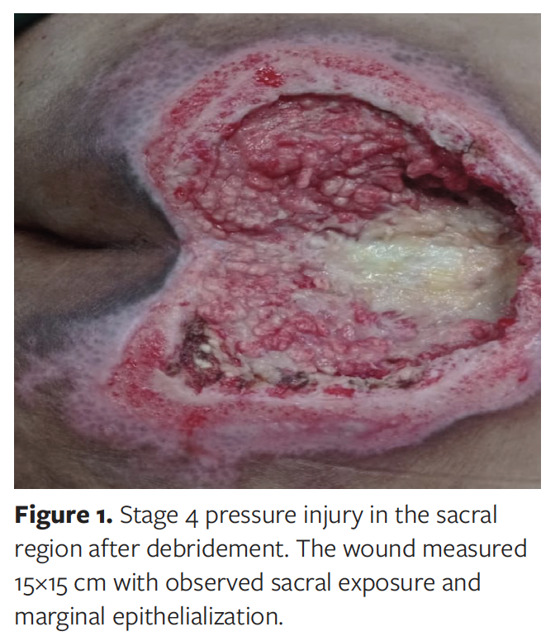
Pressure Injury PI
Stage 1: Intact skin with localized area of non-blanchable Erythema. May appear differently in darker pigmented skin tones. Changes in sensation, temperature, firmness.
Stage 2: Partial-thickness loss of skin with exposed dermis. Wound bed is viable, pink, red, and moist. May also present as an intact or ruptured serum-filled blister.
Stage 3: Full thickness loss of skin, adipose (fat) tissue is Visible in the ulcer and granulation tissue and epiboly (rolled wound edges) are often present. Depth varies by anatomical location. Can be deep! NO fascia, muscle, tendon, ligament, cartlidge or bone is seen or felt.
Stage 4: Full thickness skin and tissue loss with exposed or Directly palpable fascia, muscle, tendon, ligament, cartilage, or bone in the ulcer.
googleimages.com, 2024
Notes:
Refer to wound care protocol handout
Stage 1: darker skin- may appear purple, blue
May have change in local temp, tissue consistency or sensation
Stage 2: shallow crater or blister. Epidermis and dermis
Stage 3: deep crater, may have undermining. Involves epidermis, dermis and SQ tissue
Stage 4: exposed bone, tendon or muscle

Slide 25
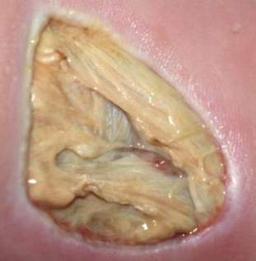
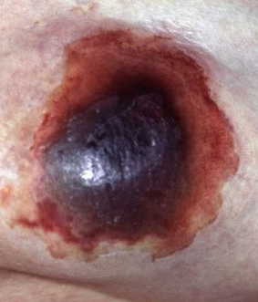
Pressure Injury (PI)
Unstageable: Full-thickness skin and tissue loss in which the extent of tissue damage within the ulcer cannot be confirmed because it is obscured by slough or eschar. If slough or eschar is removed, a Stage 3 or Stage 4 pressure injury will be revealed. Stable eschar (i.e., dry, adherent, intact without erythema or fluctuance) on the heel or ischemic limb should not be softened or removed.
Deep Tissue Injury: Intact or non-intact skin with localized area of persistent non-blanchable deep red, maroon, purple discoloration. Or epidermal separation revealing a dark wound bed or blood-filled blister. Pain and temperature change will precede skin changes. Appears differently in darker skin tones. Results from intense and prolonged pressure and shear forces at the bone-muscle interface. intact, blood-filled blister on bony prominence. May evolve rapidly to unstageable, stage 3 or stage 4.
googleimages.com, 2024
Notes:
DTI- likely caused by friction or shear or pressure. Likely to deteriorate
MDRPI: O2 tubing, feeding tubes, catheters, restraints, NPWT, bedpan, casts

Slide 26
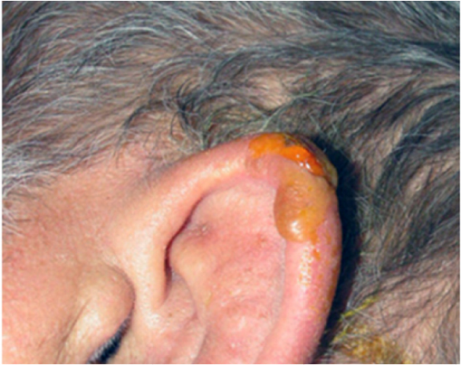
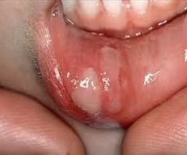
Pressure Injury (PI)
Medical Device Related Pressure Injury (MDPI) MDPI results from the use of devices designed and applied for diagnostic and therapeutic purposes. The resultant pressure injury takes on the shape or pattern of the medical device used. Stage according to the staging system. Actually, is an injury but must call it according to policy.
Mucosal Membrane Pressure Injury Mucosal membrane pressure injury is found on mucous membranes with a history of a medical device in use at the location of the injury. Due to the anatomy of the tissues these ulcers are not staged.
googleimages.com, 2024
Notes:
DTI- likely caused by friction or shear or pressure. Likely to deteriorate
MDRPI: O2 tubing, feeding tubes, catheters, restraints, NPWT, bedpan, casts

Slide 27
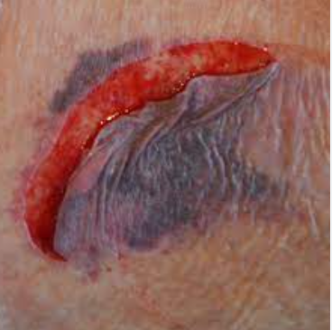
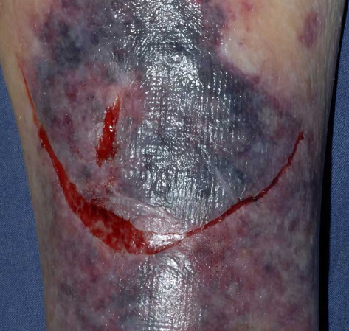
Skin Tears
Traumatic wound resulting from shear or friction, separates epidermis from dermis
Elderly at risk
Bleeding minimal to significant
Minimal pain
Treatment:
Clean/pat dry
Approximate wound edges
Adaptic, oil emulsion nonadherent layer or xeroform covered gauze/ABD pad and wrap with kling
Avoid adhesives
Notes:
Partial thickness wound

Slide 28
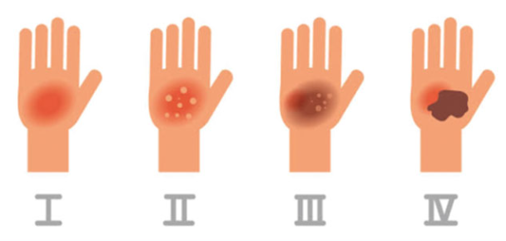
Burns
Three types:
  Thermal- direct/indirect contact with heat source
  Chemical- strong acids or alkalis reacting with body tissues
  Electrical- entrance and exit wound
Classification:
  Superficial (1st degree)
  Superficial partial-thickness (2nd degree)
  Deep partial-thickness (2nd degree)
  Full-thickness (3rd degree)
  Subdermal (4th degree)
Treatment
  Debridement, infection control, impregnated gauze, alginate and gauze for drainage, silver to prevent infection, skin grafts, biological dressings
Notes:
Chemical- burning process continues until chemical removed
Electrical- can cause fx, muscle necrosis, neurological injuries, multi organ failure
Superficial- epidermis only, e.g. sunburn- dry, red, skin blanches under pressure. Resolves 3-5 days without scarring
Superficial partial thickness- epidermis and papillary dermis- e.g. several sunburn, brief contact with dilute chemicals. Painful, moist, weeping blisters, erythema, edema. Heal 10-14 days
Deep partial-thickness. Mottled areas of red and white eschar, blisters possible. Healing 3+ weeks
Full thickens- epidermis, dermis and SQ tissue destruction. Initially red then mottled white, gray or black with eschar. Usually requires surgical debridement and skin grafting
Subdermal- beyond dermis into fat, muscle, tendon and/or bone- requires extensive surgical intervention, amputation and paralysis possible

Slide 29

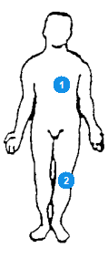

Wound Assessment
&
Documentation
Notes:
Severity of wounds as reflected in OASIS directly impacts reimbursement
PDGM: reimbursed higher for “early” period, 1st 30 days, so should increase visits to wound care patients in first episode

Slide 30
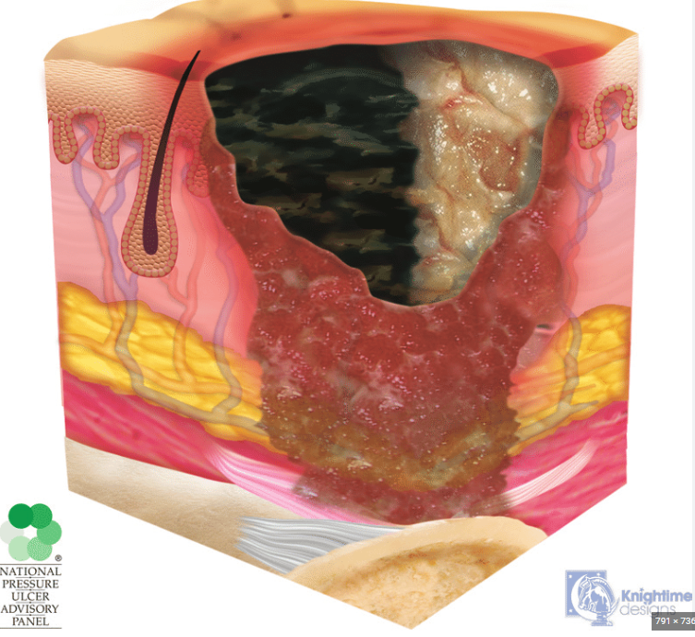
Wound Assessment:
Granulation tissue: pink-red, beefy tissue. May bleed easily
Eschar: black and usually hard. Sometimes soft with tinge of yellow
Slough: yellow threadlike fibrinous tissue. Denatured proteins that cannot be removed.
Epithelial tissue: pink, fragile-looking layer of new epithelial cells
Miscellaneous debris: sutures, foreign object
Odor: assess after cleaning wound/dsg can be odorous
Exudate: quantity and quality
Periwound: intact, red, edema, maceration
Pain: use validated tools!
Notes:
Treatment plan is devised based on clinical assessment, use of TMCAH wound formulary, and physician’s orders
Can get recommendation from WOCN but call MD for order

Slide 31
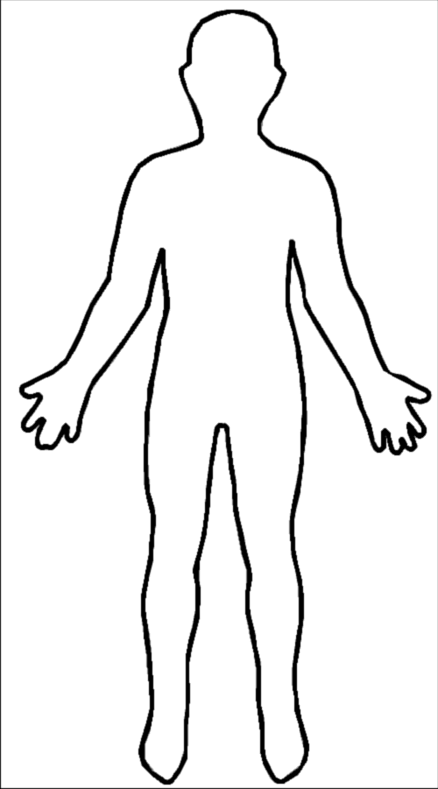

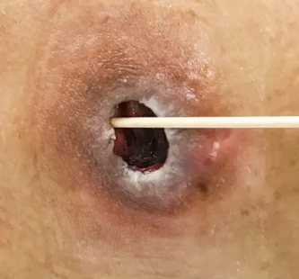

Wound Measurement:
Measure in cm, at widest/longest/deepest point
Assess and measure wounds at least weekly (photograph per policy and patient consent)
  In hospice, reassess wounds at least every 15 days, more often if clinically indicated (aligning with CMS CoPs §418.54)
  NOTE: Ensure wound consent form has been signed in Epic
Length: 12:00 to 6:00
Width: 3:00 to 9:00
Depth: If open, depth cannot be 0 cm
Tunneling: passageway from wound bed to deeper into the body, usually unidirectional
Undermining: erosion under wound edge that runs parallel to surface of body
Notes:
Probe for depth, tunnels, undermining
Reasons for tunneling- stalled wound (d/t infection, malnutrition, DM, EtOH), sedentary lifestyle, smoking, pressure, steroids, NSAIDs (effect protein synthesis, immunosuppressants
Undermining- d/t same, shear
Measure tunneling and undermining using clockface
If no change in wound size in 2 weeks, consider changing tx

Slide 32
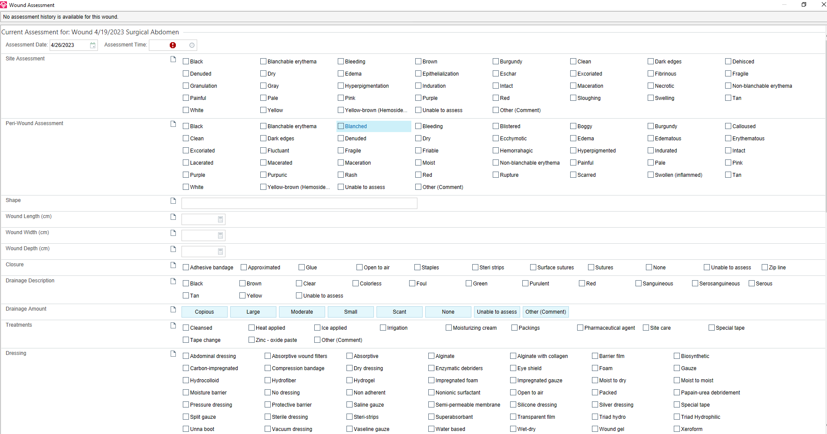
Notes:
Wound assessment form part 1

Slide 33
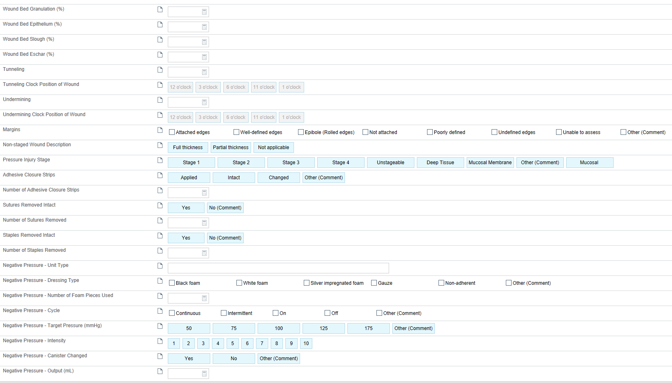
Total must be 100%!
Notes:
Wound assessment form part 2
% must add up to 100
Nurses can stage pressure injuries, cannot diagnose wound type

Slide 34
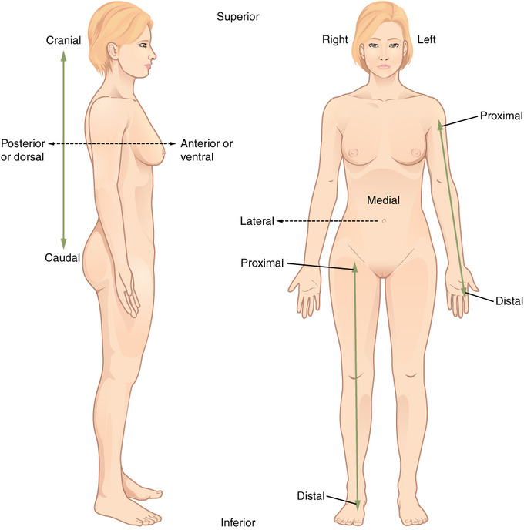
Anatomical Positions
dorsal
plantar

Slide 35


Care Plan for Wound
Order includes: site, details and frequency
Patient/Caregiver Teaching:
Assess for learning readiness, provide oral and written instructions for wound care
Evaluate effectiveness of teaching
Notes:
To enter custom order
Do not edit current order- looks like we’ve been doing since SOC.
Click end date, before accept copy and paste,
Add intervention
Tip sheet

Slide 36



OASIS Wounds M1340
Notes:
More oasis doc info on hhvna website

Slide 37





OASIS Wounds M1342
0 or 3
primary intention
1
2
3
secondary intention
Notes:
0 – Newly epithelialized for implanted venous access devices and infusion devices when the insertion site is healed and without signs and symptoms of infection.
1 – Fully granulating: Enter Response 1 when a surgical wound has a wound bed filled with granulation tissue to the level of the surrounding skin; no dead space, no avascular tissue; no signs or symptoms of infection; wound edges are open.
2 – Early/partial granulation: Enter Response 2 when ≥25% of the wound bed is covered with granulation tissue; there is minimal avascular tissue (that is, <25% of the wound bed is covered with avascular tissue); no signs or symptoms of infection; wound edges open.
3 – Not healing: Enter Response 3 when wound has ≥25% avascular tissue OR signs/symptoms of infection OR clean but non-granulating wound bed OR closed/hyperkeratotic wound edges OR persistent failure to improve despite appropriate comprehensive wound management.
Surgical wound with no granulation = Not Healing or Newly Epithelialized. UNLESS there is incisional separation, then can heal by secondary intention

Slide 38

OASIS Wounds M1342
  For the purpose of this OASIS item, a surgical site closed primarily (with sutures, staples, or a chemical bonding agent) is documented as surgical wound until re-epithelialization has been present for approximately 30 days, unless it dehisces or shows infection (Reference: CMS OASIS-E1 (2025) guidance).
  Openings in the skin adjacent to the incision line caused by the removal of staples or sutures are not to be considered as part of the surgical wound for M1342.
  Identify the most problematic observable surgical wound.
  The “most problematic” surgical wound may be the largest, the most resistant to treatment, an infected surgical wound, etc., depending on clinical judgment and the specific situation.
Notes:
0 – Newly epithelialized for implanted venous access devices and infusion devices when the insertion site is healed and without signs and symptoms of infection.
1 – Fully granulating: Enter Response 1 when a surgical wound has a wound bed filled with granulation tissue to the level of the surrounding skin; no dead space, no avascular tissue; no signs or symptoms of infection; wound edges are open.
2 – Early/partial granulation: Enter Response 2 when ≥25% of the wound bed is covered with granulation tissue; there is minimal avascular tissue (that is, <25% of the wound bed is covered with avascular tissue); no signs or symptoms of infection; wound edges open.
3 – Not healing: Enter Response 3 when wound has ≥25% avascular tissue OR signs/symptoms of infection OR clean but non-granulating wound bed OR closed/hyperkeratotic wound edges OR persistent failure to improve despite appropriate comprehensive wound management.
Surgical wound with no granulation = Not Healing or Newly Epithelialized. UNLESS there is incisional separation, then can heal by secondary intention

Slide 39

Dressing Selection
Why dress a wound?
  Insulation, prevent infection, decrease pain, eliminate dead space, remove debris/necrotic tissue, provide gas exchange, provide moist wound environment
MOIST wound environment
  Facilitates wound healing
  Reduces pain
  Reduces scarring
If the wound is:
  WET? Dry it
  Dry? Wet it
  Has a hole? Pack it
Always follow the manufacturer’s IFU for wear time and change frequency
For antimicrobial dressings: Use only when signs of critical colonization or per provider order to prevent antimicrobial overuse.
Notes:
Purpose of dsg- barrier to microorganisms, protect exposed nerves (decrease pain),
Wet wound, dressing must absorb exudate
Dry wound, dressing should donate moisture
If wound is too wet, healing can be delayed
Periwound maceration can cause additional ulceration and infection

Slide 40







Common Dressings
Gauze | Impregnated Gauze | Films | Hydrogel | Foam | Hydrocolloid
Least occlusive |  |  |  |  | Most occlusive
Notes:
Gauze- woven or non woven. Highly permeable, nonocclusive. Inexpensive, used for one time or short term use. USES frequent dsg changes, enzymatic debridement, packing
Impregnated gauze- (e.g. xeroform, Adaptec)- mesh impregnated with petrolatum, bismuth or zinc. Used as contact layer, requires secondary dsg. Nonadherent. Prevents wound from sticking to dsg. USES: burns, skin tears
Films- (e.g. Tegaderm) permeable to water vapor, O2, CO2 but impermeable to bacteria and water. Very little absorption. Allow for visualization of wound. USES: superficial wounds, donor graft sites, minimally dng wounds
Hydrogel (sheet, gel or impregnated gauze)- DONATE fluid to dry wounds. Permeable to gas and fluid. Almost nonadhesive, need secondary dressing. USES: min/mod dng wounds, burns, padding to decrease shear, softening eschar
Foam: (e.g. allevyn, mepilex border, polymem)- pulls fluid away from wound bed and holds it. Permeable to gas but not bacteria. USES: pressure ulcers, min to heavy exudate, DM ulcers, burns, venous ulcers
Hydrocolloid (e.g. duoderm): hydrophilic, vary in absorption. Absorb fluid slowly by swelling into gel like mass. Impermeable to water, O2 and bacteria (barrier for stool and urine) USES: partial to full thickness wounds, granular and necrotic wounds, minor burns, venous ulcers, sacral/coccyx pressure injuries

Slide 41




Other Dressings
Alginates
Composite
Antimicrobials- silver, cadexomer iodine, hydrofera blue, medihoney
Wound fillers
Unna boot, NPWT (VAC), antimicrobials
Notes:
Calcium Alginate- CA and NA fibers made from seaweed
Transforms to moist gel consistency promoting moist healing environment, absorbs 20x it’s weight
USES: moderate to heavy drainage, partial/full thickness wounds, stage III and IV PI’s, infected wounds. Can use as packing. Need secondary dressing. Be sure to clean old alginate off well. If not gelled, changing too soon or wound is not draining enough to warrant alginate dressing (will dry wound )

Slide 42
Other points…
What does 100% epithelialized mean?
  The wound is completely covered with new epithelial tissue (a thin, pink, fragile layer of skin cells) and there is no open area, drainage, or scab/eschar.
  Final stage of wound healing
  New epithelium is fragile and at risk for breakdown for 30 days; patient/caregiver teaching should include protecting the site from friction/trauma.
When do we “resolve” a wound in Epic
  Once epithelialized or 30 days after epithelialization if surgical wound
Wound is “Not observable”, if covered by non-removable dressing.
Be sure to pull through wounds and IVs from hospital using Rover
  Open in Rover during visit and document something, then sync in Remote Client
Resources on hhvna website, Wound/Ostomy button: VAC, PICO, Braden scale, OASIS guidelines
Notes:
Tip sheet education website

Slide 43
Hospice Considerations
Common Wounds:
  Pressure injuries, skin tears, venous, arterial, diabetic
Focus on:
  Managing drainage, odor, pain; In hospice, odor control is prioritized in alignment with patient comfort and dignity, even when wound closure is not a goal
  Preventing infection
Documentation:
  List all wounds and measure at least monthly
  Individualize wound care plans
Notes:
Tip sheet education website

Slide 44






MERRIMACK VALLEY HOSPICE WOUND DRAINAGE AND ODOR MANAGEMENT
Type of Drainage | Product(s) to Use | Frequency
No to Minimal Drainage | Non-bordered or silicone-bordered foam Hydrogel with gauze on top Triad paste to areas of incontinence or where dressing is likely to roll (back, sacrum, coccyx) | Change 2-3x/week
Minimal to Moderate Drainage | Hydrocolloid Triad paste to areas of incontinence or where dressing is likely to roll (back, sacrum, coccyx) | Change 2-3x/week
Moderate to Heavy Drainage | Alginate dressing or rope for packing. Cover with ABD or foam Silver non-adherent foam Foam self-adherent or foam adhesive border | Change 3x/week
High Exudate | Ostomy pouch; empty from bottom | Change 2x/week
Odor Control | 15 psi wound cleanser to remove bacteria and odor. Spray wound and let drain/drip. Wipe/dab with gauze. Dakin’s ½ strength. Apply to wound with syringe. Wipe from intact skin. Flagyl powder 15g size. Off formulary, need MD order and manager approval Carboflex- charcoal, nonabsorbent dressing | With every dressing change
Peri wound Care | Zinc barrier cream Barrier wipes | With every dressing change
NOTES | Avoid adhesives on fragile, elderly skin List all wounds and measure at least monthly Individualize wound care plans

Slide 45
Epic Demo/Practice
Open a visit and add/remove forms to add wound form
(click YES to keep form)
Add wound: This should be done in Rover for new patient from Epic hospital (to carryover documentation)
Fill out wound assessment
Resolve wound
Add wound care treatment order to care plan (hospice- search “HSPC”)
Change wound care order by discontinuing one order and creating new intervention, not by changing current order
Notes:
Tip sheet education website

Slide 46
Thanks for Learning
Clinical Staff Development
Tufts Medicine Care at Home
847 Rogers Street, Suite 201
Lowell, MA 01852

