Slide 1

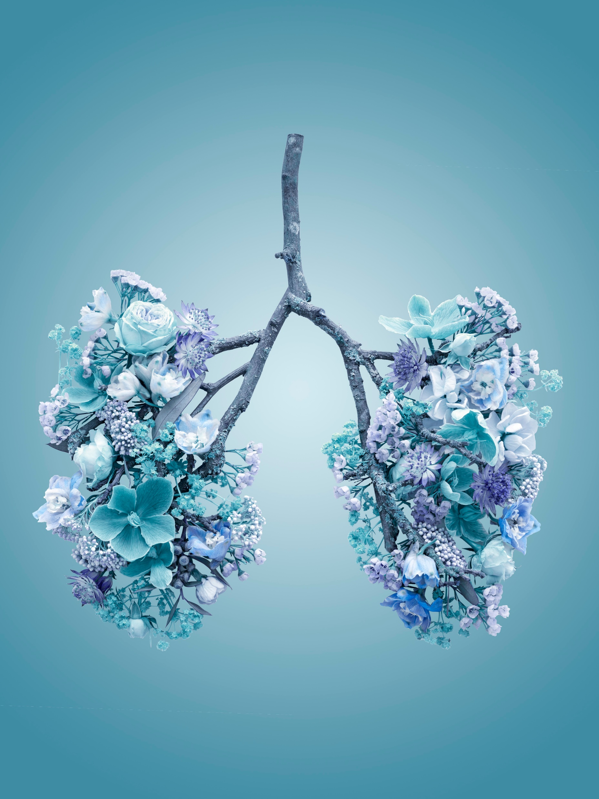
Pneumonia
TMCAH Staff Development Department 2024
Notes:
https://kidshealth.org/en/parents/heart.html

Slide 2
What Is Pneumonia?
Pneumonia is a common lung infection caused by germs, such as bacteria, viruses, and fungi. It can be a complication of the flu, but other viruses, bacteria and even fungi can cause pneumonia. Pneumonia and its symptoms can vary from mild to severe. Treatment depends on the cause of your pneumonia, how severe your symptoms are, and your age and overall health. Most healthy people recover from pneumonia in one to three weeks, but it can be life-threatening. The good news is that pneumonia can be prevented—by getting an annual flu shot (as flu often leads to pneumonia), frequently washing your hands, and for people at high risk, getting a vaccine for pneumococcal pneumonia.
More than 34 million Americans live with lung disease. When combined with lung cancer and respiratory diseases like COVID-19 and influenza, lung disease is among the top causes of death by disease in America.
Notes:
https://www.osmosis.org/learn/Congestive_heart_failure:_Clinical_sciences
HHVNA Circulatory System Procedure (VNAA)

Slide 3
Statistics
More than 34 million Americans live with lung disease.
When combined with lung cancer and respiratory diseases like COVID-19 and influenza, lung disease is among the top causes of death by disease in America
Over 1 million people in the US are hospitalized with some form of pneumonia every year. About 50,000 people die from the illness
Early treatment is key

Slide 4
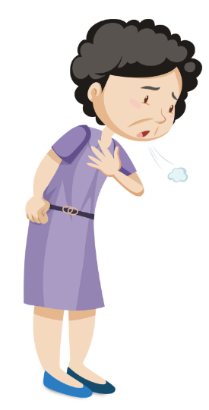
Causes of Pneumonia
COVID 19
Influenza
RSV
ARDS
Other less frequent causes
Measles
Chemotherapy
Cystic Fibrosis
HIV/AIDS
Notes:
https://ourhearthub.ca/what-is-heart-failure/
Shortness of breath, dyspnea on exertion, paroxysmal nocturnal dyspnea

Slide 5
Symptoms of Pneumonia
Cough
Fever, sweating and shakes
Shortness of Breath
Rapid, Shallow Breathing
Sharp or stabbing chest pain that worsens when you deep breathe deeply or cough
Rapid shallow breathing
Loss of appetite, fatigue
Nausea and vomiting in young children
Confusion in elders
Notes:
https://ourhearthub.ca/what-is-heart-failure/
Shortness of breath, dyspnea on exertion, paroxysmal nocturnal dyspnea

Slide 6
Types of Pneumonia
Bacterial Pneumonia
The most common form and tends to be the most serious
Symptoms often require medical care
Can develop suddenly or gradually
Fever can rise as high as 105 degrees
Nailbeds and lips may have a bluish color due to lack of oxygen
Viral Pneumonia
Symptoms develop over the course of a few days
Early symptoms are similar to flu symptoms ( headache, muscle pain, weakness)
Symptoms will get worse over a day or two and typically get worse with increase cough, shortness of breath and muscle pain

Slide 7
Types of Pneumonia ( Cont’d)
Fungal Pneumonia
This rarely affects healthy people. But it can develop in people with weakened immune systems, for example:
  Taking certain medications
  Having HIV or AIDS
  Receiving a bone marrow or organ transplant
  Receiving chemotherapy or radiation
Some fungi that can cause fungal pneumonia, such as Aspergillus and Histoplasma, can be found in soil, compost and/or bird droppings. Pneumonia can be caused by breathing tiny spores of this fungi into your lungs.
Another fungus called Pneumocystis jirovecii is found in many people's lungs but rarely causes pneumonia unless the immune system becomes very weak. People with AIDS are at high risk

Slide 8
Other types of Pneumonia
Some types of pneumonia have causes other than infection.
For example, aspiration pneumonia caused by inhaling the following:
Food
Drink
Saliva
Vomit

Slide 9
Medical History
Any recent travel
Occupation
Contact with animals
Exposure to other sick people at home, work or school
Whether you have recently had another illness
Diagnosis
Blood test
Chest Xray
Pulse oximetry
Sputum culture and sensitivity
Additional test may be ordered for high risk patients ( Bronchoscopy, Pleural fluid culture, ABG’s)

Slide 10
Medications
Antibiotics can help cure pneumonia caused by bacteria
Common antibiotics used to treat pneumonia include:
  Clarithromycin
  Azithromycin
  Doxyclycline
  Moxifloxacin
  Levofloxacin

Slide 11
Antifungal medication
Antifungal medication
If lab tests show that the pneumonia is caused by a fungus, an antifungal medication will be prescribed
For example, pneumocyctis pneumonia is often treated using a combination of sulfamethoxazole and trimethoprim
Antiviral medication
Antiviral medication can not cure viral pneumonia. But it can speed up recovery
Oseltamivir or Zanamivir may be used for influenza
Acyclovir may be used for varicella
Many cases of viral pneumonia can be treated only with supportive care

Slide 12
Supportive treatments
Pain relievers- help with headaches, muscle aches, chest pain and fevers
  acetaminophen
  nonsteroidal anti-inflammatory drug (NSAID): aspirin, ibuprofen, naproxen
Cough medicine
  Guaifenesin
Fluids (patients with Heart Failure may need to limit their fluid intake)
  Water
  Soup or broth
  Decaffeinated tea

Slide 13
Supportive treatments cont’d
Oxygen
If you have low oxygen levels in your blood oxygen may need to be given
Oxygen comes in a liquid container, tank or concentrator
Oxygen can be delivered through a mask that fits over the mouth and nose or a nasal cannula (tubing fits in nose)
Breathing treatments
Depending on symptoms and any other lung conditions a patient may have, the
following may be recommended to use:
  Inhaled medications to open the lungs and/or reduce airway swelling
  A humidifier to help this out mucous in the lungs
Medication may be prescribed to be given by inhaler or nebulizer. Patient may need to be taught how to use it

Slide 14
Patient Assessment at each visit
Clinical assessment including pulmonary assessment and assessment of co-morbidities
SDOH assessment including health literacy
Medication compliance
Education needs
Nutrition assessment
Activity assessment
Adherence to lifestyle modifications as needed
Diet, medication, activity
Patient/caregiver participation in self-management of disease to facilitate recovery
Include assessment of co-morbidities which may influence of on recovery from pneumonia: Diabetes, COPD, Cardiovascular disease, Depression, Obesity, Substance use disorders, Mental Health Disorders
Notes:
https://jeanlamantia.com/lymphedema-vs-edema/

Slide 15
How a patient can support recovery and stay out of the hospital
Take medications as prescribed. Pneumonia medication often starts to relieve symptoms within a few days. But medication should be continued for as long as it has been prescribed.
Take care of overall health. Includes:
  Healthy diet
  Get plenty of rest
  Avoid unhealthy behaviors
  Return to normal activities slowly, as able
  Avoid behaviors that could make you more sick
    Smoking
    Drinking alcohol
    Being around others that are sick

Slide 16
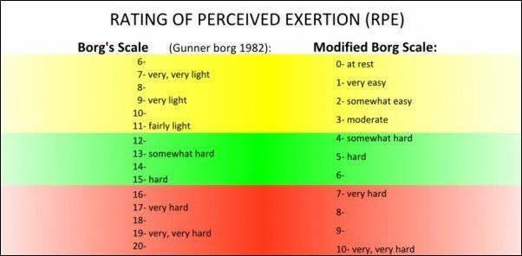
Borg’s Scale

Slide 17
Visit frequency
19 Total visits over one episode; two 30-day periods (3 prn for symptom management)
5 SN visits, 2 ZPT visits, 2 OT visits, 2 HHA visits during first 30 day episode
4 SN visits, 2 PT visits, 2 OT visits,- visits during the second 30 days
Week 1 Frontloading-2 SN visits within the first 7 days of service
Goal: Patient understands red flags and emergency action plan
Use inclusive/exclusive criteria for Telehealth and install
Call MD and reconcile meds
Call MD to obtain prn inhaler orders if not present on admission
Call MD to identify long-term oxygen plan ( weaning, prn only, continuous)
Explore patient/caregiver readiness, confidence, motivation prior knowledge level
Establish goals with patient
Teach Red zone specific to diagnosis, other red flags related to patient risk factors
Teach high risk medications using patient teaching tools (narcotics, hypoglycemics, anticoagulants)
Teach Oxygen safety
Observe nebulizer/ inhaler use
Teach/reinforce self monitoring
Notes:
References
Chatterjee, K. (2012). Pathophysiology of systolic and diastolic heart failure. The Medical Clinics of North America, 96(5), 891-898. doi:10.1016/j.mcna.2012.07.001

Slide 18
Visit Frequency, Weeks 2-4
Weeks 2-4: 3 SN visits (add a telephone visit prn to teach/reinforce or assess)
Goal: Patient has beginning understanding of self management and long-term support plan
Address non-adherence, ambivalence about self-management
Teach Yellow Zone management using teach-back
Teach medication management including prn inhaler use to patient/caregiver
Initiate discharge planning (MD f/u, long-term supportive care, referrals, MOLST)
IDT for care coordination by end of week 2

Slide 19
Visit Frequency, Weeks 5-9
Weeks 5-9: 4 SN visits (consider every other weeks for patients rapidly stabilizing; supplement with telephone visits as needed)
Goal: Patient able to teach back Zone tools, adheres to medication management and daily self management.
Address non-adherence, ambivalence about patient self management meds, f/u appointments, self monitoring)
Complete pathway teaching ( Green Zone optimal self-management)
Referrals for ongoing fu and support ( Elder Services, specialist, clinics, DME)
Ensure patient has equipment nebulizer, Oxygen) in house for long-term self-management and knows how to reorder, maintain equipment
Discharge end of week 6 to family/self support, long-term services
Continue 1 visit per week through week 9 if patient has med changes or ongoing symptoms, or MD intervention or RN oversight

Slide 20
Core components
Variance from visit frequence pathway and/or obstacles to goal attainment are discussed with Clinical Manager immediately
Changes in condition are promptly reported to MD using SBAR making appropriate recommendations
When therapy is indicated, alternate visits withy therapy so patient does not have multiple visits in one day
Multidisciplinary care-coordination- communicate need to monitor visits, reinforce teaching, use all available clinical resources
Maintain continuity, prioritize primary clinicians for frontloaded visits, introduction of new concepts
Incorporate patient education, plans for next visit in documentation/narrative note

Slide 21


