Slide 1

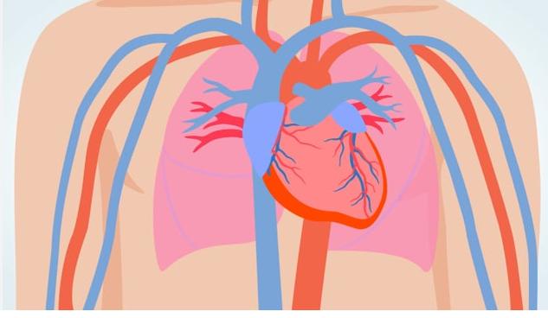
Heart Failure
TMCAH Staff Development Department 2024
Notes:
https://kidshealth.org/en/parents/heart.html

Slide 2
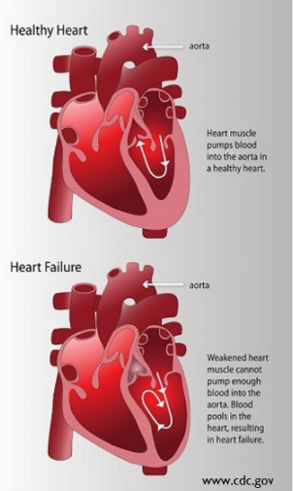
What Is Heart Failure?
Heart muscle cannot pump enough blood for the body’s needs
Caused by conditions such as CAD or HTN which gradually leave heart too weak or stiff to fill and pump efficiently
Leading cause of Medicare patient hospital readmission in the US
Rehospitalization can often be prevented with adequate self management of disease
Basic heart function (3:00) https://www.youtube.com/watch?v=CWFyxn0qDEU
Notes:
https://www.osmosis.org/learn/Congestive_heart_failure:_Clinical_sciences
HHVNA Circulatory System Procedure (VNAA)

Slide 3

What Is Heart Failure?
Left Sided Heart Failure: Blood backs up from left ventricle into the left atrium,
pulmonary veins and lungs, resulting in reduced gas exchange
Diastolic HF: Ventricles cannot relax & fill fully prior to contraction
Systolic HF: Ventricle cannot pump blood with enough force
SYMPTOMS of Left HF are due to backup of blood into lungs (Left = Lungs)
Trouble breathing, SOB, coughing, orthopnea
Right Sided Heart Failure: Left ventricle fails, causing increased fluid pressure back through lungs, damaging right side of heart
SYMPTOMS of Right HF due to backup of blood into peripheral circulation
Fluid retention, edema, palpitations, chest pain, weight gain
Congestive HF: term used interchangeably with HF. Acute decompensated heart failure with progressive signs and symptoms of fluid retention and activity intolerance
Right and left sides of heart work together as a closed pumping system, so failure of one side will eventually lead to failure of the other side
Notes:
https://www.osmosis.org/learn/Congestive_heart_failure:_Clinical_sciences
HHVNA Circulatory System Procedure (VNAA)
Systole = contracting
Diastole = relaxing

Slide 4
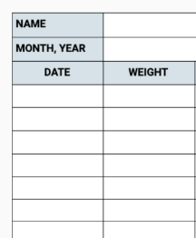
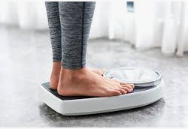

Heart Failure- Signs/Symptoms
SOB, DOE, PND, orthopnea, tachypnea
Lower extremity edema, ascites
Weight gain (2lb in 24 hr or 5lb in a week)
JVD distention, chest pain/tightness
Weakness, fatigue, decreased alertness, frequent falls
Dizziness, rapid heart rate, arrhythmia, murmur
Nausea, poor appetite, abdominal pain
Cough with frothy sputum, wheezing, cyanosis, hypoxia (listen for crackles)
Sounds of Heart Failure (1:28) https://tinyurl.com/359exmyj
Weight gain is often the first warning sign that HF is starting to decompensate
Teach Dry weight daily- am, empty bladder, before eating/drinking, same clothes
Report gain of >2lb/day or 5lb/week or per MD orders – to MD or TMCAH – we may be able to help keep patient out of the hospital by completing full assessment and calling for extra diuretic order
Notes:
https://ourhearthub.ca/what-is-heart-failure/
SOE, DOE, PND: Shortness of breath, dyspnea on exertion, paroxysmal nocturnal dyspnea (SOB that wakes you up), orthopnea (SOB laying down), tachypnea (fast HR)
Highlighted = most common

Slide 5
Heart Failure Medications

Slide 6
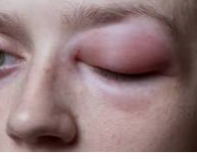

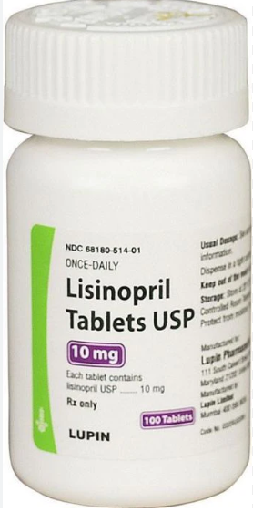
Ace Inhibitors (“-pril”)
Common medications: lisinopril, enalapril, captopril, benazepril, enalaprat
Action:
Prevent the conversion of angiotensin I to angiotensin II, a vasoconstrictor, resulting in
vasodilation and decreased blood pressure
Decrease aldosterone production, resulting in reduced sodium and water retention, which results in lower blood pressure
Prescribed for: HF, HTN, diabetic nephropathy, MI
Adverse Effects: angioedema, persistent dry cough, altered taste, fatigue, h/a, hyperkalemia, hypotension
Contraindications: impaired renal fx, serious autoimmune disease, pregnancy/breast feeding
Nursing Considerations:
Monitor VS, WBC count, electrolytes, especially potassium
Give potassium supplements sparingly due to potential hyperkalemia
Monitor for dry, persistent cough (could also be a sx of worsening HF)
Monitor for/ educate on orthostatic hypotension
Notes:
https://journals.lww.com/nursing/citation/2006/03000/fast_facts_about_ace_inhibitors.52.aspx#:~:text=Nursing%20considerations,-Observe%20your%20patient&text=Give%20potassium%20supplements%20and%20potassium,moexipril%201%20hour%20before%20meals.
Angioedema- swelling of deeper layers of skin, usually affects the eyes\
Cough caused by breakdown of bradykinin- accumulation of bradykinin in pulmonary tree causes cough

Slide 7
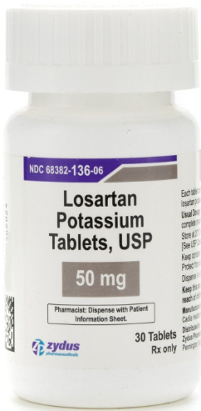
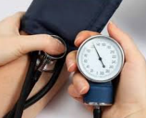
Angiotensin 2 Receptor Blockers (ARB) (“-sartan”)
Common medications: irbesartan, losartan, valsartan, candesartan
Action:
When the body has too much angiotensin II, the body retains fluids, which causes increases BP and constricted blood vessels
ARBs block receptors preventing angiotensin can’t bind and constrict blood vessels
Prescribed for: HTN, HF, kidney disease. Commonly used as alternative to ACEI for those who develop cough. Often prescribed with diuretics
Adverse Effects: hyperkalemia, h/a, fatigue, cough, angioedema, GI reaction
Contraindications: pregnancy, lithium (can cause toxicity), fluconazole can increase
losartan, causing hypotension
Nursing Considerations:
Monitor VS, weight, electrolyte and fluid status,
orthostatic hypotension

Slide 8
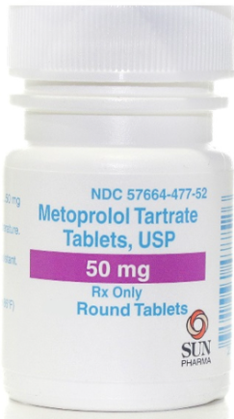
Beta Blockers (“-olol”)
Common medications: bisoprolol, atenolol, metoprolol, labetalol, propranolol
Action:
Inhibit beta-1 adrenergic receptor sites in the heart muscle and conduction system
Results in decreased heart rate, lower demand for oxygen, decreased blood pressure
Prescribed for: HTN, ocular hypertension, vascular migraines
Adverse Effects: bradycardia, angina, peripheral edema, HF, arrhythmia, N/V
Contraindications: impaired renal fx, serious autoimmune disease, pregnancy/breast feeding, bronchiole constriction (do not administer to asthmatics)
Nursing Considerations:
Monitor VS, orthostatic hypotension
Monitor breathing for development of asthma
Stopping abruptly can result in angina, HTN, arrhythmia, MI- taper doses gradually
Notes:
https://nursingcecentral.com/beta-blockers/

Slide 9
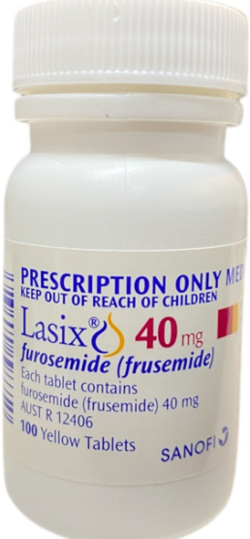
Diuretics- Loop (“-emide”)
Common medications: furosemide, bumetanide, torsemide, ethacrynic acid
Action: Target the Loop of Henle in the kidney nephron- inhibits the Na/K/Cl transporter
Prescribed for:
First line therapy for acute relief of pulmonary and peripheral edema due to HF
Edema associated with liver cirrhosis and renal disease
Adverse Effects: hyponatremia, hypokalemia, increased calcium excretion
(avoid if osteoporosis)
Contraindications: electrolyte abnormality, dehydration, oliguria/anuria
Nursing Considerations:
Monitor VS
Monitor intake and output and electrolyte levels- especially potassium
Avoid aminoglycosides (gentamicin, tobramycin, streptomycin)- can cause
ototoxicity (hearing/balance problems)
Notes:
https://www.nursingcenter.com/ncblog/october-2021/5-classes-of-diuretics
Anuria- lack of urine production

Slide 10
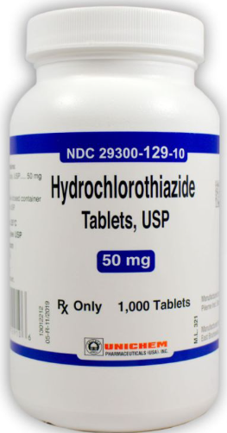
Diuretics- Other
Carbonic Anhydrase Inhibitors- e.g. acetazolamide
Decrease Na and Bicarb reabsorption in proximal tubule
Also used for other diseases- glaucoma, altitude sickness, epilepsy
Adjunctive therapy to treat edema in HF
Potassium-Sparing Diuretics- e.g. spironolactone, triamterene
Interrupt Na reabsorption in the collecting duct
Used with thiazide or loop diuretic to enhance its action; weak diuretic when used alone
Risk of hyperkalemia
Osmotic Diuretics- e.g. mannitol
Increase urinary flow by osmotic retention of water throughout the nephron
Used to decrease intracranial pressure and cerebral edema
Given by IV injection
Notes:
https://www.nursingcenter.com/ncblog/october-2021/5-classes-of-diuretics
Torsade de points (type of ventricular tachycardia)

Slide 11
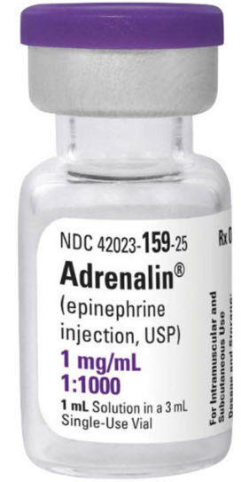
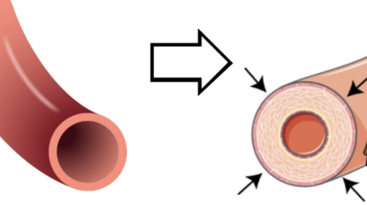
Vasopressors
Common medications:
Vasopressin, phenylephrine, epinephrine, norepinephrine
Epi-pen contains epinephrine, nasal decongestants contain ephedrine/
pseudoephedrine, many cold meds (e.g. Sudafed) contain phenylephrine
Action: Create vasoconstriction or increase cardiac contractility, resulting in
increased perfusion to organs (raise blood pressure)
Prescribed for: systolic HF, pulmonary HTN, septic shock, low blood pressure, heart attack
Adverse Effects: arrhythmias, severe hypertension, blood clot
Contraindications: Not typically any
Nursing Considerations: Typically administered IV,
preferably by central line
Notes:
https://www.ncbi.nlm.nih.gov/books/NBK482411/

Slide 12
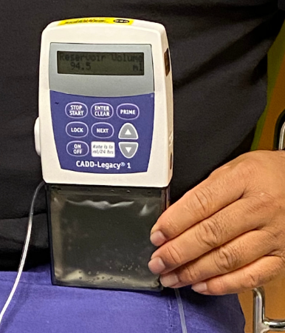
Inotropes
Common medications: dobutamine, milrinone
Action:
Dobutamine: stimulates B1-adrenergic receptors, resulting in increased heart rate and
contractility, increasing cardiac output
Milrinone: inhibits cAMP phosphodiesterase-3 enzyme, which prevents breakdown of cAMP
in cardiac and peripheral smooth muscle, resulting in vasodilation and increased cardiac
contractility
  Independent of b1-adrenergic receptor stimulation so preferred in patients taking beta blocker; better for Right HF
Prescribed for:
End stage HF patients with continued symptoms at rest despite use of conventional HF medications to improve quality of life and reduce episodes of decompensation/hospitalization
Patients awaiting LVAD, heart transplant, long term if not candidate for surgery
Adverse Effects: cardiac arrythmia, hypotension
Contraindications: renal disease (milrinone)
Nursing Considerations:
Intermittent or continuous infusion- Median survival on continuous IV inotropes is 9 to 18 months
Hospice: may be used as palliative therapy and allow patient to return home from hospital for end-of-life care. Plan to taper or dc infusion when sxs worsen rather than increase while using more traditional symptom management medications (morphine, lorazepam)
Notes:
Ginwalla M, Tofovic DS. Current status of inotropes in heart failure. Heart Failure Clijn. 2018; 14:601-616
Tariq S, Aronow WS. Use of inotropic agents in treateement of systolic heart failure. Int J Mol Sci. 2015 Dec4;16(12); 29060-8

Slide 13
Left Ventricular Assist Device (LVAD)
Pump used for patients who have reached end-stage heart failure
Surgically implanted, battery operated, mechanical pump which helps the left ventricle pump blood to the rest of the body
Can be used as:
  Bridge to transplant therapy- patient can use until heart becomes available. In some cases LVAD is able to restore the failing heart, eliminating need for transplant
  Destination therapy- If patient is not a candidate for heart transplant, LVAD can be long term treatment to prolong and improve patient’s life
LVAD (2:38) https://www.youtube.com/watch?v=mOZIYoq32SQ
Notes:
https://stanfordhealthcare.org/medical-treatments/l/lvad.html

Slide 14
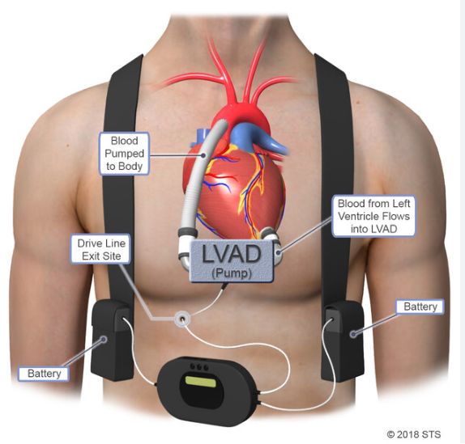
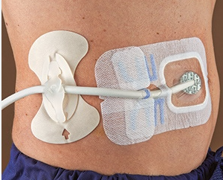
Left Ventricular Assist Device (LVAD)
Dressing change under sterile technique, similar to changing central line dressing
New LVAD patient should have detailed instructions and family member trained on dressing change
Notes:
https://careguides-videos.med.umich.edu/media/t/1_gu4g5b2v/130689761
10 min video, driveline dressing change

Slide 15
Assessment of Patient with LVAD
Auscultate heart sounds: should hear “humming” sound
May or may not be able to detect a blood pressure and pulse- obtain doppler BP if possible
Assess level of consciousness, skin color
If patient is unconscious, unresponsive, pulseless, listen to the patient’s chest. If you hear the humming sound, DO NOT PERFORM CPR. If you cannot hear the LVAD device, CPR can be performed
Defibrillation is okay with LVAD patients
LVAD patients and caregivers should be well educated on VAD and care necessary.
Medications- patient will likely be on HF medications and blood thinner to prevents clots
Notify Fire Department of patient with new LVAD
Notes:
https://www.slideshare.net/allison2007/left-ventricular-assist-device

Slide 16
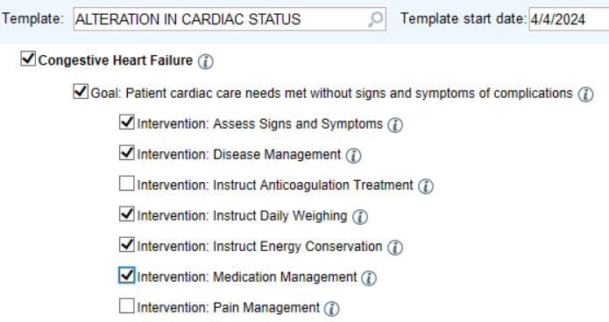
Care Plan for Heart Failure
What Else?
Notes:
Educate about cardiac diet, fluid restriction
Mointor drug efficacy
Labs
Fall prevention, safety, respiratory, pain/comfort

Slide 17
Heart Failure- Interventions
Procedure: HHVNA Circulatory System- ASSESSMENT – HEART FAILURE PATIENT
Teach self management:
  Low sodium diet
  Medications
  Exercise
  Stop smoking, reduce alcohol intake
Obtain orthostatic BP at SOC
  Repeat at each visit if patient has dizziness, change in medication, or other reason to suspect orthostatic hypotension
Teach/monitor daily weight- establish parameters with physician for reporting (e.g. >2lb/day, >5lb/week)
Cardiac auscultation- listen for apical pulse, gallop
Pulmonary auscultation- listen for crackles that do not clear with cough
Assess for peripheral edema
Notes:
https://ourhearthub.ca/what-is-heart-failure/
Shortness of breath, dyspnea on exertion, paroxysmal nocturnal dyspnea

Slide 18
Heart Failure- Goals
Goals of Treatment
Treat underlying cause: CAD, HTN, DM
Slow HF progression and prevent further cardiac damage
Reduce symptoms
Improve quality of life
Prevent hospitalization
When to refer in other disciplines
Decreased activity endurance
Unsafe with ADLS due to fatigue/SOB
MSW if difficulty paying for medications
Goals of Self Management
Monitor symptoms
Maintain daily dry weight log
Restrict sodium and possibly fluid intake
Take medications as directed- pill box, reminders, smartphone apps, etc.
Exercise
Keep follow-up appointments
Notes:
Heidenreich PA, Bozkurt B, Aguilar D, et al. 2022 AHA/ACC/HFSA Guideline for the Management of Heart Failure: Executive Summary: A Report of the American College of Cardiology/American Heart Association Joint Committee on Clinical Practice Guidelines. Circulation. 2022;145(18):e876-e894. doi:10.1161/CIR.0000000000001062

Slide 19
Clinician Toolkit:
Heart Failure Visit Frequency Recommendation
17 total visits over one episode; two 30-day periods
(+ 3 PRN visits for symptom management)
First 30 Days: 7 SN, 2 PT, 1 OT, 1 MSW visit
Second 30 Days: 5 SN, 1 PT visit

Slide 20
Heart Failure Care Pathway
Week 1: Frontload- 3 SN visits within first 7 days of service
GOAL: Patient understands red flags and emergency action plan
Call MD to reconcile meds/ confirm orders/ report assessment/ make recommendations (use SBAR)
Call MD to obtain PRN diuretic parameters
Explore patient/caregiver readiness, confidence, motivations, prior knowledge level
Establish goal with patient- suggest dietary, medication or self-monitoring goal
Teach Red Zone specific to diagnosis, other red flags related to patient risk factors
Teach high risk medications using patient teaching tool (narcotics, hypoglycemics, anticoagulants)
Teach self monitoring
Provide tools for self-tracking of weight and BP

Slide 21
Heart Failure Care Pathway
Weeks 2-4: 4 SN visits (add telephone visit PRN to teach/reinforce or assess)
GOAL: Patient has beginning understanding of self-management and or long-term support plan
Address non-adherence, ambivalence about patient self-management (meds, f/u appointments, self-monitoring)
Teach Yellow Zone management using teach-back
Teach medication management including PRN diuretic use to patient/ caregiver
Initiate discharge planning (MD f/u, long term supportive care referrals, MOLST)
IDT for care coordination by the end of week 2

Slide 22
Heart Failure Care Pathway
Weeks 5-9: 5 SN visits
GOAL: Patient able to teach back zones tool, adheres to medication management and daily self-management
Address non-adherence, ambivalence about patient self-management (meds, f/u appointments, self-monitoring)
Complete pathway teaching (green zone optimal self-management with additional SMART goals)
Referrals for ongoing follow up and support (elder services, specialists, clinics, DME)
Ensure patient has equipment in the house for long-term self monitoring (BP cuff, scale)
Discharge end of week 6 to family/ self support, long-term services
Continue one visit per week through week 9 if patient has ongoing symptoms or medication changes requiring MD intervention and RN oversight

Slide 23
Heart Failure Care Pathway
Core Concepts:
Variance from visit frequency pathway and/or obstacles to goal attainment are discussed with team clinical manager immediately
Changes in condition are promptly reported to MD using SBAR and making appropriate recommendations
When therapy disciplines are indicated, alternate visits with therapy so that patient does not have multiple visits scheduled in a single day
Multidisciplinary care coordination- communicate need to monitor vs. reinforce teaching; use all available clinical resources effectively
Maintain continuity – prioritize primary clinicians for frontloaded visits, introduction of new key concepts
Incorporate patient education, plans for next visit in documentation/ narrative note

Slide 24
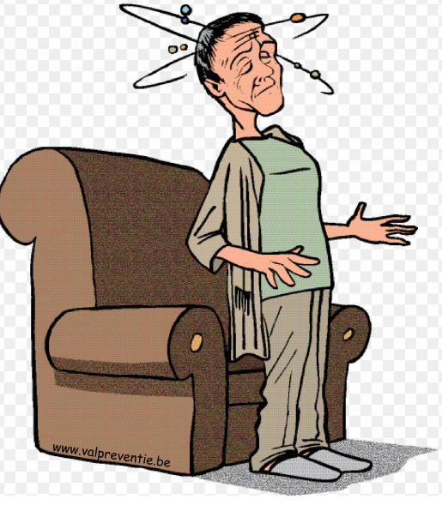
Orthostatic Hypotension
Procedure: HHVNA Circulatory System- BLOOD PRESSURE
Orthostatic hypotension is defined as a decreased in systolic pressure > 20 mmHg
or decrease in diastolic pressure >10 mmHg within 3 minutes of changing from
supine to erect position
Orthostatic hypotension occurs when blood pools into the abdomen and legs
when quickly changing from lying to upright position
Many conditions, such as aging and cardiovascular medications, interrupt the compensatory mechanisms, which normally stabilize the blood pressure
At SOC- measure BP in both arms, since 6% of patients have differences between arms. Make subsequent readings on arm with higher reading

Slide 25
Measuring Orthostatic Blood Pressure
Procedure: HHVNA Circulatory System- BLOOD PRESSURE
Have patient lie supine for at least 5 minutes
Take pulse and BP. Keep BP cuff in place until readings completed
Instruct patient to sit
Immediately take pulse and BP again
Instruct patient to stand (guard patient in case of dizziness)
Support patient’s arm in yours, so it is at the same angle as when supine
Take pulse and BP again
If significant change in BP or pulse is noted, take additional measure in 2-5 minutes

Slide 26
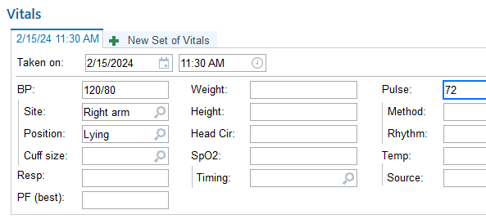
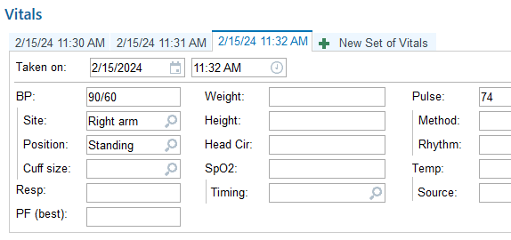
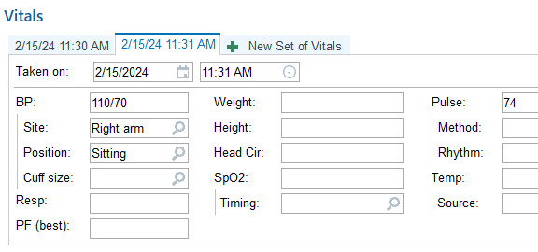
Documentation in Epic- Orthostatic BP
Click on “+ New Set of Vitals” to add additional set
Be sure to fill in accurate time and position
Orthostatic BP must be obtained and documented at SOC for ALL patients. Then obtain every visit for CHF patients or patient with history of orthostatic hypotention

Slide 27
Modified Borg Dyspnea Scale
Tell me how you are breathing right now.
Measure | Description | How do I feel?
0 | No difficulty at all | I am comfortable and breathing easily
½ | Very, very slight
1 | Very slight
2 | Slight | My breathing is a bit light and I am beginning to feel some difficulty breathing
3 | Moderate
4 | Somewhat severe
5 | Severe | I am having a lot of trouble catching my breath. It is hard to carry on a conversation
6
7 | Very severe
8 |  | I am completely breathless. I need medical help right away.
9 | Very, very severe
10 | Maximum
How is your breathing difficulty now compared to your breathing the last time you were asked?
Much less difficulty breathing | A little less difficulty breathing | About the same difficulty breathing

Slide 28
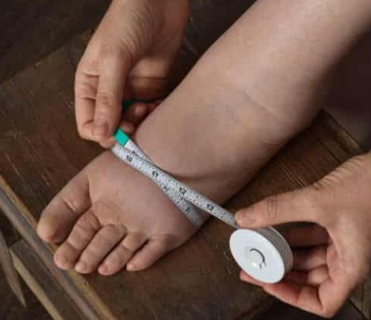
Measuring Edema
Procedure: HHVNA Circulatory- ASSESSMENT: EDEMA
Multiple ways of measuring peripheral edema have been suggested in the literature Currently, the literature does not agree on the best methods, and no method passes the test for a reliable, valid standardized tool that can be used in clinical practice
TMCAH has determined that, for consistency, the measurement of extremities will be used for all pitting and non-pitting edema
The use of digital pressure measurement may be used only as a secondary description of pitting edema
Instep: 12.5 cm from big toe
Ankle: 10 cm from heel
Lower leg (calf): 28 cm from heel
Abdominal girth: at the level of the umbilicus

Slide 29
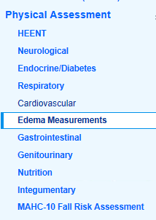
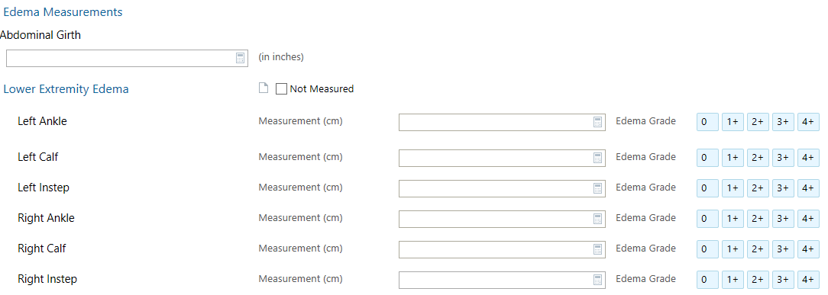
Documentation in Epic- Edema
Measurement of edema must be obtained at SOC and at every visit for all CHF patients and any patient with history of edema

Slide 30


Disease Folder- Hearts at Home
Booklet/ Caring for Your Heart: Living with Heart Failure
Guide to disease, medications, diet, exercise
Daily weight
When Should I Call
Handouts
Welcome to Hearts at Home
Zone Tool
S.M.A.R.T. Goal
Making Healthy Changes that Last
Patient Teaching- High Risk Medicine

Slide 31
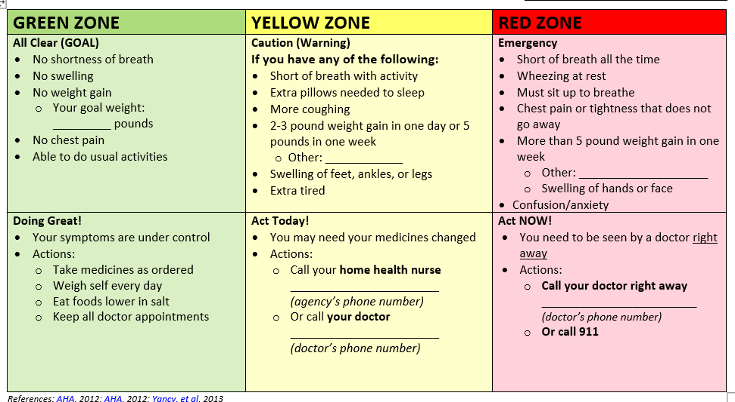
Heart Failure Zone Tool
Notes:
*******DIFFERENT HANDOUT IN FOLDER********

