Slide 1
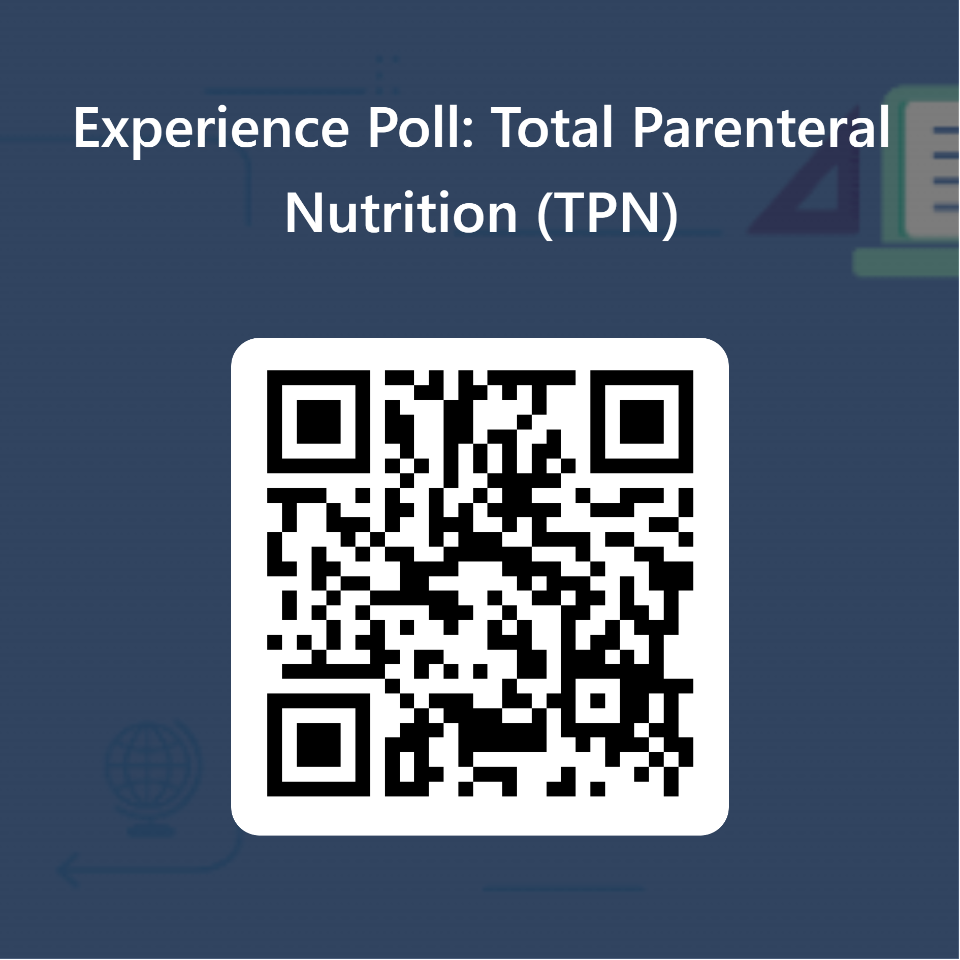
Scan to respond to the pre-training poll Your answers are anonymous

Slide 2


Slide 3
Total Parental Nutrition (TPN) First-Dose Training Safe Practice for Home Infusion
Clinical Staff Development: Nicole M. Tsoukalas, MSN, APRN, FNP-C August 2025

Slide 4
Training Objectives
Regulatory alignment (MA/NH, CMS, Joint Commission, Infusing Nurses Society, ASPEN/ESPEN).
RN role in safe practice.
First-dose workflow in the home.
Complication recognition & emergency response.
Patient/caregiver teaching essentials.

Slide 5
Nursing Practice
BORN MA/NH Nurse Practice Act
Department of Public Health (DPH/DHHS))
CMS
FDA
OSHA
Joint Commission
INS
ASPEN

Slide 6
Indications for TPN
When enteral feeding is not feasible due to GI dysfunction:
Bowel Obstruction
Short bowel syndrome
Severe Irritable Bowel Disease (IBD) flare (Crohn’s Disease, Ulcerative Colitis)
High-output fistula
Severe malabsorption or intolerance to enteral nutrition
Severe malnutrition pre/post major surgery or ins critical illness

Slide 7
Total Parenteral Nutrition (TPN)
Direct IV Nutrition
Protein & Nitrogen Balance
Energy Supply
Electrolyte & Fluid Homeostasis
Micronutrient Support
Bypassing Impaired GI Function
TPN works by providing complete system nutrition intravenously, bypassing the gut, to meet metabolic demands, prevent catabolism, and maintain organ and immune function until oral or enteral feeding becomes possible.

Slide 8
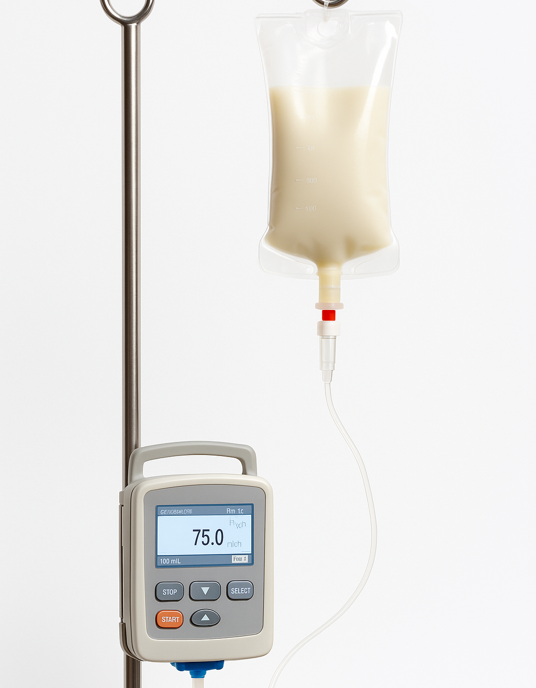
What is TPN?
TPN Components:
Macronutrients: Carbohydrates (dextrose), Proteins (amino acids), Fats (lipid emulsions)
Micronutrients: Electrolytes, trace elements, vitamins, minerals
Water (fluid balance)
Goals of Treatment
Maintain or restore nutritional status
Promote healing
Prevent Malnutrition

Slide 9
Amino Acids ~ 15-20%
Lipids ~ 20-30%
Carbohydrates ~ 50-60%
Electrolytes Vitamins Trace Elements

Slide 10
Patient Selection: Indications
Intestinal/Bowel Obstruction
Bowel Pseudo- Obstruction (with food intolerance)
GI Fistulas with High Flow (rest the bowel)
Infant GI system immaturity or congenital GI malformation
Post-op bowel anastomosis leak
Severe diarrhea/vomiting and inability to maintain nutritional status
Hypercatabolic state (due to sepsis, polytrauma, and/or major fractures)
NPO status >7 days (e.g., inflammatory bowel disease, critically ill patients)

Slide 11
Patient Selection: Contraindications
Infants with less than 8cm of the small bowel
Critical cardiovascular or metabolic instability – which would require correction before administering IV nutrition
When GI feeding is possible (e.g., enteral feedings)
If/when nutritional status is “good” – TPN is no longer needed
TPN should not be sued to prolong life when death is inescapable

Slide 12
Criteria for Patient Acceptance to CAH
Clinically stable: Indications for TPN are clear; nutritional status requires parenteral support; patient tolerates central venous access device; and baseline labs corrected/stabilized before discharge/start of TPN.
Central Line & Vascular Access: Central venous access device in place and functioning, site free of infection or thrombosis, and patient/caregiver willing and able to maintain sterile technique and dressing care.
Caregiver & Patient Capacity: Physically and cognitively able to perform or assist with line care, pump operation, and aseptic technique; recognize complications; follow daily monitoring; demonstrate competency via teach-back/return demonstration; and reliable support system available.

Slide 13
Criteria for Patient Acceptance to CAH continued….
Home Environment: Clean, stable environment with space for sterile setup; refrigerator for TPN storage; running water, electricity, and emergency phone access; and safe disposal method for sharps and used supplies.
Multidisciplinary Support: Prescriber (MD/NP) available for urgent issues; pharmacy partner able to compound and deliver TPN safely and on schedule; home infusion agency/RN staff trained and competent for first-dose administration and ongoing monitoring; and access to emergency care.
Regulatory & Payer Requirements: Meets with CMS coverage criteria for parenteral nutrition in the home; agency policies comply with Joint Commission, INS Standards of Practice, ASPEN/ESPEN guidance, MA/NH Nurse Practice Acts, and reimbursement/insurance approval for home TPN is confirmed.

Slide 14
TPN First-Dose verse Subsequent Doses

Slide 15
Unlike routine IV medications… TPN is high-alert, high-risk, and patient-specific. The 10 Rights of Medication Administration serve as a checklist that forces you (the RN) to validate every safeguard (order → compounding → line → monitoring → documentation)

Slide 16
Difference between TPN First Dose vs. Subsequent Doses
First Dose
Highest Risk for a Side Effect
NEW Therapy: Patient’s metabolic and infusion tolerance is unknown
Risk of infusion reaction, electrolyte derangement, fluid shifts
Requires RN presence and continuous monitoring for at least 60 minutes after starting infusion.
Subsequent Doses
Typically managed by caregiver at home (after training)
RN role shifts to monitoring, education reinforcement, troubleshooting
Risk is lower BUT ongoing vigilance is needed

Slide 17
ASPECT | FIRST DOSE | SUBSEQUENT DOSES
Who Can Administer | RN Only | Trained caregiver (with RN oversight)
Monitoring Intensity | Continuous: Vitals every 15 to 30 minutes | Routine, per protocol
Risk Level | Highest (reaction, electrolyte shifts) | Lower, but infection/metabolic risk
RN Role | Direct infusion, emergency readiness | Reinforcement, troubleshooting
Documentation | Full Details: Order, labs, teaching, assessment (including vitals) | Tolerance, adherence, ongoing issues

Slide 18

You Are The NET!!!

Slide 19
RN Workflow TPN and TPN @ SOC

Slide 20
Best Practice
TPN first-dose visit is likely coinciding with the Start of Care (SOC) visit.
You have more assessment requirements for the SOC than for the first-dose of TPN however, TPN requires a specific focused assessment that can (and should) be incorporated into your SOC process.
Pre-visit prepping will set the “stage” for your visit
1. Begin with an agenda. 2. Lead the visit flow.
3. Acknowledge concerns completely & confirm understanding. 4. Keep patient safety and clinical tasks the priority!

Slide 21
TPN First-Dose Administration
Pre-Visit
Arrival
Setup
Monitoring
Documentation
Teaching
Wrap-up

Slide 22
Pre-Visit Preparation
Review provider order, pharmacy compounding sheet, and patient’s most recent labs (electrolytes, glucose, renal/hepatic, triglycerides).
Confirm TPN bag availability, correct storage (2-4°C), and within expiration.
Ensure required supplies are delivered to the home:
Central line access equipment (flushes, sterile gloves, dressing change kit, disinfection caps).
Infusion set with correct filter (0.2 micron without lipids, 1.2 micron with lipids).
Solis CADD pump, AC power, spare batteries.
Emergency contact information and agency escalation numbers.

Slide 23
Pre-Visit “Pitfalls”
What Can Go Wrong / Pitfalls
Patient or caregiver is/was not informed, and no one is available to assist.
TPN bag not delivered, expired, or still cold from refrigeration.
Missing supplies (filters, tubing, batteries, PPE).
Labs not completed or results not reviewed before infusion.

Slide 24
Arrival & Environmental Setup
Introduce yourself; verify two patient identifiers (name, DOB).
Explain the visit flow to the patient & caregiver (set expectations, confirm caregiver presence if applicable).
Assess home environment for:
Clean workspace
Refrigerator for TPN storage
Safe sharps and trash disposal areas

Slide 25
Arrival & Setup “Pitfalls”
What Can go Wrong / Pitfalls
Patient unprepared for the visit and there is no clean or safe work area.
Pets, children, or distractions in the infusion/care space.
Poor lighting or lack of clean surface for sterile setup.
No sharps container or safe waste disposal available.

Slide 26
Pre-Infusion Assessment
Perform hand hygiene and don PPE.
Inspect central line site: Check for redness, swelling, drainage, dressing integrity.
Verify line patency: Blood return and saline flush without resistance.
Obtain baseline vitals (BP, HR, RR, Temp, O₂ sat).
Re-review TPN bag: Clarity, no precipitate, warmed to room temperature (~1-2 hours out of the fridge).
Verify order against pharmacy label (components, additives, rate, volume, expiration).

Slide 27
Pre-Infusion “Pitfalls”
What Can Go Wrong / Pitfalls
Central line site shows redness, drainage, or is non-patent.
RN attempts to use a non-dedicated lumen.
Failure to flush/confirm patency before infusion.
Dressing loose or soiled, but no supplies to change it.

Slide 28
Equipment Setup
Place sterile barrier on a clean surface.
Prime tubing with correct in-line filter, ensuring no air.
Load tubing into Solis CADD pump.
Program pump settings (VTBI, infusion rate, duration).
Double-check programmed settings against order and pharmacy label).

Slide 29
Equipment “Pitfalls”
What Can Go Wrong / Pitfalls
Pump not charged; no AC power or spare batteries.
Wrong filter size used (0.2 vs 1.2 micron).
Tubing not primed fully air in line.
Pump settings entered incorrectly (rate, VTBI, duration).
Pharmacy label/order mismatch overlooked.

Slide 30
Initiating Infusion
Connect tubing to dedicated lumen of CVAD (never share with other infusions).
Start infusion on Solis CADD pump.
Remain with the patient during monitoring period (at least first 30 to 60 minutes).

Slide 31
Monitoring During Infusion
Re-check vitals at 15-30 minutes.
Observe for:
Hypersensitivity (rash, SOB, chest pain, wheezing).
Infusion reaction (fever, chills, back pain).
Fluid overload (edema, crackles, hypertension).
Electrolyte imbalance (arrhythmias, confusion, weakness).
Verify pump function and alarms.
Check blood glucose as ordered (baseline + 1-2 hours after infusion initiation, especially in diabetics or high-risk patients).

Slide 32
Infusion “Pitfalls”
What Can Go Wrong / Pitfalls
RN leaves patient too soon (especially during the first 30 to 60 minutes of the infusion).
Missed early signs of hypersensitivity (rash, SOB, chest pain).
No baseline or repeat vitals documented.
Blood glucose not checked when indicated.
Alarms ignored or silenced without troubleshooting.

Slide 33
Emergency Response
Emergency Response (if needed)
Stop infusion maintain IV access assess ABCs.
Know when to call 911 verse prescriber; call 911 for severe/life-threatening reaction.
Know your agency protocol escalation.
Document event, interventions, and patient outcomes.
Ensure you have available supplies on-hand (gloves, batteries, emergency numbers).

Slide 34
Patient & Caregiver Teaching
Review:
Purpose of TPN and schedule
Pump basics: Start/stop/silence alarms.
Line care: Hand hygiene, site checks, “scrub the hub”.
Signs/symptoms to call RN vs. 911.
Safe storage and disposal of supplies.
Use teach-back/return demonstration with caregiver.
Leave written materials/checklists.

Slide 35
Patient & Caregiver “Pitfalls”
What Can Go Wrong / Pitfalls
RN allows patient to dominate the visit, derailing structured teaching.
Education rushed; no teach-back or return demonstration.
Caregiver unsure what to do in case of alarm or reaction.
Emergency contact process not reviewed.

Slide 36
Post-Infusion / Departure
Stop pump and disconnect tubing aseptically; teach caregiver/patient.
Flush and secure central line per protocol; teach caregiver/patient.
Apply disinfection cap to lumen; teach caregiver/patient.
Reassess vitals and/or patient tolerance; teach caregiver patient.
Ensure supplies are stored safely; sharps disposed of correctly.
Reinforce caregiver education and answer questions.
Confirm follow-up plan: Daily labs (~3-4 days to monitor stability), next infusion, RN visit schedule.

Slide 37
Documentation
Document in EPIC:
Pre-infusion safety checks (orders, labs, baseline vitals, line status).
Infusion details (start/stop, settings, filter type).
Patient tolerance, vitals, teaching provided, caregiver response.
Any adverse events, interventions, or notifications.
Ensure documentation meets CMS, Joint Commission, MA/NH regulatory standards.

Slide 38
Visit Departure “Pitfalls”
What Can Go Wrong / Pitfalls
Line not flushed or secured properly after disconnect.
Supplies not disposed of safely.
Incomplete documentation; missing vitals, start/stop times, and/or education provided.
Regulatory documentation (CMS, Joint Commission, MA/NH BON standards) not met.

Slide 39
First-Dose TPN Administration & Start of Care

Slide 40
SOC Best Practice Flow (CMS, Joint Commission, MA/NH BOR, DPH) | First-Dose TPN Overlay (INS, ASPEN/ESPEN, MA/NH BOR)
Pre-Visit Prep Review referral, medications, labs; Confirm visit time; Bring SOC packet and education materials | Confirm TPN bag delivery, storage, expiration; Ensure pump, filters, supplies available; Remind caregiver presence is required
Arrival & Introduction Verify patient identifiers; Review rights & visit agenda | Set expectations: SOC + first infusion today; Confirm caregiver availability
Home Safety Assessment Evaluation environment, falls, infection risk; Confirm safe disposal plan | Assess clean workspace for sterile setup; Check refrigerator for TPN; Confirm emergency phone access
Comprehensive Assessment Vitals, health history, medication reconciliation; OASIS documentation/requirements; Physical assessment | Inspect central line site & dressing; Verify line patency; Review baseline labs (electrolytes, glucose, renal/hepatic, triglycerides)
Care Planning Identify skilled needs & goals; Create individualized plan of care | Incorporate TPN schedule, lab monitoring, teaching plan into POC
Medication/Treatment Setup Verify medication list with patient; Teach high-alert medications | Verify TPN order verse pharmacy label; Warm bag, inspect for clarity/precipitates; Prepare pump & tubing with filter
Treatment Initiation Provide ordered skilled service(s) | Connect to dedicated lumen; Program Solis CADD pump; Start infusion; Stay with patient 30 to 60 minutes (plan for 60 minutes)
Monitoring & Teaching Assess vitals, pain, response to treatment; Provide SOC education | Vitals at 15-30 minutes; Watch for hypersensitivity, reactions; Teach caregiver: Pump basics, line-care, red flag symptoms
Post-Treatment Care Reassess vitals; Reinforce education; Supply & safety check | Stop pump & disconnect (or teach caregiver/patient); Flush line and secure lumen; Reassess tolerance; Confirm supply storage & sharps disposal
Documentation Summarize plan of care; provide emergency contacts; Confirm understanding | Document pre-checks, infusion details, patient tolerance, caregiver teaching, adverse events
Visit Closure: Summarize plan of care; Provide emergency contacts; Confirm understanding | Reinforce when to call RN vs. 911; Confirm caregiver competence; Review follow-up labs and next infusion

Slide 41
TPN Administration Guidelines

Slide 42
CVAD
TPN Must be given via central line access device (CVAD).
PICC; Tunneled catheter (Hickman, Broviac); Implanted Port
You cannot use a peripheral line due to the hyperosmolar contents & risk of phlebitis and/or tissue damage.
RNs use sterile technique for dressing changes, proper catheter site cleaning (chlorhexidine use), flushing protocols, and hub/connector disinfection (“scrub the hub”).
TPN infusions can be continuous (24-hours) or cyclic (12 to 18 hours).
Line Safety: Dedicated lumen ONLY (do not piggyback medications)
Filters: 0.2 micron (without lipids); 1.2 micron (with lipids)
Aseptic Technique: Critical to prevent infection/CLABSI (a lab-confirmed bloodstream infection

Slide 43
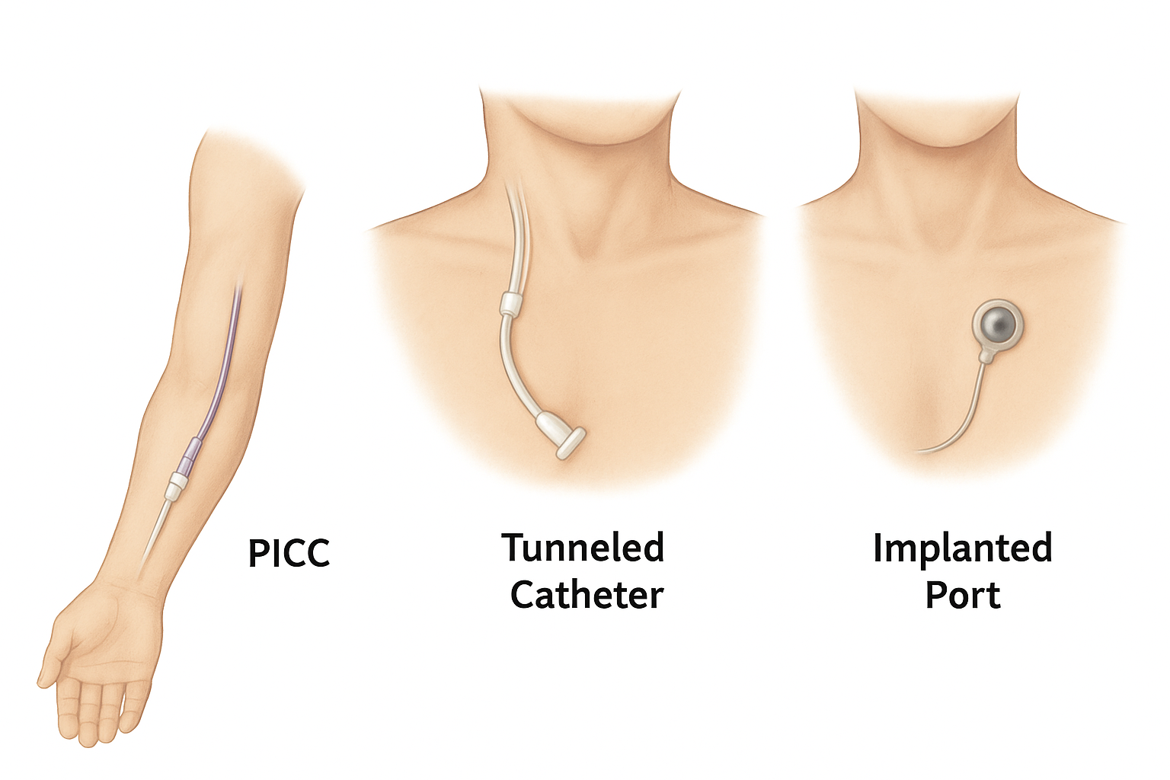

Slide 44
Safety Considerations & Monitoring
Baseline labs:
Electrolytes, glucose, liver/kidney function (CMP), triglycerides
Baseline Vitals:
Temperature (infection screen); Heart rate; Respiratory Rate; Blood Pressure; O₂ Saturation; Weight
Ongoing Monitoring:
First 3-4 days after the first dose OR until stable
Glucose (typically before infusion, then every 4-6 hours until stable, then may be reduced to daily or pre-infusion checks
Weight (daily if unstable, otherwise weekly)
Intake/Output (urine, stool, ostomy, drains)
Symptoms of electrolyte disturbance (confusion, weakness, arrhythmias)
Symptoms of fluid imbalance (edema, crackles, SOB)
Weekly:
Labs (CMP), Magnesium, phosphate, calcium, triglycerides (especially with lipids), CBC (if at risk of infection or anemia); Weight (compared to baseline, monitor for weight gain); Nutritional Status (functional status, healing, strength, appetite – if transitioning to enteral/oral), signs of over/underfeeding.

Slide 45
Safety Considerations & Monitoring Continued…..
Monthly to Quarterly:
Comprehensive labs (as patient stabilizes (micronutrients, vitamins, trace elements (zinc, copper, selenium, manganese), liver function tests
Central Line Maintenance:
Dressing changes at least every 7 days (or sooner if soiled/loose); Connector/cap changes per police (usually every 96 hours)
Interdisciplinary Review:
Provider, pharmacist, dietician, RN collaborate on ongoing regimen adjustments; Evaluate potential to reduce or transition TPN if gut function improves
At Every Home RN Visit (regardless of frequency):
Vital signs and focused assessment; Line site/dressing check; Infusion bag/tubing check; Teaching reinforcement with caregiver; Documentation of tolerance, complications, and inteventions

Slide 46
Central Line Access & Care
Inspect Site
Redness
Swelling
Drainage
Dressing Intact
Verify patency before infusion (blood return, flush without resistance)
Dressing Care: Changed every seven (7) days (or sooner if soiled/loose)
Dedicated lumen for TPN only

Slide 47
Monitoring During Infusion
Stay with patient during infusion initiation
Recheck vital signs at 15-30 minutes, then per policy
Observe for:
Hypersensitivity reaction (rash, shortness of breath, chest pain, wheezing)
Infusion-related reactions (fever, chills, back/chest pain)
Fluid overload (edema, crackles, hypertension)
Electrolyte imbalance symptoms (weakness, arrythmias, confusion)
Check pump function: Correct rate/volume, no alarms

Slide 48
Be Prepared
TPN mixture should be removed from the refrigerator 2 hours before use to allow it to be brought to room temperature
TPN mixture preparation should only be managed in a clean – sterile spot. Choose a smooth surface that is not near an open window or doorway. Clean the surface and dry with a paper towel.
Gather supplies
A sterile barrier
TPN solution administration set
1 or 2 (10 mL) syringes
Insulin syringe (if needed)
Alcohol wipes
Multivitamin infusion (MVI), as ordered
A sharps container
Trash disposal

Slide 49
Be Prepared (continued)
Perform hand hygiene
Place sterile barrier on clean surface
Prepare alcohol wipes
Remove syringes from wrappers, push in the plungers, place on a sterile barrier
Take the TPN out of its protective bag. Check for cloudiness, particles or change in color. If lipids (fat) have been added to the bag, check the solution for fat or separation of the lipids from the solution – If any of these is detected DO NOT USE the mixture and return it to infusion company
Place the solution bag on the sterile barrier
Remove the TPN administration set from its container. Close the roller clamp and place the set on the sterile barrier
Gather any prescribed medications and place them on the sterile barrier.
Declutter prior to administration, throw out any trash

Slide 50
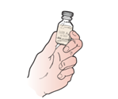
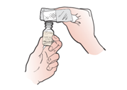
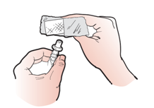
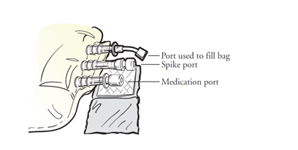
Preparing & Adding Medications to TPN
Check the medication label and expiration date.
Take the protective cover from the top of the medication bottle. Clean top of bottle with wipe.
Clean the medication port of the TPN bag with an alcohol wipe. The medication port may be located on the outside or middle of the TPN bag.
Open another alcohol wipe fully and put the clean medication port on a new alcohol wipe.
Using appropriate syringe prepare medication dose. Put the needle into the medication port on the TPN bag and inject. Dispose of syringe in sharps container. Repeat process for all medications prescribed.

Slide 51
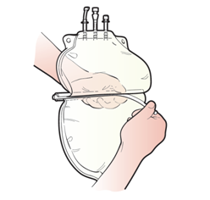
Preparing and Adding Medications to TPN (cont.)
Gently rock the TPN bag to mix the medication(s) into the mixture. The mixture will go from clear to yellow. Check for cloudiness or participates. If discoloration, cloudiness or particles are observed – do NOT use the bag. Prepare a new bag.
Note: If you added medication the middle divider can now be removed from the TPN bag, if you have one. Then gently rock the bag as above.

Slide 52
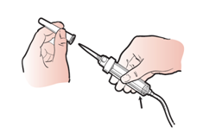
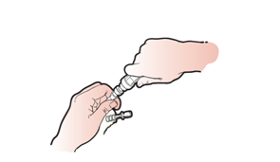
Attaching the administration set to the TPN Bag
Take the protective covering (pull-tab) off the TPN bag spike port and put it on the sterile barrier. Do not touch the exposed end or let it come in contact with anything.
Remove the protective covering.
Insert the tip of the administration set completely into the spik port of the TPN bag using a twisting motion.

Slide 53
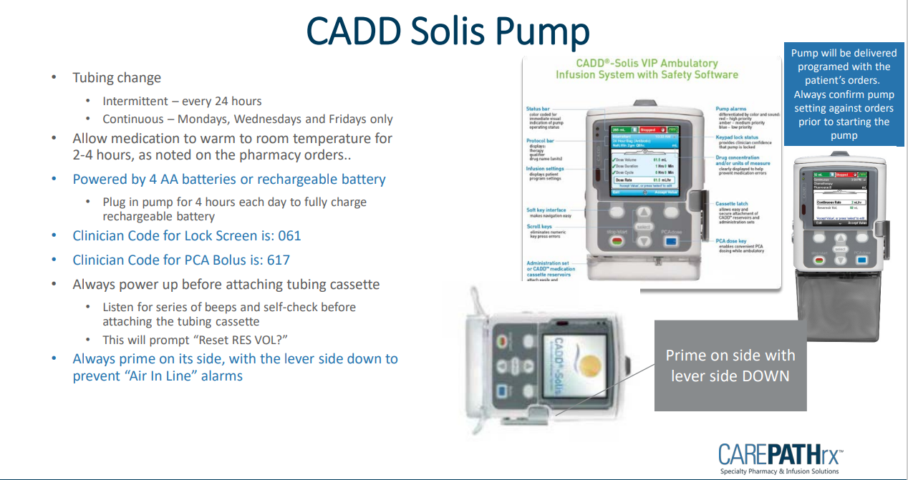

Slide 54
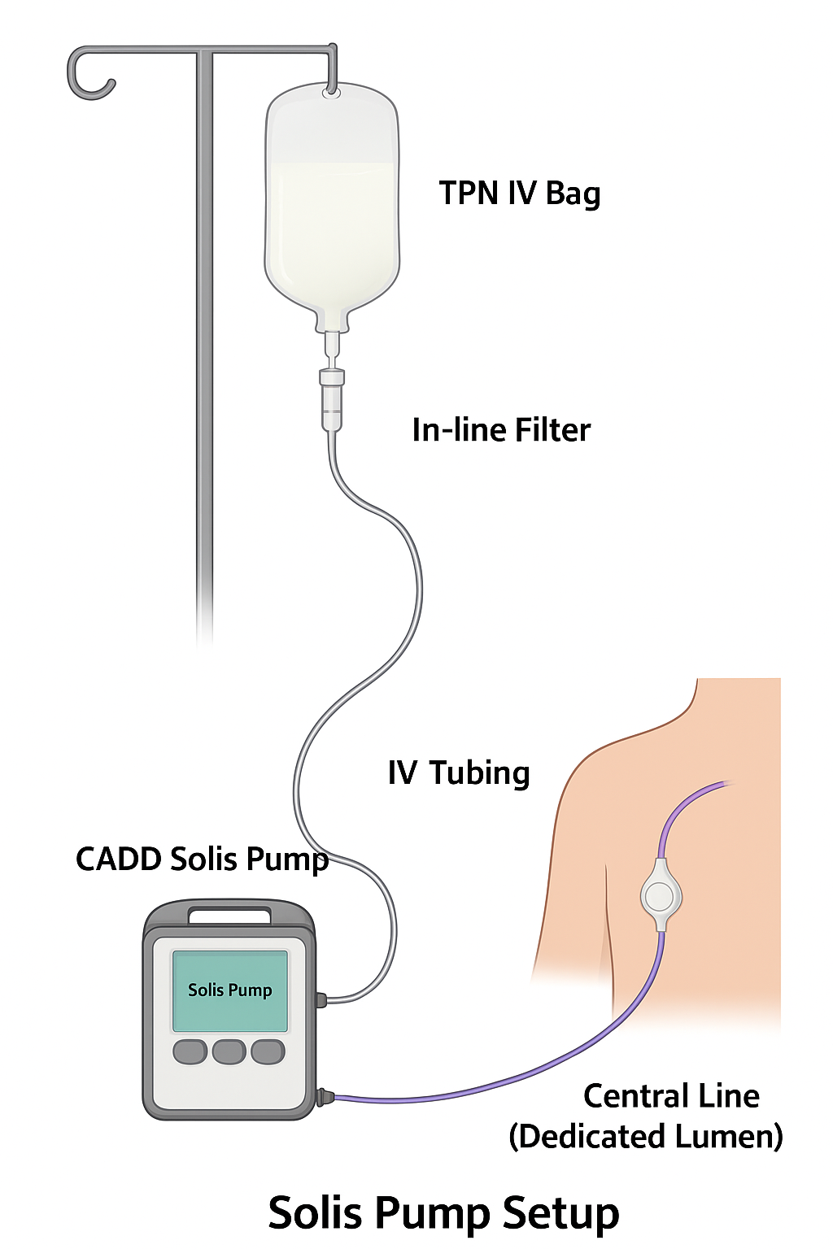
Pump Setup
Verify solution label vs. provider order before programming
Load tubing with in-line filter (0.2 micron without lipids; 1.2 micron with lipids)
Prime tubing fully to eliminate air
Connect to dedicated central line lumen
Double-check all programmed settings before starting infusion

Slide 55
Programming Steps
Turn pump on
Confirm battery or AC power connected
Select therapy mode (continuous or cyclic)
Enter volume to be infused (VTBI) and rate per order
Confirm with a second check (read-back of order vs. pump screen)
Start infusion and observe for initial flow

Slide 56
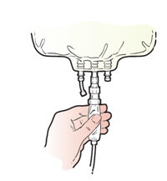
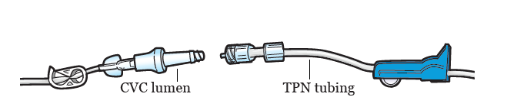
Infusion Process
Hang TPN bag on IV pole. With end of tubing over a trash (not touching) squeeze the chamber of the administration set 1 time
Open the roller clamp and let the solution fill the entire length of the tubing, including the filter. When the tubing is filled close the roller clam.
Thread the tubing through the infusion pump.
Clean the CVC connection at the end of the lumen with an alcohol wipe.
Flush the lumen that you will be using for infusion with 10 mL of normal saline
Remove the protective cap from the TPN tubing
Attach TPN tubing to the CVC lumen. If multiple lumen exist switch between them. Do not touch any open connections.

Slide 57
Disconnecting the TPN Tubing & Flushing CVC
When infusion is completed TPN will be disconnected.
Gather supplies
One pre-filled 10 mL syringe of normal saline (1 syringe is needed per lumen)
Nonsterile gloves
Alcohol wipes
One disinfection cap for each lumen
Perform hand hygiene and apply PPE
Turn infusion pump off
Close claim on TPN tubing and disconnect the TPN tubing from the CVC
Unclamp lumen, remove any cap. If no disinfection cap is present, use alcohol wipe on end of needless connector for 15 seconds allow to air dry for 15 seconds
Push saline into lumen
Attach disinfection cap to the end of the needleless connector
Repeat for each lumen.
Throw away trash
Perform hand hygiene

Slide 58
Blood Glucose Monitoring
High dextrose concentration can cause hyperglycemia
First dose: Check blood glucose at baseline, then as ordered (often at the 1 to 2-hour mark)
Diabetic or high-risk patients: Close monitoring may be needed
Document results and provider notification (if abnormal)

Slide 59
Complications

Slide 60
ASPECT | HOSPITAL SETTING | HOME CARE SETTING
Environment | Controlled; Sterile Environment | Uncontrolled (pets, children, clutter, refrigerator)
Staffing | Continuous monitoring by multiple clinicians | Intermittent RN visits; Care-Giver led Care
Supplies & Equipment | Readily available (pumps, filters, emergency medications) | Limited to what is provided by infusion program
Emergency Response | Rapid response team Code Team available | RN must call 911 Delayed EMS response possible
Infection Control | Hospital Infection-Prevention Infrastructure | Dependent on patient/caregiver compliance and RN teaching
Documentation | Charted in EMR with frequent inpatient monitoring | Charted in EMR remotely by RN, less continuous oversight
This comparison table reinforces why homecare first-dose TPN requires strict adherence to protocol – because the safety net is thinner outside of the hospital

Slide 61
Emergency Readiness in the Home
Be prepared for infusion reactions (rash, shortness of breath, anaphylaxis)
Follow agency emergency protocol: Stop the infusion, maintain IV access, call 911, notify provider
Keep supplies available: Gloves, masks, extra tubing, batteries, sharps container
Caregiver must know when/how to call RN or emergency services

Slide 62
Risks & Complications
Metabolic
Electrolyte Shifts (K, Mg, Phos)
Infections
Central line-associated bloodstream infection (CLABSI)
Mechanical
Allergic reaction (lipids)
Infusion-Related
Hyper/Hypoglycemia
Liver dysfunction
Catheter occlusion
Dislodgement
Pump malfunction
Fluid overload
Venous Access
Pneumothorax; Air Embolism; Bleeding; Venous Thrombosis; Vascular Injury
Refeeding syndrome

Slide 63
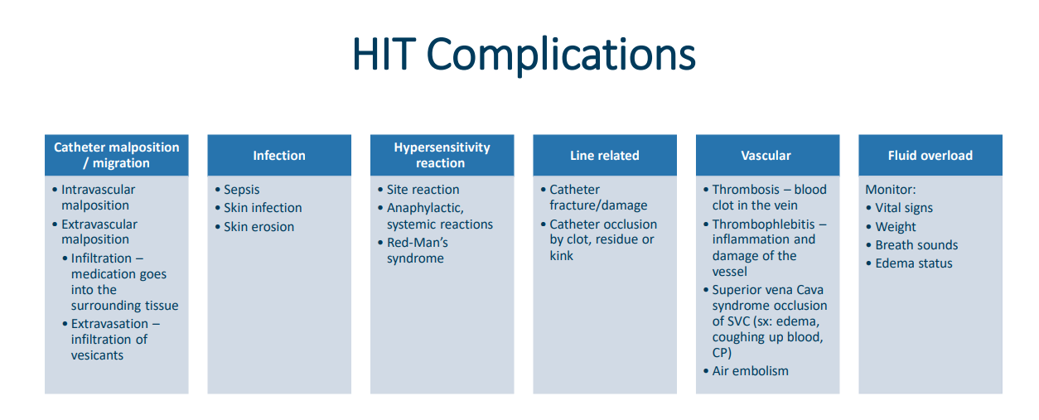
Recognizing and Preventing Infections

Slide 64
Refeeding Syndrome Metabolic Complication
Refeeding syndrome can occur in severely malnourished and cachectic individuals when feeding is reintroduced and can lead to severe electrolyte instabilities.
Refeeding syndrome can correlate with hypophosphatemia, respiratory distress, rhabdomyolysis, and acute kidney injury.
Prevention of refeeding syndrome is critical and achievable with a slower initial infusion of TPN than expected.

Slide 65
Toxicity
Toxicity of TPN is related to the individual toxicity of its components.
Glucose and lipid excess can lead to hepatic toxicity
Glucose infusion rate greater than 5mg/Kg/min can result in fatty liver
Long-term usage of TPN, ranging from weeks to months, can be associated with rare complication of manganese toxicity

Slide 66
Alarms & Troubleshooting
Occlusion Alarm:
Check clamps, catheter patency
Air-in-Line Alarm:
Re-prime tubing, check connections
Low Battery:
Plug into AC or replace batteries
Door Open / Set Not Loaded:
Reload tubing correctly
You (the RN) are responsible if the alarm is unresolved → escalate to infusion company AND provider

Slide 67
Backup & Safety
Always plug into AC when possible
Carry spare batteries at each visit
Keep backup pump access available (through infusion company – know your phone numbers/access points)
Caregiver should know how to silence alarm, check screen, and call RN/Infusion Company for help

Slide 68
Emergency Response
Immediate action required if reaction is suspected:
Stop infusion
Maintain IV access with saline if ordered
Assess: Airway, Breathing, Circulation (ABCs)
Call 911 if severe or life-threatening
Notify provider per protocol
Document event, interventions, notifications, and patient outcome

Slide 69
Delivering TPN in the Home Patient and Caregiver Education/Training
Assess, Set Goals with Patient, Teach-back, Repeat = Patient Engagement and Goal Attainment

Slide 70
Patient & Caregiver Teaching: Why it Matters
Essential for safe long-term home TPN
Reduces complications (infection, metabolic instability)
Promotes patient independence and confidence
Required by CMS, Joint Commission, and State DPH/DHHS for safe discharge and ongoing care

Slide 71
Core Teaching Topics
Purpose of TPN and why it is needed
Central Line Care: (hand hygiene, site checks, aseptic technique)
Pump Operation Basics: Start, stop, silence alarms
Recognizing Complications: Fever, chills, rash, chest pain, shortness of breath
Daily Monitoring: Weight, temperature, glucose (if ordered)
Supply Management: Safe storage and disposal

Slide 72
Patient Education
Procedure for medication administration, to incorporate infection control, standard precautions for caregivers, aseptic non-touch technique (ANTI), hand hygiene
Risks, benefits, side effects and goal of treatment
Activity precautions
Proper care of access
Routine site inspection for redness, swelling or pain
Educational materials provided for the dispensed medication(s)
Set up, features, routine use, cleaning and troubleshooting infusion pump and supplies
Signs and symptoms of access device complications
Adverse effects of treatment
Safe storage of medications (appropriate conditions of light and temperature) and supplies
Disposal of medications, supplies and equipment
How to contact the appropriate personnel

Slide 73
Pump Teaching
Demonstrate pump setup with RN present
Teach how to start/stop infusion
Review common alarms (occlusion, low battery, air-in-line)
Caregiver must know how to silence alarms temporarily and when to call RN/infusion company

Slide 74
Complication Recognition
Call RN/MD immediately if:
Fever, chills, rash, chest pain, shortness of breath
Line site redness, swelling, leakage
Pump alarms that can’t be resolved
Call 911 if:
Difficulty breathing, severe chest pain, anaphylaxis symptoms

Slide 75
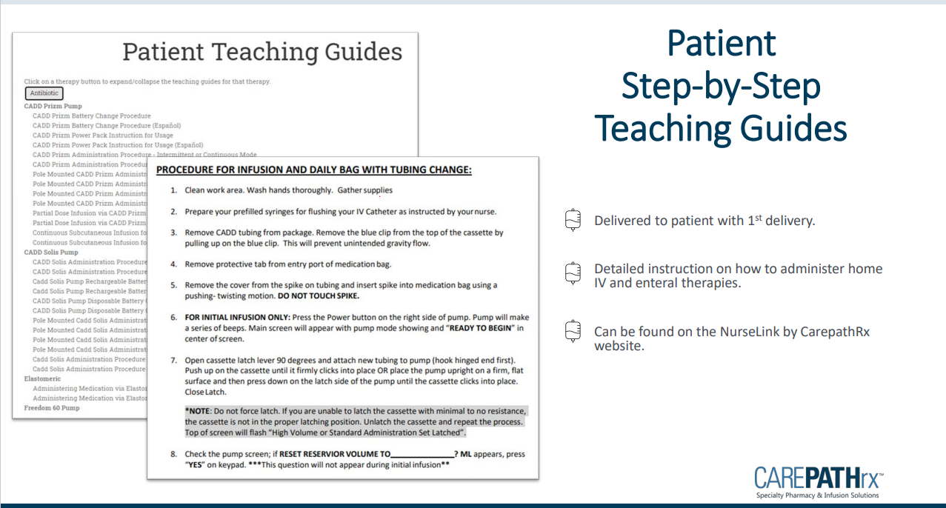

Slide 76
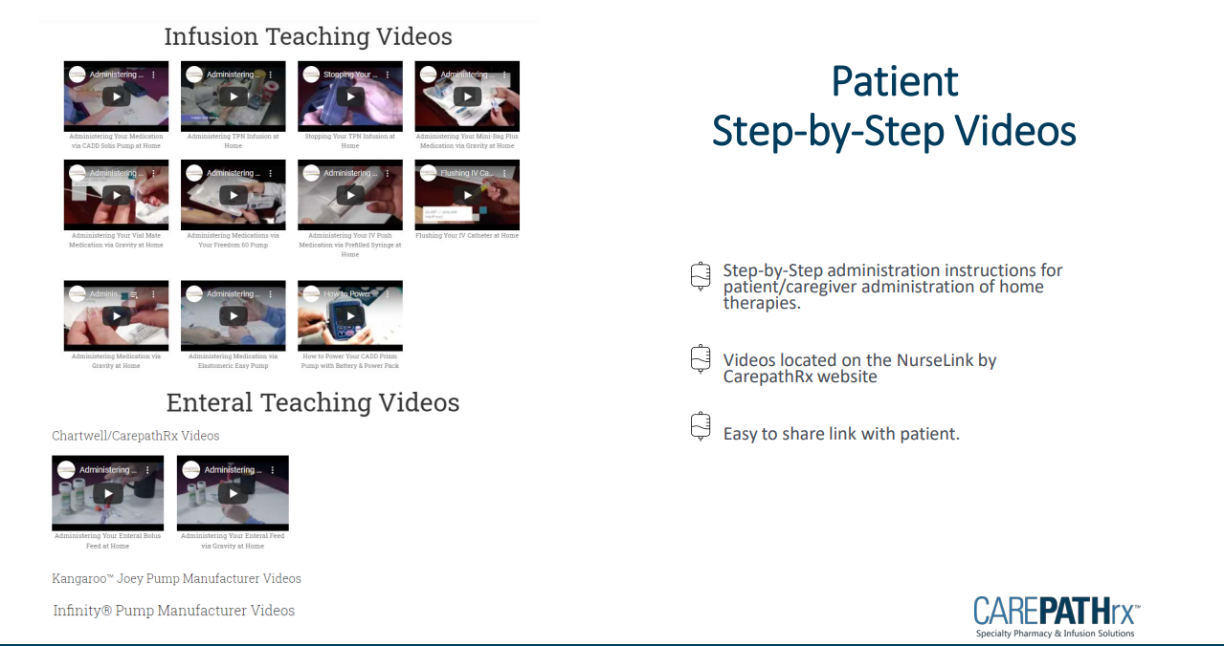

Slide 77
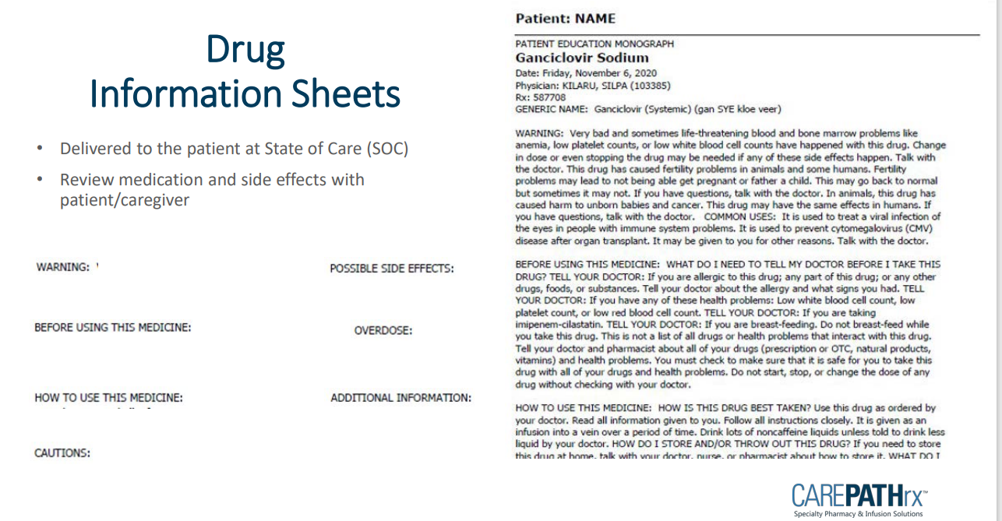

Slide 78
Teaching Strategies
Teach-Back Method: Patient/caregiver explains or demonstrates steps back to RN
Return Demonstration: Patient/caregiver sets up tubing and pump with RN observing
Written Materials: Leave checklists and visual instructions
Reinforce teaching at each visit

Slide 79
Post-Infusion / Departure
Verify pump is running correctly at ordered rate
Reassess vitals and patient tolerance before leaving
Confirm central line secure and dressing intact
Ensure supplies are safely stored/disposed of
Reinforce education and provide opportunity for questions
Document in EMR: Pre-checks, infusion details, vitals, patient response, teaching provided, caregiver demonstration, and any provider notifications

Slide 80
Documentation & EPIC

Slide 81
RN Role & Documentation
RN must remain in home during entire first-dose monitoring window
Document
Pre-infusion checks (order, labs, line, baseline vitals)
Vitals and observations during infusion
Patient/caregiver teaching provided
Any adverse events and interventions
Ensure documentation needs CMS, Joint Commission, and DPH standards

Slide 82
Documentation in EPIC
Pre-Infusion:
Verify MD order and labs.
Confirm central line patency.
During Infusion:
Record vitals (per policy).
Monitor for adverse reactions.
Document infusion settings.
Post-Infusion:
Document start/stop times.
Record patient tolerance.
Note teaching provided.
Log any notifications/escalations.

Slide 83
Documentation of Teaching
Document in patient’s record:
Topic(s) taught to patient/caregiver
Patient/caregiver response
Return demonstration outcomes
Any re-education required
Supports regulatory compliance and quality tracking

Slide 84
Policy & Standard Operating Procedures (Handout)

Slide 85
10 Rights of Medication Administration First-Dose TPN (1-5)
Right Patient
Confirm patient identify using two identifiers (Name, DOB).
For TPN: Verify patient’s central line access device matches the order (correct lumen, correct patient).
Right Medication (Solution)
TPN is a custom-compounded sterile solution
Compare prescribers order, pharmacy label, and MAR carefully – TPN must match the individualized formula
Right Dose
Dose = the volume and composition of TPN solution.
First Dose: Double-check macronutrient concentration (dextrose %, lipid %, electrolytes) against order.
Wrong dose – electrolyte shifts, hyperglycemia, or fluid overload
Right Route
TPN must be infused via central venous access (PICC, tunneled, or port) – never peripheral
Verify the patency and that TPN runs through a dedicated lumen only.
Right Time
Initiate at the prescribed time, starting slowly for the first dose (per order/protocol)
Monitor closely during the first 30 to 60 minutes (highest risk for infusion reactions)

Slide 86
10 Rights of Medication Administration First-Dose TPN Continued…(6-10)
Right Patient/Caregiver Education
For first dose: RN must explain what TPN is, expected monitoring, and possible side effects.
Teach caregiver about pump alarms, what to watch for (rash, shortness of breath, chest pain), and when (and who) to call for help.
Right Documentation
Document: Order verification; Central line assessment; Vitals before, during, and after infusion; Patient education provided; and Any adverse events or interventions
Right to Refuse
Patients (or caregivers) have the right to refuse therapy.
RN must assess reasons (fear, misunderstanding), re-educate, and notify the prescriber if refusal persists.
Right Assessment
Before first dose: Review labs (electrolytes, glucose, renal/hepatic function, triglycerides)
During infusion: Monitor vitals, infusion site, and patient tolerance.
Ongoing: Weight, Input/Output (I&O), labs daily/weekly.
Right Evaluation
After infusion: Evaluate patient’s tolerance, metabolic response, and central line condition.
For first dose: Ensures no signs of hypersensitivity or fluid/electrolyte imbalance before concluding monitoring.

Slide 87
REFERENCES
American Society for Parenteral and Enteral Nutrition. (2018). Guidelines for the provision and assessment of nutrition support therapy in the adult critically ill patient. Journal of Parenteral and Enteral Nutrition, 42(3), 508–534. https://doi.org/10.1177/0148607115621863
Boullata, J. I., Guenter, P., Mirtallo, J. M., & ASPEN Board of Directors. (2016). ASPEN safe practices for enteral nutrition therapy. Journal of Parenteral and Enteral Nutrition, 41(1), 15–103. https://doi.org/10.1177/0148607116673053
Gorski, L. A., Hadaway, L., Hagle, M. E., McGoldrick, M., Orr, M., Doellman, D., … Infusion Nurses Society. (2021). Infusion therapy standards of practice. Journal of Infusion Nursing, 44(1S Suppl), S1–S224. https://doi.org/10.1097/NAN.0000000000000396
Massachusetts Board of Registration in Nursing. (1994). Advisory ruling on nursing practice: 92-04 – Infusion therapy. Commonwealth of Massachusetts. https://www.mass.gov/orgs/board-of-registration-in-nursing
National Institute for Health and Care Excellence. (2017). Nutrition support for adults: Oral nutrition support, enteral tube feeding and parenteral nutrition (Clinical Guideline 32, updated August 2017). NICE. https://www.nice.org.uk/guidance/cg32
New Hampshire Board of Nursing. (2023). Nurse Practice Act, RSA 326-B. State of New Hampshire. https://www.oplc.nh.gov/scope-practice
Pironi, L., Boeykens, K., Bozzetti, F., Joly, F., Klek, S., Lal, S., … Van Gossum, A. (2020). ESPEN guideline on home parenteral nutrition. Clinical Nutrition, 39(6), 1645–1666. https://doi.org/10.1016/j.clnu.2020.03.005
U.S. Centers for Medicare & Medicaid Services. (2023). Medicare and Medicaid programs; conditions of participation for home health agencies. 42 CFR Part 484. https://www.ecfr.gov/current/title-42/chapter-IV/subchapter-G/part-484
U.S. Centers for Disease Control and Prevention. (2017). Guidelines for the prevention of intravascular catheter-related infections. U.S. Department of Health and Human Services. https://www.cdc.gov/infection-control/hcp/intravascular-catheter-related-infection/index.html
The Joint Commission. (2023). Comprehensive accreditation manual for home care. Oakbrook Terrace, IL: The Joint Commission.

Slide 88
What’s Next?

Slide 89
Knowledge Competency (HHVNA: RN Training)

Slide 90
CADD Solis VIP Infusion Pump Training (All CAH Staff) Competency

Slide 91
Thank You for Learning
Tufts Medicine Care at Home
847 Rogers Street, Suite 201
Lowell, MA 01852

