Slide 1

DIABETES SELF MANAGEMENT

Slide 2
Impact of Diabetes
An estimated 10.5% of the US population are dealing with diabetes.
34.2 million Americans just over 1 in 10 have diabetes
Diabetes is the 7th leading cause of death in the US.
According to the CDC, diabetes is the most expensive chronic condition in the US.
The total annual cost of diabetes is $327 billion.
One dollar out of every four dollars in US Healthcare care costs is spent on caring for people with diabetes.
Sixty one percent of diabetes costs are for people 65 years or older. These costs are mainly paid by Medicare.

Slide 3
What is Diabetes
Diabetes mellitus (DM) is a chronic endocrine disease characterized by impaired glucose regulation that occurs when the pancreas fails to produce adequate amounts of insulin (Type 1 DM) or when the patient’s body is unable to effectively utilize the insulin that is produced (Type 2 DM). (WHO, 2021)
Insulin- hormone that the body uses to allow sugar (glucose) to enter the body cells to produce energy
Pancreas secretes insulin into the blood stream
Insulin allows sugar to enter the cells, lowering the amount of sugar in the bloodstream
As the blood sugar level drops, the pancreas puts less insulin into the bloodstream
Signs and Symptoms of Diabetes:
3 P’s: Polydipsia (excessive thirst) Polyuria (excessive urination Polyphagia (excessive hunger) | Unintentional weight loss Irritability, mood changes Fatigue, weakness Blurry vision
Notes:
https://www.mayoclinic.org/diseases-conditions/type-1-diabetes/symptoms-causes/syc-20353011

Slide 4
Diabetes- Type 1 vs Type 2
Type 1 DM:
Pancreas produces little to no insulin
Usually childhood onset but can develop in adults
Cannot be prevented and there is no cure. Treatment directed at management of blood sugar using insulin, diet and lifestyle modifications to prevent complications
Type 2 DM:
Pancreas produces insulin, but it is not used efficiently, or not enough insulin is produced, or both
End result is too much sugar circulating in the blood, which can lead to disorders of circulatory, nervous and immune systems
More common in older adults
No cure, but losing weight, eating a healthy diet and exercising and help manage the disease
Notes:
https://www.mayoclinic.org/diseases-conditions/type-1-diabetes/symptoms-causes/syc-20353011

Slide 5
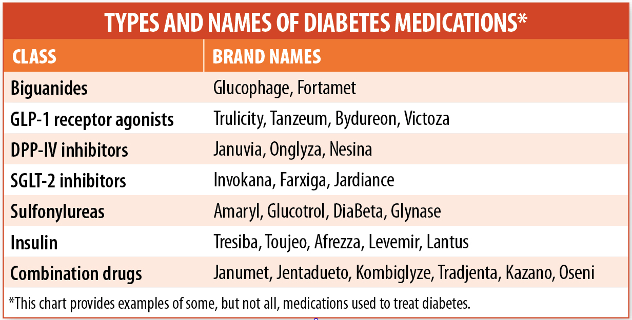
Diabetes – Medications

Slide 6
Medication options for Type 2 Diabetes
Meglitinides ( Repaglinide, Nafeglinide)
Triggers release of insulin from pancreas
Works quickly
Side effects: hypoglycemia and weight gain
Sulfonylureas ( Glipizide, Glimepiride, Glyburide)
Triggers release of insulin from pancreas
Low cost
Effective in lowering blood sugar
Side effects: hypoglycemia, weight gain, skin rash, nausea/vomiting with alcohol consumption
Dipeptidyl-peptidase ( DPP-4) inhibitors (Saxagliptin, Januvia, Tradjenta, Nesina )
Causes the release of insulin when blood sugar is rising and limits liver’s ability to release glucose
Doesn’t cause weight gain or hypoglycemia
Can cause upper respiratory tract infection, sore throat, headache
Biguanides (Metformin )
Limits liver’s ability to release sugar and improves cells’ sensitivity to insulin
Very effective, low cost, may lead to minor weight loss
Side effects: nausea, stomach pain, diarrhea, buildup of Lactic acid (rare) in patients with kidney failure or liver failure

Slide 7
Medication options for Type 2 Diabetes
Thiazolidinediones (Avandia, Actos)
Improve cells’ sensitivity to insulin and limits liver’s ability to make and release glucose
May slightly increase high density HDL cholesterol
Side effects: weight gain, fluid retention, increase risk of bone fractures, heart problems, CHF, possible increased risk of bladder cancer with Actos
Patients with liver problems or history of Heart Failure should not take thiazolidinediones
Alpha-glucosidase inhibitors (Acrobose, Glyset)
Slows body’s ability to breakdown starches and some sugars
Doesn’t cause weight gain or hypoglycemia unless taken
Doesn’t cause blood sugar levels to drop too low unless taken with insulin or sulfonylurea
Side effects include gas, stomach pain, diarrhea
Sodium-glucose transporter 2 ( SGLT2) inhibitors. Invokana, Farxiga, Jardiance, Steglatro
Limits the kidneys’ ability to take in sugar, which increases the amount of sugar that leaves the body in urine
May lead to weight loss and/or lower blood pressure
Side effects: urinary tract infections, yeast infections

Slide 8
Medication options for Type 2 Diabetes
Bile acid sequestrants (Welchol)
Lowers cholesterol and has a small effect in lowering blood sugar when used with other DM meds
Safe for patients with liver problems
Side effects include; gas, constipation, indigestion, rise in triglycerides
Injectables:
Amylin mimetics (Symlin)
Helps to regulate blood sugar and slows digestion in stomach
Used with Insulin
Side effects: nausea, abdominal pain, hypoglycemia
GLP-1 Receptor agonist (Trulicity, Byetta, Victoza, Adlyxin, Ozempic)
Causes release of Insulin as blood sugars rise
May be used with Metformin, basal insulin or a sulfonylurea
May decrease hunger and lead to weight loss
Side effects: nausea, vomiting, diarrhea, abdominal pain, increased risk of inflamed pancreas

Slide 9
Choosing Diabetic Medications
Diabetes treatment is very individualized. What works for one person may not work for another.
Your Health care provider will determine what medication or combination of medications will fit in a patient’s diabetic treatment plan
Combining medications may sometimes increase the effectiveness of each individual medication to lower blood sugar
Pros and cons of each medication will be determined when deciding on a medication plan of care

Slide 10
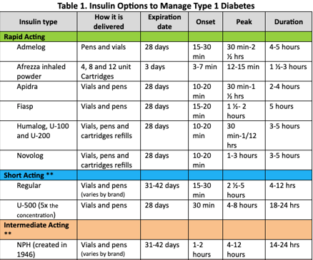
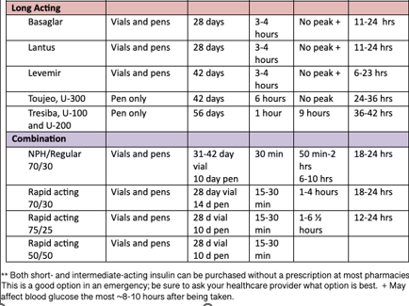

Slide 11
Diabetes Complications
Macrovascular- acceleration of atherosclerosis, leading to coronary artery disease, cerebrovascular disease, peripheral vascular disease
Microvascular- changes resulting from endothelial dysfunction caused by dyslipidemia, oxidative stress and chronic inflammation. Retinopathy, nephropathy, neuropathy, sexual dysfunction, gastroparesis, skin problems, foot problems
Notes:
https://www.mayoclinic.org/diseases-conditions/type-1-diabetes/symptoms-causes/syc-20353011

Slide 12
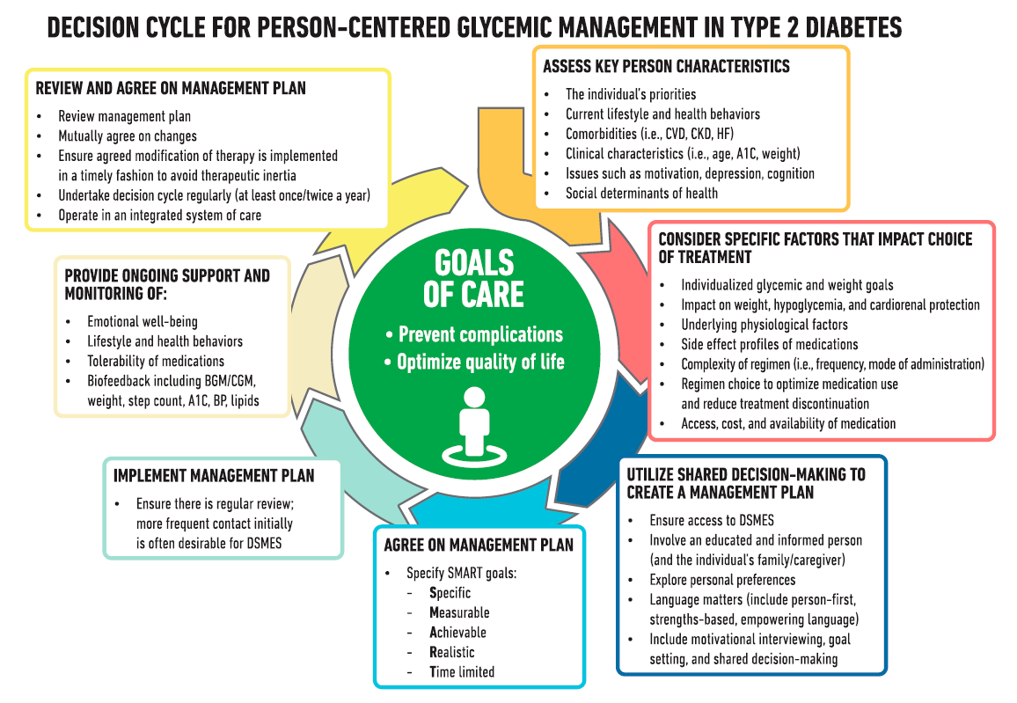
Goals of Diabetes Self Management

Slide 13
Goals for living well with Diabetes
Maintaining medication regime
Monitoring your diabetes- checking blood sugar, maintaining healthy levels. Importance of A1c testing
Problem Solving- knowing signs and symptoms of hypo- and hyperglycemia. Measures to take on sick days.
Reducing risks- Taking care of feet, eyes, heart and kidneys.
Healthy eating- Helps control blood sugar, weight, blood pressure and cholesterol
Being active- Contributes to lower blood sugar and increased energy
Healthy coping- taking care of emotional health
Notes:
A1C: Glucose in the bloodstream causes glycosylation of the hemoglobin component of RBCs. This glycosylation is directly correlated to the amount of circulating glucose over the previous 90-120 days. The higher the average circulating glucose, the more glycosylation that occurs to hemoglobin. Measured as a percentage of Hgb with glycosylation.
A1C 5.0 = 97 mg/dL glucose A1C 12.0 = 298 mg/dL glucose

Slide 14
TMCAH Tools for Patient Self-Management of DM
Education packet “Learning to Live with Diabetes”
Zone tool
Hypo and Hyperglycemia
Sick days with diabetes
Recommendations for physician, A1C testing, immunizations, dental care follow up
Foot Care
Diet Information
Meal Planning
Nutrition label reading

Slide 15
When to Refer in Another Discipline
Occupational Therapy
Help develop skills to track blood sugar, make healthy choices, manage medications
Physical exercises to increase hand dexterity for insulin
strategies and compensations for those with sensory loss
Physical Therapy
Exercise program to help blood sugar control, increase ADL ability, stress relief, muscle strengthening for safety and improved safety and quality of life
Nutritionist
Diabetic diet, weight loss for improved glucose control
MSW
Assist with insurance coverage, medication coverage, financial issues
DM support groups and counseling

Slide 16
Care Plan Interventions for Diabetes
Awaiting feedback from Rehospitalization Task Force that revised Care Plan Interventions

Slide 17

Clinician Tool Kit- Diabetes Care Pathway
Incorporates visit sets for two 30-day episodes
Weekly patient goals
Nursing interventions
Patient education
Multidisciplinary coordination

Slide 18
Diabetes Care Pathway
Visit Guidance:
17 total visits over one episode; two 30-day periods
6 SN visits, 1 OT visit, 1 MSW visit, 3 HHA visits during the first 30 days
4 SN visits, 2 HHA visits during the second 30 days
Week 1: 2 SN within first 7 days of service
Goal: Patient understands red flags and emergency action plan
Call MD to reconcile meds/confirm orders/report assessment/make recommendations- use SBAR template
Call MD to clarify blood sugar monitoring, BS parameters, recent A1C levels or request order to obtain A1C
Explore patient/caregiver readiness, confidence, motivation, prior knowledge level
Establish goals with patient
Teach Red Zone specific to diagnosis, other red flags related to patient risk factors
Teach high risk medications using patient teaching tool
Teach/observe insulin injection and/or blood sugar monitoring
Include foot monitoring/teaching in plan of care for all diabetics

Slide 19
Diabetes Care Pathway
Week 2-4: 4 SN visits
Goal: Patient has beginning understanding of self-management and long-term support plan
Address non-adherence, ambivalence about patient self-management ( meds, f/u.self-monitoring)
Teach Yellow Zone management using teach-back
Teach medication management and relationship to blood sugar monitoring
Initiate discharge planning ( MD fu, longterm supportive care referrals, MOLST)
IDT for care coordination by end of Week 2

Slide 20
Diabetes Care Pathway
Week 5-9: 4 SN visits (consider every other week for patients rapidly stabilizing; supplement with telephone visits as needed)
Goal: Patient able to teach back Zones Tool, adheres to medication management and daily self- management.
Address non-adherence, ambivalence about patient self-management (meds, f/u appointments, self-monitoring)
Complete pathway teaching ( Green Zone optimal self management)
Referrals for ongoing follow-up and support (Elder Services, specialist, clinics, DME )
Ensure patient has equipment in home for long term self-management (strips, lancets, sharps disposal) and knows how to re-order/maintain equipment, ensure proper sharps disposal process
Discharge end of week 6 to family/self support, long term services
Continue one visit per week through week 9 if patient has ongoing symptoms or medication changes requiring MD intervention and RN oversight

Slide 21
Diabetes Care Pathway
Core Concepts:
Variance from visit frequency pathway and/or obstacles to goal attainment are discussed with team clinical manager immediately
Changes in condition are promptly reported to MD using SBAR and making appropriate recommendations
When therapy disciplines are indicated, alternate visits with therapy so that patient does not have multiple visits in a single day
Multidisciplinary care coordination- communicate need to monitor visits, reinforce teaching, use all available clinical resources effectively
Maintain continuity- prioritize primary clinicians for frontloaded visits, introduction of new key concepts
Incorporate patient education, plans for next visit in documentation/ narrative note

Slide 22
Diabetes Tool kit
High Risk Medications (hypoglycemia) | Hypoglycemia Rule of 15
All insulin Glyburide (Diabeta, Micronase, Glynase Glipizide (Glucatrol) Glimepirde (Amaryl) Prandin (Regaglinide) Starlix (Nateglinide) | BG < 70, take 15g fast-acting carb Recheck in 15 min If still < 70, repeat 15g carg If after 3 snacks if still low call 911
A1c Goals | A1C Conversion Chart
Healthy, longer life expectancy < 6.5-7% Older, frail, reduced life expectancy <7.5-8% All children < 19 yrs old <7.5% | A1C% 5 6 7 8 9 10 11 | Average Glucose 97 126 154 183 212 240 269

Slide 23
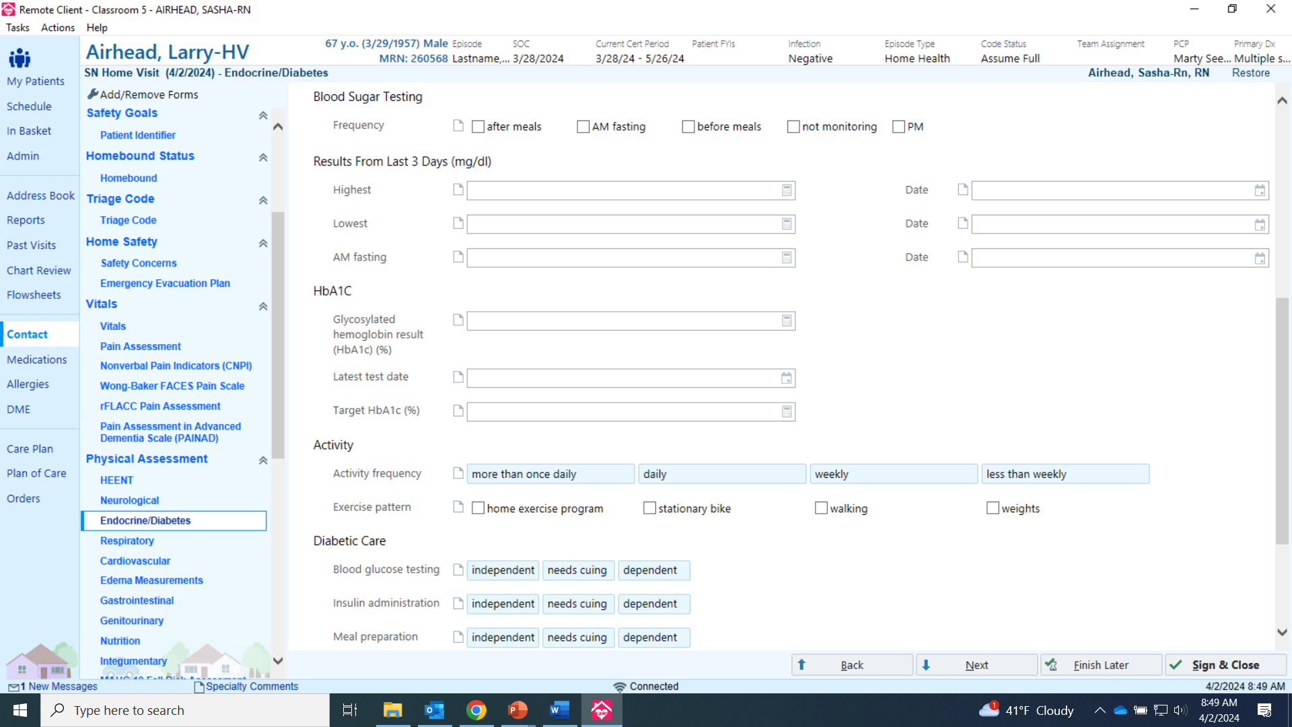
Documentation in EPIC

Slide 24

Questions

