Slide 1
Clinical Practice & Skills Competency Tufts Medicine Care at Home
Brought To You By: Clinical Staff Development

Slide 2
Clinical Skills Day 1: Objectives
By the end of this Skills Day, ALL participants will be able to:
Define health literacy, social determinants of health (SDOH), patient preferences (spiritual, religious, cultural preferences), and patient rights.
Apply principles of education by identifying learning styles, using Teach Back, and evaluating patient understanding.
Assess home safety, weapons, pets, falls, personal safety, and sharps safety, and demonstrate knowledge of mandatory reporting requirements for abuse/neglect, and appropriate escalation pathways.
Apply principles of supervision and delegation, along with professional licensure/certification requirements.
Demonstrate correct infection control practices, including bag technique, standard precautions, transmission-based precautions, sharps safety, and exposure response protocols in the home and hospice setting.
Accurately measure and interpret vital signs, orthostatic blood pressures, O₂ saturation, and weight, and apply findings to patient safety assessments (e.g., falls prevention, oxygen safety).
Perform pain, fall risk, and skin assessments using validated tools, and document findings appropriately.
Demonstrate safe and effective use of SBAR communication for patient care handoffs and escalation situations.
Apply best practices in clinical documentation, including accuracy, timeliness, objective language, and organization using SOAP note structure.

Slide 3
Clinical Skills Day 1: Objectives continued..
By the end of this Skills Day, participants will be able to:
Apply the steps of the medication reconciliation process: distinguishing between:
Nursing: Full medication reconciliation
Therapy (PT/OT/MSW): Medication information gathering only.
Provide diabetic foot care education, perform monofilament testing for neuropathy screening, and escalate findings appropriately.
Safely assess and remove staples using appropriate technique, documenting patient tolerance and wound status.
Nursing Only:
Collect specimens accurately, including urine and PT/INR, and document results per policy.
Educate patients and families on insulin injections using pen needs, ensuring correct preparation, injection technique, and safe sharps disposal.
Insert and manage Foley catheters using aseptic technique, including patient monitoring and infection prevention practices.

Slide 4

Today’s Agenda
Morning
Welcome & Overview
Health Literacy, SDOH, Patient Education
Home Safety, Supervision, and Delegation
Licensure Renewals, BLS
Infection Control & FIT Testing
Vital Signs Assessment
Patient Assessments
Safe & Effective Communication
Afternoon
Clinical Skills & Competency Validation

Slide 5
Part 1: Health Literacy Social Determinants of Health (SDOH) Patient Preferences Patient Rights Principles of Patient Education Reflection / Knowledge Check

Slide 6

Health Literacy
Definition: Ability to obtain, process, and understand basic health information.
Impact: Low literacy linked to poor outcomes, hospital readmissions.
Barriers: Language, jargon, complex instructions, cognitive limitations.
Best Practices: Plain language, visuals, repeat-back checking information.

Slide 7
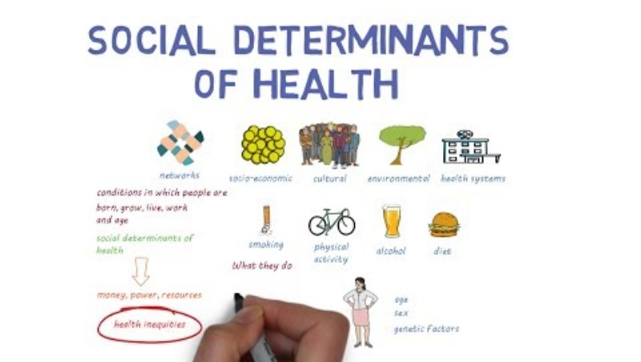
Social Determinants of Health (SDOH)
Definition: Conditions were people live, learn, work, and age.
Examples: Income, housing, food insecurity, transportation, education, access to care.
Why it Matters: Shapes health outcomes more than clinical care.
Role in Home Health & Hospice: Assessing needs, connecting to resources, escalating concerns.

Slide 8

Patient Preferences & Healthcare
Respecting: Spiritual, religious, and culture needs.
Examples: Dietary restrictions, end-of-life rituals, prayer, cultural practices, and chaplaincy involvement.
Documentation: Always record patient/family preferences.
Impact: Trust, adherence, satisfaction.

Slide 9
Patient Rights
Right to informed consent.
Right to refuse treatment.
Right to dignity, respect, and privacy.
Right to receive information in understandable terms.
Mandatory reporting of abuse/neglect.

Slide 10
Principles of Patient Education
Learning Styles: Visual, auditory (adapt education accordingly).
Teach Back Method: Ask patient to explain in their own words.
Motivational Interviewing:
Collaborative, patient-centered communication.
Explore ambivalence, support autonomy.
Best Practices:
Small amount of information at a time.
Use plain language (avoid jargon) and visuals.
Reinforce and reassess understanding.

Slide 11
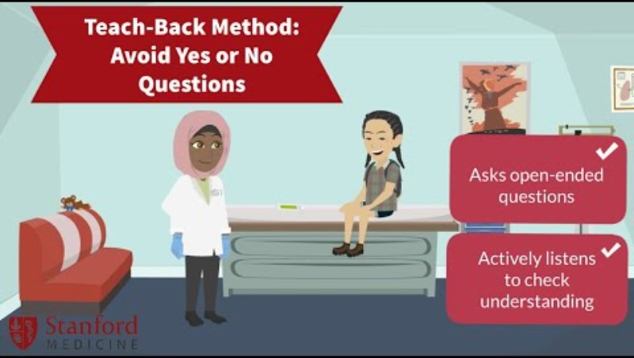
Patient Education & Teach Back
What is Teach Back?
Teach Back is a communication method where the patient explains back what they understood.
Why does it matter?
Confirms comprehension
Identifies gaps in understanding
Improves safety and adherence
How to use it:
Use plain language
Ask open-ended questions
Encourage the patient to “teach back” in their own words
Clarify as needed

Slide 12
Reflection & Knowledge Check
What barriers to health literacy have you observed in practice?
How do you adapt education to fit patient preferences and learning styles?
When would you use Teach Back?

Slide 13
Part 2: Home Safety Personal Safety Patient Safety Mandatory Reporting & Escalation

Slide 14
Home Safety
Environmental Hazards: Clutter, rugs, cords, stairs, hoarding.
Pets: Bites, infection risk, trip hazards (for the patient, you, and future colleagues that come into the home).
Weapons: Firearms, knives (how to respond, TMCAH escalation).
Oxygen Safety: Fire hazard, tubing trip hazards

Slide 15

Personal Safety
Situational awareness
Entering / leaving homes safely
Parking & neighborhood awareness
When to remove yourself from an unsafe situation
Use of AVADE / violence prevention training

Slide 16
Patient Safety
Falls prevention
Sharps safety
Infection control basics
Medication safety (lock boxes, pill boxes, narcotics)

Slide 17
Mandatory Reporting & Escalation
Abuse & Neglect: What must be reported.
All licensed healthcare providers are legal required to report suspected abuse, neglect, and/or exploitation of vulnerable populations to the appropriate state agency.
Purpose: To protect patients who cannot always protect themselves, ensure safety, and fulfill federal and state compliance requirements.
Applies To: Children, elders, and in some cases disabled or vulnerable adults.
Escalation Pathways: Who to notify, chain of command.
Documentation Expectations

Slide 18
Who is a Mandatory Reporter (Elder Abuse/Neglect)?
Physicians, physician assistants, nurses, medical interns;
Coroners, dentist, podiatrist, osteopaths;
Social workers, occupational therapists, physical therapists;
Psychologists, psychiatrists, family counselors;
Police, probation officers; EMTs, firefighters;
Director of a home health aide agency, homemaker agency, assisted living residence, case managers;
Health aides, homemakers
Council on aging directors
Outreach workers

Slide 19
Who is a Mandatory Reporter (Child Abuse/Neglect)?
Physicians, medical interns, hospital personnel engaged in the examination, care or treatment of persons, medical examiners;
Emergency medical technicians, dentists, nurses, chiropractors, podiatrists, optometrists, osteopaths;
Public or private school teachers, educational administration, guidance or family counselors;
Early education, preschool, childcare or after school program staff, including any person paid to care for, or work with, a child in any public or private facility, home or program funded or licensed by the Commonwealth, which provides childcare or residential services. This includes childcare resource and referral agencies, as well as voucher management agencies, family childcare providers and childcare food programs;
Childcare licensors, such as staff from the Department of Early Education and Care;
Social workers, foster parents, probation officers, clerks magistrate of the district courts, parole officers;
Firefighters and police officers;
School attendance officers, allied mental health and licensed human services professionals;
Psychiatrists, psychologists, clinical social workers, drug and alcoholism counselors;
Persons in charge of a medical or other public or private institution, school or facility or their agents;
Clergy members, including ordained or licensed leaders of any church or religious body, persons performing official duties on behalf of a church or religious body, or persons employed by a religious body to supervise, educate, coach, train or counsel a child on a regular basis; and
The Child-Advocate

Slide 20
Massachusetts
M.G.L. c. 19A, §14-26
Who is covered?
Adults age 60 and older.
What must be reported?
Physical abuse
Emotional/Psychological abuse
Sexual abuse
Financial Exploitation
Neglect (including caregiver neglect or self-neglect)
Where to report?
Massachusetts Executive Office of Elder Affairs / Protective Services
MA Elder Abuse Hotline: 800-922-2275
M.G.L. c. 119, § 51A
Who is covered?
Any child under 18 years of age.
What must be reported?
Physical abuse
Sexual abuse
Emotional/Psychological abuse
Neglect (basic needs unmet, unsafe environment).
Where to report?
Massachusetts Department of Children and Families (DCF) (via 51A report)
DCF: 800-422-5437

Slide 21
New Hampshire
RSA 161-F:46-57
Who is covered?
Adults age 60 and older, and incapacitated adults.
What must be reported?
Physical, emotional, or sexual abuse
Financial exploitation
Neglect or self-neglect
Where to report?
NH Bureau of Elderly & Adult Services (BEAS): 800-949-0470
RSA 169-C:29-39
Who is covered?
Any child under 18 years of age.
What must be reported?
Physical abuse
Sexual abuse or exploitation
Emotional/psychological abuse
Neglect (lack of food, clothing, shelter, supervision, education, medical care)
Where to report?
NH Division for Children, Youth and Families (DCYF): 603-271-6562

Slide 22
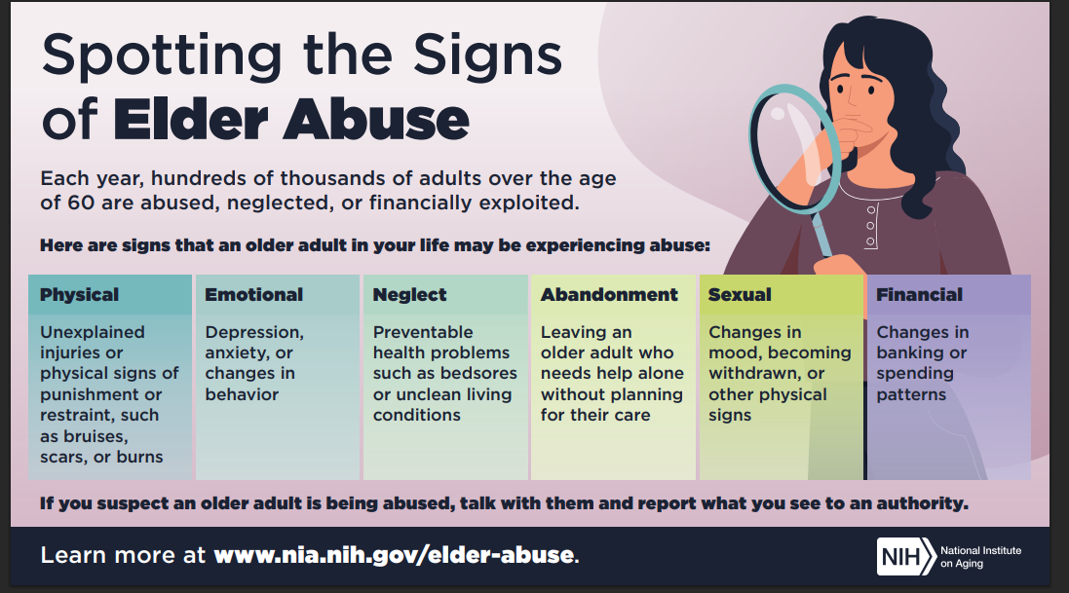

Slide 23
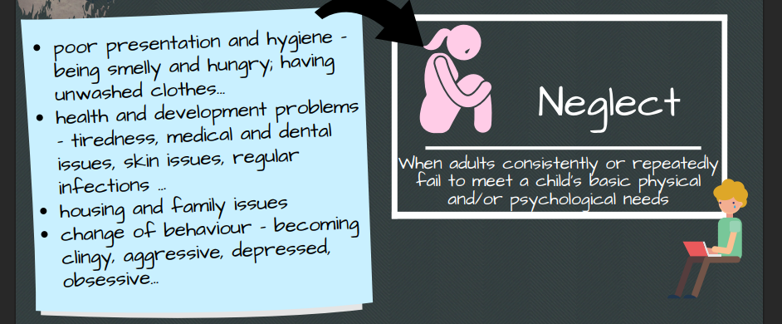
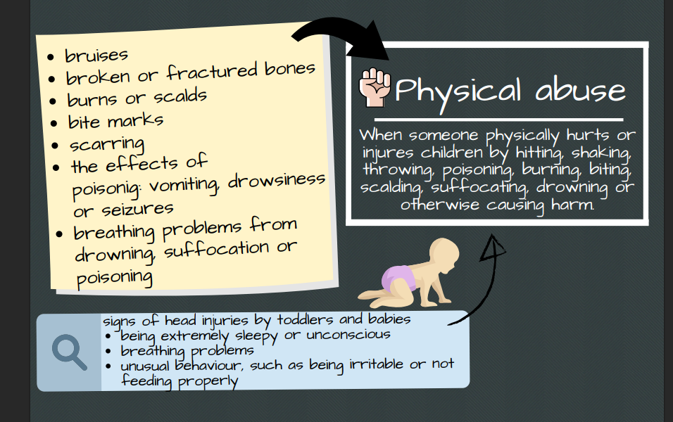

Slide 24
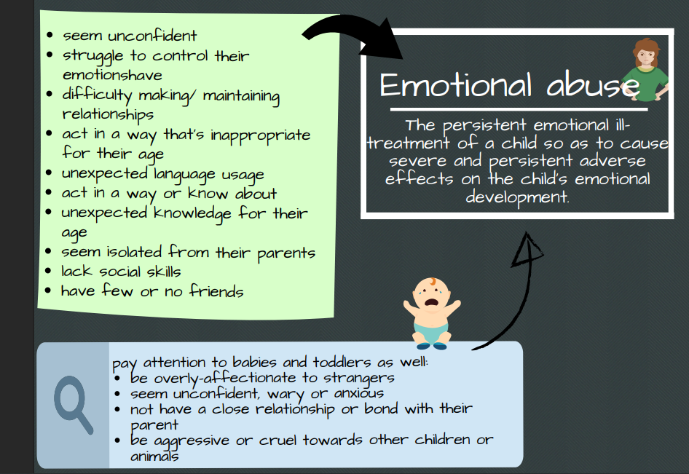
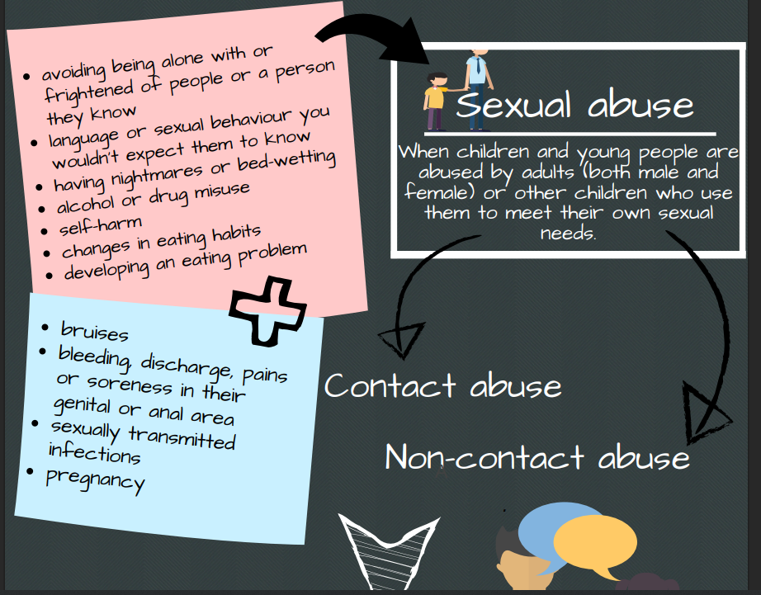

Slide 25
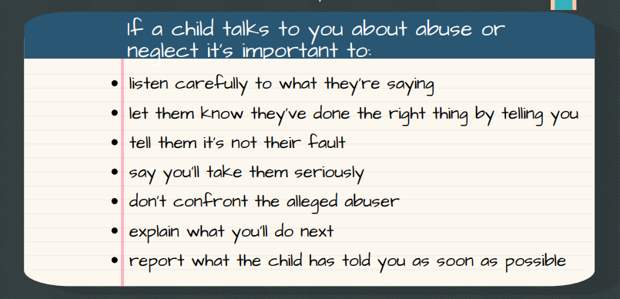

Slide 26

Recognizing Elder Abuse

Slide 27
Part 3: Principles of Supervision & Delegation Professional Licensure Basic Life Support

Slide 28
Delegation & Supervision
Defined:
Delegation transfers responsibility for a task, while supervision ensures oversight and accountability.
RN to LPN and Aide:
RN retains accountability for patient outcomes.
Delegate tasks appropriately to scope, training, and competency.
Provide clear instructions and verify understanding.
Supervise visit (time points in patient care).
PT to PTA:
PT completes evaluation and develops PT plan of care.
PTA implements selected interventions within scope.
PT provides ongoing supervision, reassessment, communication, oversight, and accountability.
OT to OTA:
OT completes evaluation and develops OT plan of care
OTA carries out interventions under OT supervision.
OT ensures ongoing supervision, reassessment, communication, oversight, and accountability..

Slide 29
Delegation & Supervision, continued…
Professional Responsibility in Delegation:
It is the responsibility of each licensed professional to:
Understand their scope of practice as defined by state regulations and professional standards.
Evaluate their own knowledge, skill, and training before accepting a delegated task.
Accept only those tasks they are competent to perform safely.
Seek clarification or additional support when needed to ensure safe and effective care.

Slide 30
Basic Life Support (BLS) Requirements
General Rules:
BLS Certification must be obtained through the American Heart Association (AHA), or another approved provider.
TMCAH provides free recertification
Certification must remain active and current; typically renewed every 2 years.
Staff are responsible for maintaining their own certification and providing documentation to HR/Staff Development, prior to the expiration date.
Who Must Have BLS in Homecare:
Practitioners: Doctors, Nurse Practitioners, Physician Assistants
Nurses: RNs and LPNs
Aides: CNAs, HHAs, Care Partners
Therapists: PTs, PTAs, OTs, OTAs, Speech-Language Pathologists
Medical Social Workers
Anyone that has contact and/or cares for our patients!

Slide 31
Part 3: Infection Control Standard & Transmission-Based Precautions Bag Technique FIT Testing

Slide 32
Bloodborne Pathogens
Video: Click here

Slide 33
Precautions
Standard
Contact
Droplet
&
Airborne

Slide 34
Standard Precautions
Apply to all patients, regardless of diagnosis or infection status
Hand hygiene before and after patient contact
Use of gloves, gowns, masks, and eye protection when exposure to blood/body fluids is possible
Respiratory hygiene/cough etiquette
Safe injection practices
Proper cleaning and disinfection of equipment and environment

Slide 35
Transmission-Based Precautions
Used in addition to Standard Precautions for patients with known or suspected infectious disease.
Types include:
Contact Precautions
Droplet Precautions
Airborne Precautions

Slide 36
Contact Precautions
For infections spread by direct or indirect contact (e.g., MRSA, VRE, C. difficile)
Wear gown and gloves upon entry to the room.
Use dedicated disposable patient care equipment.
Clean and disinfect environment frequently.
Patient education for self and caregivers/household members.

Slide 37
Droplet Precautions
For infections spread by large respiratory droplets (e.g., influenza, pertussis)
Wear surgical mask within 6 feet of a patient
Patient to wear mask during transport, wound/IV care.
Limit transport and movement of patient

Slide 38
Airborne Precautions
For infections spread by small particles that remain in the air (e.g., TB, measles, varicella
Place patient in Airborne Infection Isolation Room (negative pressure) if/when possible
Wear N95 respirator or PAPR
Patient to wear surgical mask during transport, home visits
Limit patient movement outside of room/home
Education to patient/caregivers to reduce transmission to others

Slide 39

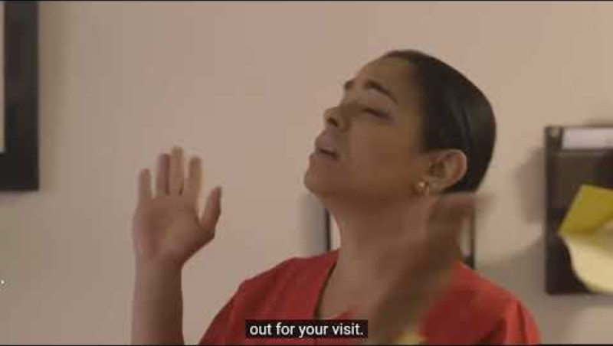
Handwashing, Hand-Rubbing, & Bag Technique
Hand Hygiene
Practice
Donning & Doffing PPE
Video
Practice
Bag Technique
Receive & Review Bag
Video
Practice

Slide 40

FIT Testing Time!

Slide 41
Part 5: Vitals Pain Assessment Fall Risk Assessment

Slide 42
Vital Sign Assessment & Best Practice
General Principles:
Verify patient identity, explain procedure, and ensure comfort.
Wash hands before and after patient contact
Allow patient to rest at least 5 minutes prior to measurement
Document immediately in EMR; Don’t rely on your memory!

Slide 43
Blood Pressure
Ensure patient is seated with back supported, feet flat on the floor, and arm at heart level (relaxed)
Use the correct cuff size for accuracy
Place cuff snugly on bare arm, 1 inch above the elbow crease
Avoid measurement on arms with IV lines, fistulas, or post-mastectomy without clearance
Take at least two readings if abnormal, record site and position

Slide 44
Orthostatic Blood Pressure
Purpose: Orthostatic blood pressure (also called postural BP) helps identify changes in cardiovascular response to position changes, such as dizziness, fainting, or falls risk.
Procedure:
Preparation:
Explain procedure to the patient
Ensure patient safety – have assistance, if possible, if the patient is at risk of dizziness or falls
Supine (Lying Down)
Have the patient lie flat for 5 minutes
Measure and record blood pressure and heart rate
Sitting
Assist the patient to sit upright with feet flat on the floor
Wait 1-2 minutes
Measure and record blood pressure and heart rate
Standing
Assist patient to stand (support if needed)
Measure blood pressure and heart rate at: 1 minute after stand, and 3 minutes after standing
Record results and any symptoms (dizziness, lightheadedness, syncope)

Slide 45
Orthostatic Blood Pressure, continued…
Interpretation:
Orthostatic Hypotension is defined as:
Systolic BP drop >/= to 20 mmHg; or
Diastolic BP drop >/= 10 mmHg; or
Symptoms present (dizziness, lightheadedness, fainting)
Best Practice Notes
Ensure patient is safe throughout procedure – stand close to assist if dizziness occurs
Always document the position, BP, HR, and symptoms at each stage
If abnormal, notify the provider promptly and follow agency protocols
Consider hydration, medications, or underlying conditions as contributing factors

Slide 46
Heart Rate (HR/Pulse)
Assess rate, rhythm, and strength
Palpate radial pulse for 30-60 seconds, use apical pulse if irregular
Normal adult resting range: 60 – 100 bpm
Document rate and quality (regular/irregular, strong/weak)

Slide 47
Respiratory Rate (RR)
Count respirations without informing the patient (avoid altered breathing pattern)
Observe chest rise/fall for 30 – 60 seconds
Assess rate, rhythm, depth, and effort
Normal adult range: 12 – 20 breaths/min

Slide 48
Oxygen Saturation (SpO₂)
Use a clean, properly placed pulse oximeter probe (finger, toe, or earlobe)
Ensure adequate perfusion (warm extremity, no nail polish/false nails)
Normal range: 95 – 100% (unless otherwise directed by provider/disease process)
Document oxygen flow rate and device if patient is on supplemental oxygen

Slide 49
Weight
Weigh at the same time each day, using the same scale
Ensure shoes, jackets, and heavy clothing are removed
For patients with heart failure, accurate daily weights are critical – report sudden changes (>2 pounds/day or >5 pounds/week)
Record weight and trend findings to previous weights

Slide 50
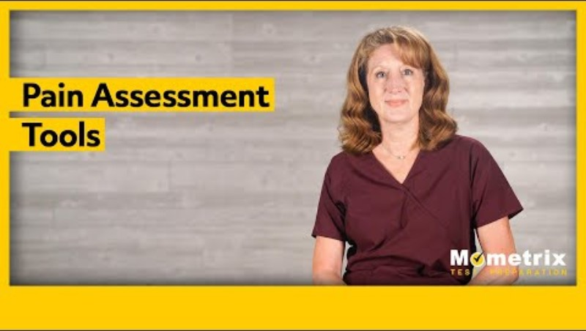
Best Practices: Pain Assessment

Slide 51
Best Practices: Falls Assessment
Purpose: Falls are a leading cause of injury and hospitalizations in older adults. A systematic falls assessment identifies risks and guides prevention strategies to keep patients safe at home or in facility care.
When to Assess:
At SOC and ROC
After any fall or near-fall incident
With any change in condition (mobility, medications, cognition, environment)
At routine reassessments (per CMS guidelines, at least every 60 days in home health)

Slide 52
Key Components of a Falls Assessment
Patient History:
Prior falls (frequency, circumstances, injuries)
Fear of falling or reduced activity
Review of comorbidities (cardiac neuro, arthritis, diabetes, vision/hearing loss)
Medication review: High-risk medications (sedatives, antihypertensives, opioids, polypharmacy)

Slide 53
Key Components of a Falls Assessment, continued…
Physical Assessment:
Vital signs (including orthostatic blood pressures)
Gait, balance, and mobility screening (e.g., Timed Up & Go (TUG) test)
Muscle strength, ROM, sensation, coordination
Vision, hearing, cognition, continence status

Slide 54
Key Components of a Falls Assessment, continued…
Environmental Assessment:
Home Safety Risks: Clutter, poor lighting, rugs, cords, lack of grab bars/handrails
Footwear and assistive device use

Slide 55
Key Components of a Falls Assessment, continued…
Documentation & Communication
Record risk factors, test results, and interventions in EMR
Communicate findings to the interdisciplinary team (RN, PT/OT, MD, caregivers)
Develop individualized fall-prevention care plan

Slide 56
Patient & Caregiver Education
Teach safe mobility, assistive device use, and home modifications
Stress importance of regular vision/hearing checks
Encourage medication review with provider
Provide strategies for exercise, strength, and balance improvement
Reinforce when to call for help (dizziness, new weakness, near-falls)

Slide 57
Key Safety Interventions
Remove hazards (throw rugs, clutter, cords)
Improve lighting, especially nightlights in hallways/bathrooms
Recommend non-slip footwear and mobility aids if needed
Review high-risk medications with prescriber
Encourage hydration and nutrition to avoid dizziness/weakness
Remember: A falls assessment is not one time – it must be ongoing and updated whenever the patient condition or environment changes.

Slide 58
Let’s Practice Vital Signs!

Slide 59
Part 6: Nursing Clinical Skills Foley Catheter PT/INR Staple Removal Insulin Pens Monofilament Testing

Slide 60
Clinical Skills
Foley Catheter Training & Competency
MEDBRIDGE Video; Practice
Diabetic Foot Care & Insulin Pens
Video; Practice
PT/INR Practice

Slide 61
Sign-Off Competency Training
This concludes your Clinical Skills Practice & Competency Training for Today!
Q & A

Slide 62
Thank you for Learning!
Tufts Care at Home
Clinical Staff Development Team

